Slide 1
Machine Learning in
Fighting Climate Change
MLRS 2023 Tutorial
David Rolnick
Climate Change AI and McGill University
Notes:
Hi everyone, and welcome to our ICML 2022 tutorial on “Climate Change and Machine Learning: Opportunities, Challenges, and Considerations.”

Slide 2

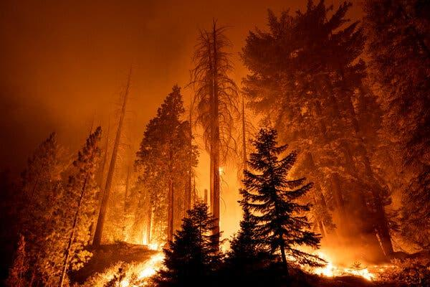
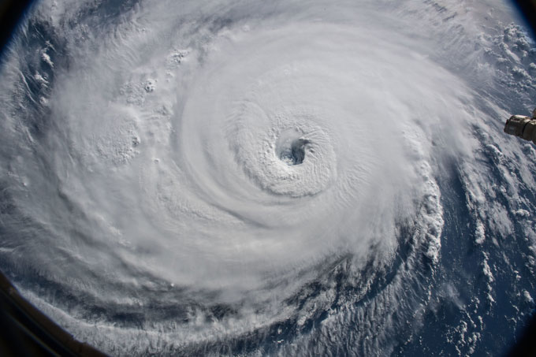
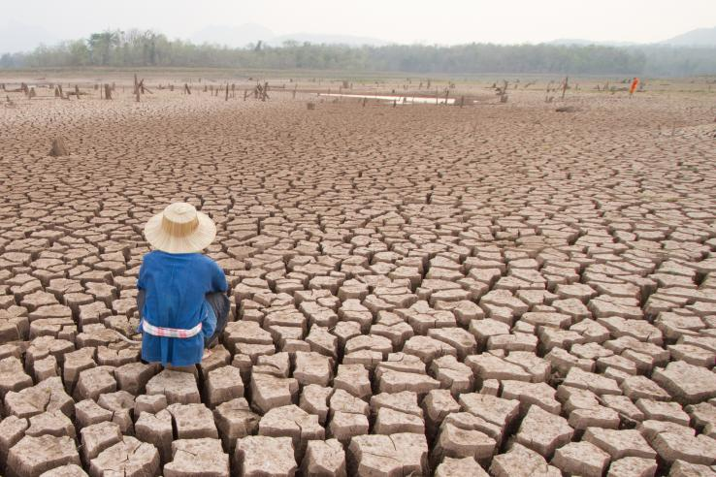
Climate change warrants rapid action
Impacts felt globally
Disproportionate impacts on most disadvantaged populations
Need net-zero greenhouse gas emissions by 2050 (IPCC 2018)
Across energy, transport, buildings, industry, agriculture, forestry, etc.
How does ML fit into this picture?
Filippo Monteforte | AFP | Getty Images
David Mcnew | Getty Images
NASA
Piyaset | Shutterstock.com
Notes:
Climate change is one of the most pressing issues that we as a society are facing today, and we're already facing its effects, from storms to droughts to fires to flooding.
These impacts are being felt globally, and they are disproportionately being felt by the world's most disadvantaged populations, creating an imperative to act quickly on this issue.
In particular, according to the UN Intergovernmental Panel on Climate Change, we as a society need to hit net-zero greenhouse gas emissions by 2050 in order to stave off some of the worst effects of climate change.
And this will require a rapid transformation across virtually every sector of society, ranging across energy, transport, buildings, agriculture, and so forth.
So, given this huge imperative to act on climate change, one might ask the question: How does machine learning fit into this picture? During today’s tutorial, we’ll aim to give an overview of some answers to this question.

Slide 3
Tutorial outline
Introduction to climate change
Opportunities for ML in climate action
Research challenges
Physics-informed and robust ML
Interpretable ML and uncertainty quantification
Generalization and causality
Example projects
Is ML a help or hindrance for climate action?
Considerations for research and deployment
Takeaways and how to get involved
Notes:
In particular, today we'll start with an introduction to climate change, covering a little bit about what climate change is, but then importantly, what it actually means to act on this issue.
We’ll then give an overview of the ways in which machine learning can play a role in climate action - in actually responding to climate change.
The opportunities here represent a mix of applications that are ready for implementation today, as well as novel and important research directions for the machine learning research community, in collaboration with other communities.
During the next part of the tutorial, we’ll then aim to highlight a few examples of some of these research directions that come up across different climate change-related domains.
These include physics-informed and robust machine learning; interpretable machine learning and uncertainty quantification; and questions in generalization and causality.
Now, while the majority of this tutorial will focus on these aspects of how machine learning can aid in climate action, it’s worth noting that ultimately, machine learning is a general-purpose technology that can have both good and bad effects for the climate.
So, we’ll also dive a little into this broader picture of the mechanisms through which machine learning may help or hinder climate action, and how that should affect the way we approach machine learning research and practice.
Finally, we’ll close with some important considerations for research and deployment
And with some takeaways and pointers on how to get involved.

Slide 4
Acknowledgments
Based on a tutorial designed with Prof. Priya Donti (MIT) and Prof. Lynn Kaack (Hertie School) for ICML 2022
Thanks also to the following individuals for their input on this tutorial:
Kyri Baker
Arindam Banerjee
David Dao
Roel Dobbe
Finale Doshi-Velez
Unai Fischer Abaigar
Julian Heiss
Kelly Kochanski
Claire Monteleoni
Vaishnavh Nagarajan
Zoltan Nagy
Catherine Nakalembe
Melrose Roderick
Jakob Runge
David Russell
Duncan Watson-Parris
The Climate Change AI team
Notes:
Before diving in, we’d like to thank a number of individuals for their input and feedback on this tutorial - as listed on the slide - as well as the broader Climate Change AI team.
We’d also like to thank the members of the Computational Sustainability Network, Climate Informatics, and the other communities that have been instrumental in building up this broader space - which we’ll also provide pointers to towards the end of this tutorial.
Finally, we’d like to thank the ICML organizers for putting this broader conference and tutorials series together.
So with that, thanks everyone for joining today, and we’re excited to dive in!

Slide 5
Tutorial outline
State of
climate change
Approaches for climate action
Introduction to climate change
Opportunities for ML in climate action
Research challenges
Physics-informed and robust ML
Interpretable ML and uncertainty quantification
Generalization and causality
Example projects
Is ML a help or hindrance for climate action?
Considerations for research and deployment
Takeaways and how to get involved
Notes:
We're going to start off with an introduction to climate change, both where we are and what we can do about it.

Slide 6
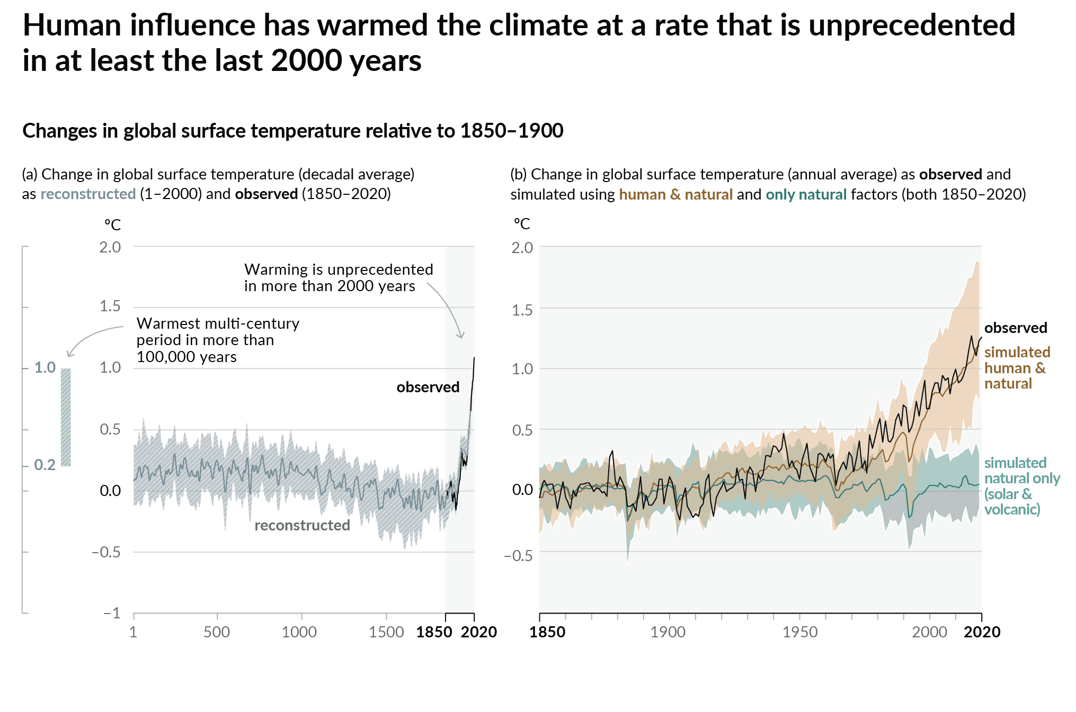
The state of climate change
Earth has already warmed over 1°C, compared to pre-industrial period
Due to excess greenhouse gas (GHG) emissions from human activities
E.g., carbon dioxide (CO₂), methane (CH₄), nitrous oxide (N₂O)
Has induced major changes in climate
Climate = “average weather”
Extreme heatwaves, precipitation, droughts, hurricanes, etc.
Figure source: IPCC AR6 WG1 Report (2021)
Notes:
The Earth has already warmed over 1°C above pre-industrial levels, as human activities have put an excess of greenhouse gas emissions (like carbon dioxide, methane, and nitrous oxide) into the atmosphere.
This warming has in turn induced major changes in the climate (defined as the average weather over 10-30 years)
and we’re seeing increased extremes in terms of phenomena like heat waves, precipitation, droughts, and hurricanes.

Slide 7
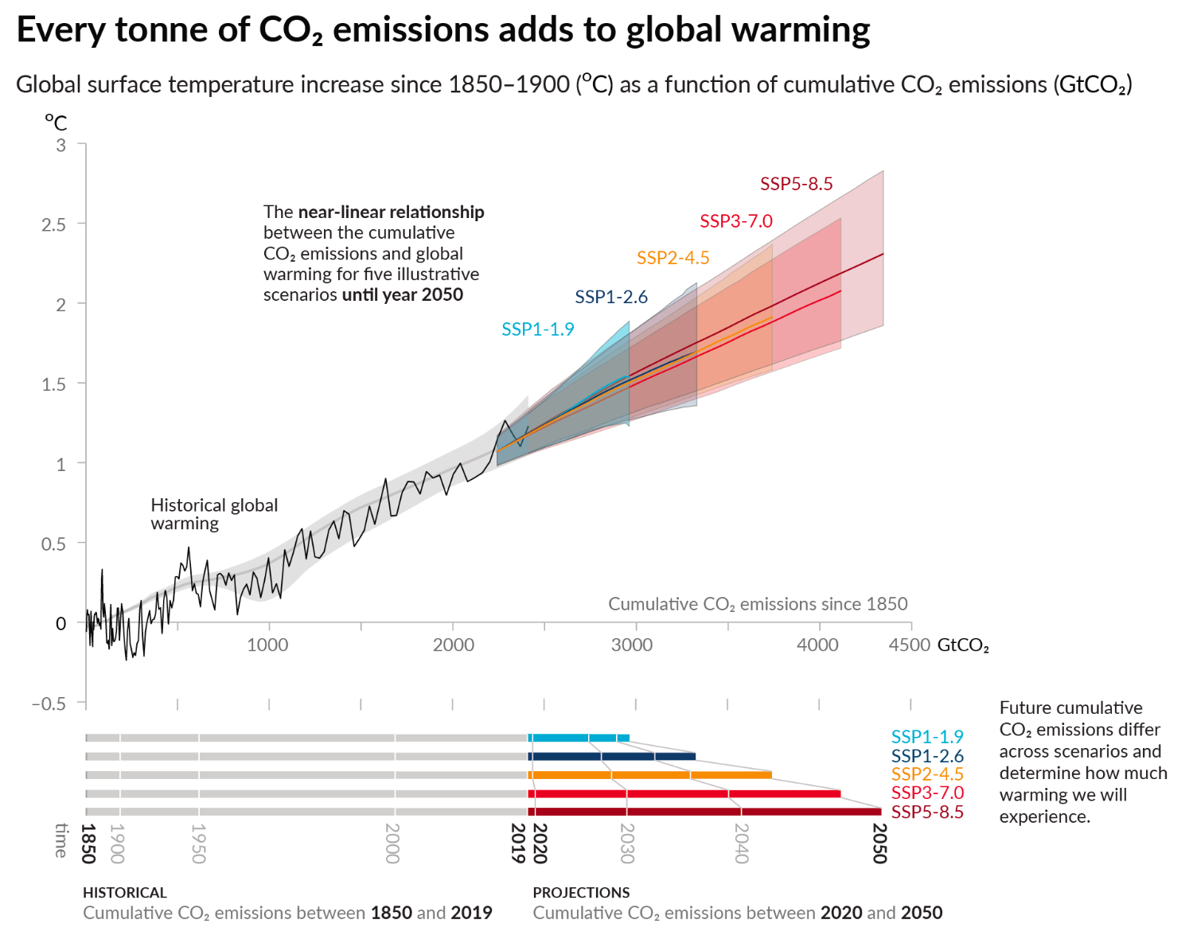
Rapid action is needed to limit warming
Speed and scale of systemic changes affects total warming
Net-zero by 2050 (SSP1-1.9) limits warming to ~1.5°C
Figure source: IPCC AR6 WG1 Report (2021)
Notes:
Every unit of greenhouse gas emissions we put into the atmosphere adds further to this warming of the Earth and the subsequent changes in the climate.
In particular, this plot from the UN Intergovernmental Panel on Climate Change (IPCC) shows how much more warming we can expect depending on how rapidly we act.
The upshot is that the faster we act, the less warming we’ll see. For instance, hitting net-zero greenhouse gas emissions by 2050 limits warming to 1.5°C, a goal that the international community has agreed will help avoid some of the worst impacts of climate change.
While this target is important and one we should absolutely aim to hit, it’s also worth noting that it’s not an on-off switch - in the end, every unit of greenhouse gas emissions we avoid putting into the atmosphere will reduce the extent to which the Earth warms.

Slide 8
Approaches to addressing climate change
Axes of action
Climate science: Understanding and predicting climate change
Mitigation: Reducing or preventing greenhouse gas emissions
Adaptation: Responding to the effects of a changing climate
Important frameworks
Climate justice: An equity-centered approach to climate change
Co-benefits: Explicitly considering linkages between climate action and other UN Sustainable Development Goals (SDGs)
Notes:
So how do we actually go about addressing climate change? There are several different axes of action here.
One of them is climate science, which aims to understand and predict the extent to which the climate will change.
The second is climate change mitigation, which means preventing emissions and reducing atmospheric greenhouse gas concentrations, in order to reduce the extent to which the Earth actually warms.
The third is climate change adaptation - given the effects we are and will experience, how do we respond to those?
In addition to these major axes of action, there are several important frameworks that underpin these actions.
One of these is climate justice, which basically notes that the brunt of climate change’s impacts will be felt by the world’s already most disadvantaged communities, and for that and many other reasons, equity needs to be a central consideration in how we approach climate action.
Another of these is a “co-benefits” framework, which notes that it’s important to think about climate action holistically, and understand how it interacts with other societal priorities like human well-being and ecosystem health.
Given that overview, let’s talk a bit more about each of these axes of action.

Slide 9
Approaches to addressing climate change
See NeurIPS tutorials by McKinnon & Poppick (2021) and Monteleoni & Banerjee (2014)
Axes of action
Climate science: Understanding and predicting climate change
Mitigation: Reducing or preventing greenhouse gas emissions
Adaptation: Responding to the effects of a changing climate
Important frameworks
Climate justice: An equity-centered approach to climate change
Co-benefits: Explicitly considering linkages between climate action and other UN Sustainable Development Goals (SDGs)
Notes:
So first, climate science.
Climate science entails the study of the Earth, the ocean and cryosphere, and the atmosphere to understand how climatic processes are playing out in these systems.
I’m actually not going to dive into this area further, but refer you to two great NeurIPS tutorials on climate science by McKinnon & Poppick and Monteleoni & Banerjee that were given in prior years.

Slide 10
Approaches to addressing climate change
Axes of action
Climate science: Understanding and predicting climate change
Mitigation: Reducing or preventing greenhouse gas emissions
Adaptation: Responding to the effects of a changing climate
Important frameworks
Climate justice: An equity-centered approach to climate change
Co-benefits: Explicitly considering linkages between climate action and other UN Sustainable Development Goals (SDGs)
Notes:
I do want to dive further into climate change mitigation, which again, are strategies that aim to reduce or prevent greenhouse gas emissions.

Slide 11
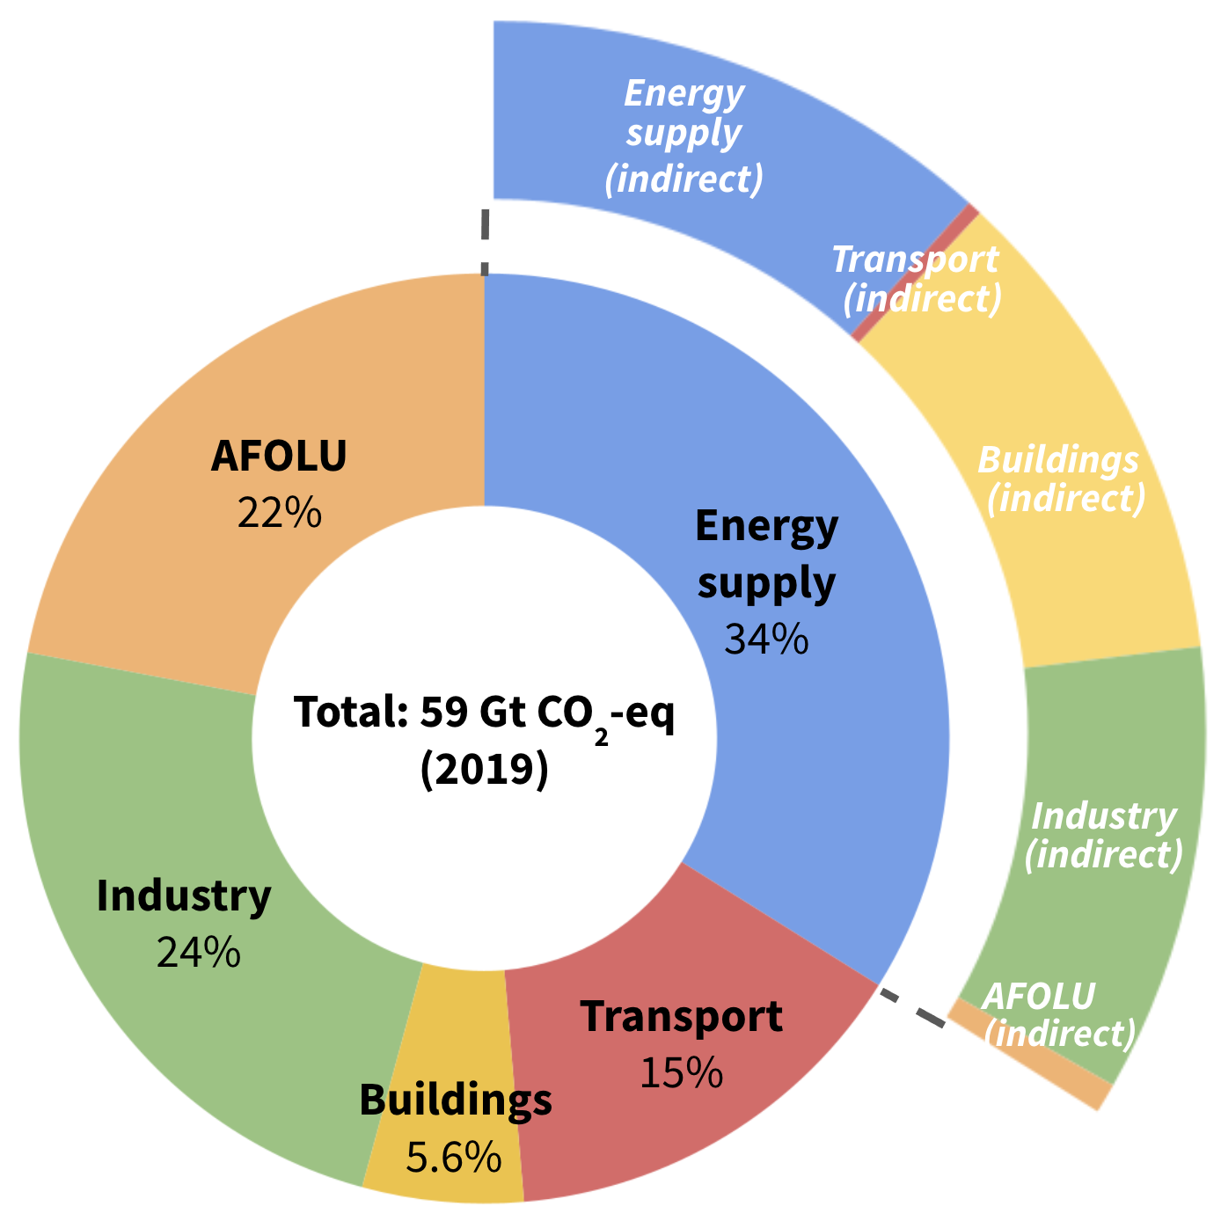
Climate change mitigation
Mitigation: Reducing or preventing GHG emissions
Figure data based on IPCC AR6 WG3 Report (2022). Percentages shown do not add to exactly 100% due to rounding to two significant figures.
Notes:
Greenhouse gas emissions come from many different sectors - as shown by the plot on the slide - and accordingly strategies to reduce emissions also need to span these different sectors.

Slide 12
Climate change mitigation
Mitigation: Reducing or preventing GHG emissions
Sectors
Energy supply
Transportation
Buildings
Industry
Agriculture
Forestry
Other land use
CO₂ removal
Figure data based on IPCC AR6 WG3 Report (2022). Percentages shown do not add to exactly 100% due to rounding to two significant figures.
Notes:
Diving into these sectors, I want to break them into a few categories.

Slide 13
Climate change mitigation
Mitigation: Reducing or preventing GHG emissions
Sectors
Energy supply
Transportation
Buildings
Industry
Agriculture
Forestry
Other land use
CO₂ removal
Energy-related emissions
Notes:
The first four sectors on the slide - energy supply, transportation, buildings, and industry - are sectors where the emissions come primarily from the production and use of energy.

Slide 14
Mitigation: Energy-related emissions
Conceptual framework based on Kaya identity:
GHG emissions = population x x x
service
population
energy
service
GHG emissions
energy
Notes:
When we think about reducing emissions in energy-related sectors, we can turn to a conceptual framework based on what’s called the Kaya identity, which breaks down greenhouse gas emissions into the product of a few different illustrative terms - population, service/population, energy/service, and GHG emissions/energy.

Slide 15

Mitigation: Energy-related emissions
Conceptual framework based on Kaya identity:
GHG emissions = population x x x
service
population
energy
service
GHG emissions
energy
Reducing consumption
Reduce number of miles driven
Individual change: Move closer to work
Systemic change: Dense urban areas
Increase passengers per trip and vehicle
Example: Passenger cars Service = vehicle-kilometers | Reduce number of miles driven Individual change: Move closer to work Systemic change: Dense urban areas Increase passengers per trip and vehicle
General energy- related sectors | Individual behavior changes Systemic changes & structural improvements
Example: Passenger cars
Service = vehicle-kilometers
Individual behavior changes
Systemic changes & structural improvements
Notes:
So for instance, starting with service/population. This refers, in broad terms, to how much a given person consumes - so reducing the service/population term means reducing per-capita consumption.
To make this more concrete, I’m going to use the running example of passenger travel in cars. In this case, the “service” we’re referring to is the number of vehicle-kilometers traveled.
There are a couple of strategies here that can help reduce the amount of “service” used per person - that is, reduce per-capita consumption.
One of these is, for example, reducing the number of kilometers driven - for instance, an individual could move closer to work (or work remotely) in order to drive less, and on a systemic level, laying out cities in a way such that homes and work are closer together could reduce the total need for driving.
We could also increase the number of passengers per vehicle to reduce the amount of unique vehicle-kilometers per person.
These examples are illustrative of some of the broader general levers we have - which include individual changes to reduce consumption, but importantly systemic changes and structural improvements that enable individual and organizational action.

Slide 16
Mitigation: Energy-related emissions
Conceptual framework based on Kaya identity:
GHG emissions = population x x x
service
population
energy
service
GHG emissions
energy
Improving efficiency
Example: Passenger cars Service = vehicle-kilometers | Improve vehicle efficiency (e.g., fuel economy) Drive more efficiently Switch to other transport modes (e.g., bikes)
General energy- related sectors | Efficient end-use technologies Efficient generation technologies
Improve vehicle efficiency (e.g., fuel economy)
Drive more efficiently
Switch to other transport modes (e.g., bikes)
Efficient end-use technologies
Efficient generation technologies
Notes:
The next term in the Kaya identity refers to the amount of energy/service. Reducing this term can basically be thought of as reducing waste, or improving efficiency.
So, for example, in the case of passenger cars, you can reduce the amount of fuel that is used for each mile by using a more efficient vehicle, by driving more efficiently, or by switching to modes like biking that still get you where you need to go but by using less energy.
Again, these hint at some general principles in energy-related sectors: You can reduce waste in terms of how your energy is consumed, and you can also reduce waste in how the energy is produced and moved around.

Slide 17
Mitigation: Energy-related emissions
Conceptual framework based on Kaya identity:
GHG emissions = population x x x
service
population
energy
service
GHG emissions
energy
Switching to clean energy
Example: Passenger cars Service = vehicle-kilometers | Switch to battery electric vehicles Switch to alternative fuels (e.g., electrofuels, solar fuels, hydrogen)
General energy- related sectors | Electrify & switch to low-carbon power Replace fossil fuels with clean alternative fuels
Switch to battery electric vehicles
Switch to alternative fuels (e.g., electrofuels, solar fuels, hydrogen)
Electrify & switch to low-carbon power
Replace fossil fuels with clean alternative fuels
Notes:
The last major term here is greenhouse gas emissions per energy - so bringing this term down implies switching to clean energy sources.
In the example of cars, for instance, you could switch from fossil fuel vehicles to electric vehicles that are then charged on a clean grid.
You could also switch to alternative fuels that can be used within gas-powered cars - for instance, electrofuels, solar fuels, and hydrogen fuels that can be produced in a carbon-neutral manner - though in general, this is technology still under development.
Again this hints at some broader strategies, one of which is to electrify things - take something powered by fossil fuel, make it electric, and charge it using low-carbon power like solar, wind or nuclear.
The other strategy is to take your liquid fossil fuel and replace it with some clean alternative fuel.

Slide 18
Mitigation: Energy-related emissions
Conceptual framework based on Kaya identity:
GHG emissions = population x x x
service
population
energy
service
GHG emissions
energy
Reducing consumption
Switching to clean energy
Improving efficiency
Notes:
So to summarize, in energy-related sectors, we can reduce greenhouse gas emissions by reducing consumption, improving efficiency, and switching to clean energy sources.

Slide 19
Climate change mitigation
Mitigation: Reducing or preventing GHG emissions
Sectors
Energy supply
Transportation
Buildings
Industry
Agriculture
Forestry
Other land use
CO₂ removal
Energy-related emissions
Land use (AFOLU) emissions
Notes:
The next major category of sectors is land use sectors, primarily agriculture and forestry, which also make up an important share of greenhouse gas emissions.

Slide 20
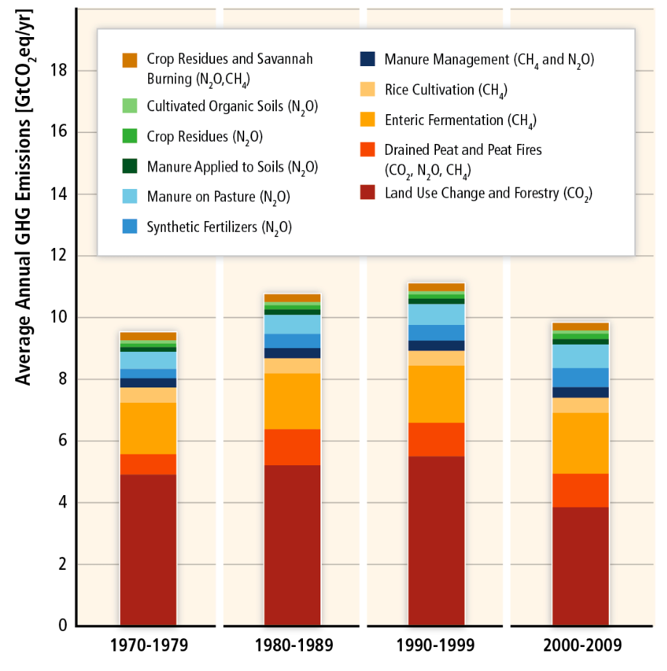
Mitigation: Land use emissions
GHG emissions result from (e.g.)
Land use changes (forests, peatlands, etc.)
Fertilizer use
Livestock
Complex to assess effects of interventions
Natural systems are in complex carbon cycle
Interactions between climate system, natural factors, socioeconomic factors
AFOLU:
Figure source: IPCC AR5 WG3 Report (2014)
Notes:
When we think about emissions in land use-related sectors, this results primarily from
Land use change - things like cutting down trees or draining peatlands to for instance make room for agriculture
Fertilizer use - ammonia production for fertilizer actually accounts for around 2% of global energy consumption, and the application of fertilizer leads to the release of nitrous oxide
And livestock - primarily methane emissions from ruminants, largely cow burps.
Thinking through the implications of strategies in land use can be somewhat complex, given the complexity of the natural carbon cycle and the many different interactions between climate-related, socioeconomic, and natural factors.
For instance, one common climate-related strategy is afforestation - planting trees.
While planting trees can capture carbon, tree monoculture could degrade ecosystems in ways that cause more carbon to be released - this is an example of one way in which the natural carbon cycle can get complex.
In addition, there are lots of economic incentives that may cause those trees to get cut down, affecting what’s called the solution’s permanence.
So it’s important to think through how these different kinds of factors may interact.

Slide 21
Example mitigation strategies: Land use
GHG emissions result from (e.g.): Land use changes Fertilizer use Livestock
Natural systems
Prevent deforestation Preserve peatlands and coastal wetlands Protect biodiversity Protect indigenous rights
Agriculture
Reduce fertilizer use Reduce cows and other ruminant animals Improve land management
Demand-side measures
Reduce losses in food supply chain Dietary change Change wood procurement practices
Monitoring: E.g., via remote sensing
See also: IPCC AR5 WG3 Report (2014) and IPCC AR6 WG3 Report (2022)
Notes:
So, given that the greenhouse gas emissions here come primarily from land use change, fertilizer use, and livestock, there are a number of strategies that try to cut down on these sources of emissions.
When it comes to our natural land systems, the strategies are mostly on the land use change side of things - preventing deforestation, preserving peatlands and coastal wetlands, protecting biodiversity, and protecting the stewardship of indigenous lands
(which is good for many reasons, but relevantly, also has implications for protecting biodiversity).
On the agriculture side, strategies include reducing fertilizer use, reducing cows and other ruminant animals, and improving land management strategies for both cropland and grazing land.
There are several kinds of actions that can be taken on the demand side - things like reducing waste in food supply chains, reducing meat and dairy consumption, and avoiding purchasing “virgin wood” as construction material.
In addition to these strategies, monitoring the amount of emissions that come from the land is also important for informing these strategies, since it’s generally a bit more difficult to get precise emissions estimates for land use-related sectors.
Satellite imagery-based monitoring is actually a common technique here.

Slide 22
Climate change mitigation
Mitigation: Reducing or preventing GHG emissions
Sectors
Energy supply
Transportation
Buildings
Industry
Agriculture
Forestry
Other land use
CO₂ removal
Energy-related emissions
Land use (AFOLU) emissions
“Negative emissions”
Notes:
Having talked through strategies to reduce emissions in energy-based and land use sectors, I finally want to turn to negative emissions strategies.

Slide 23
Mitigation: Negative emissions strategies
Negative emissions strategies remove CO₂ from the atmosphere
Carbon capture and storage (CCS): Use sorbents to capture CO₂ from exhaust or directly from air
Related: Bioenergy with carbon capture and storage (BECCS)
Enhancing natural sinks: Afforestation, reforestation, soil carbon restoration, peatland restoration, etc.
Biochar: Pyrolize plant materials & store underground
Notes:
Negative emissions strategies are strategies to actually remove GHGs - usually carbon dioxide - from the atmosphere
These can include technological solutions like carbon capture and storage, where we capture carbon dioxide - either from exhaust at industrial facilities or directly from the air - and then store it underground.
A related strategy is bioenergy with carbon capture and storage, which entails growing plants to pull CO₂ from the atmosphere, and then combusting them for energy in a power plant with carbon capture and storage.
Negative emissions can also include solutions that enhance nature’s ability to absorb carbon dioxide - things like planting trees, sequestering CO₂ in soil, restoring peatlands, and so forth.
And this can include producing biochar and storing it underground, where biochar is the byproduct of subjecting biomass to pyrolysis, and provides a more “permanent” way to store the CO₂ captured in plants.
Overall, negative emissions strategies are an important part of the portfolio of actions, but face their own complications and are not a substitute for other aggressive mitigation actions.

Slide 24
Climate change mitigation
Mitigation: Reducing or preventing GHG emissions
Sectors
Energy supply
Transportation
Buildings
Industry
Agriculture
Forestry
Other land use
CO₂ removal
Energy-related emissions
Land use (AFOLU) emissions
“Negative emissions”
Notes:
So, that was a whirlwind tour through the different kinds of mitigation strategies in different sectors. In addition to sector-specific strategies, we can also think about cross-cutting economy-wide strategies that mandate or incentivize these reductions in the first place.

Slide 25
Total GHG emissions
Economy-wide strategies to limit total GHGs
Targets (mandatory or voluntary)
International: UNFCCC and COP (Kyoto Protocol, Paris Agreement)
At national or sub-national levels
Regulation, standards, and investments
Carbon pricing
Carbon tax: Tax per unit of CO₂ or CO₂-eq emissions
Carbon markets: Emissions trading under some agreed-upon CO₂-eq cap (i.e., cap-and-trade or emissions trading system)
Notes:
This often starts with setting targets. For example, at the international level, negotiations in the context of the United Nations Framework Convention on Climate Change have caused almost 200 countries around the world to set voluntary targets, and several cities for example have set mandatory ones.
Of course, targets themselves don’t do anything - they need to be followed up by actions meant to actually hit such targets.
This includes economy-wide regulations and standards, and large-scale governmental investments.
It can also include putting a price on greenhouse gas emissions to account for the costs of climate change and disincentivize greenhouse gas emissions from being emitted. This can be done through strategies like a carbon tax, or a “cap-and-trade” system where entities can trade and sell a fixed number of emissions permits between them.

Slide 26
Approaches to addressing climate change
Axes of action
Climate science: Understanding and predicting climate change
Mitigation: Reducing or preventing greenhouse gas emissions
Adaptation: Responding to the effects of a changing climate
Important frameworks
Climate justice: An equity-centered approach to climate change
Co-benefits: Explicitly considering linkages between climate action and other UN Sustainable Development Goals (SDGs)
Notes:
So, that's our dive into climate change mitigation. Switching gears,

Slide 27
Approaches to addressing climate change
Axes of action
Climate science: Understanding and predicting climate change
Mitigation: Reducing or preventing greenhouse gas emissions
Adaptation: Responding to the effects of a changing climate
Important frameworks
Climate justice: An equity-centered approach to climate change
Co-benefits: Explicitly considering linkages between climate action and other UN Sustainable Development Goals (SDGs)
Notes:
So, that's our dive into climate change mitigation. Switching gears,

Slide 28
Climate impacts and downstream effects
Climate impacts
Rising temperatures
Changing precipitation patterns
Rising sea levels
Ocean acidification
Downstream effects
Droughts and heatwaves
More intense storms and flooding
More frequent wildfires
Loss of ecosystem services
Biodiversity loss
Spread of disease vectors and pests
Figure adapted from Kris Sankaran
Notes:
Climate change has some direct effects such as rising temperatures and changing precipitation.
In addition, oceans have absorbed 30% of the CO₂ we’ve emitted and 90% of the resulting heat increase, causing the water to expand and ice to melt - causing sea level rise - and the ocean to acidify.
This leads to different downstream effects such as droughts and heatwaves, more intense storms and flooding, wildfires, loss of ecosystem services, biodiversity loss, and the spread of disease vectors and pests -
all of which we need to adapt to.

Slide 29
Climate change adaptation
Adaptation: Responding to the effects of a changing climate
Notes:
So how do we actually deal with these things?

Slide 30
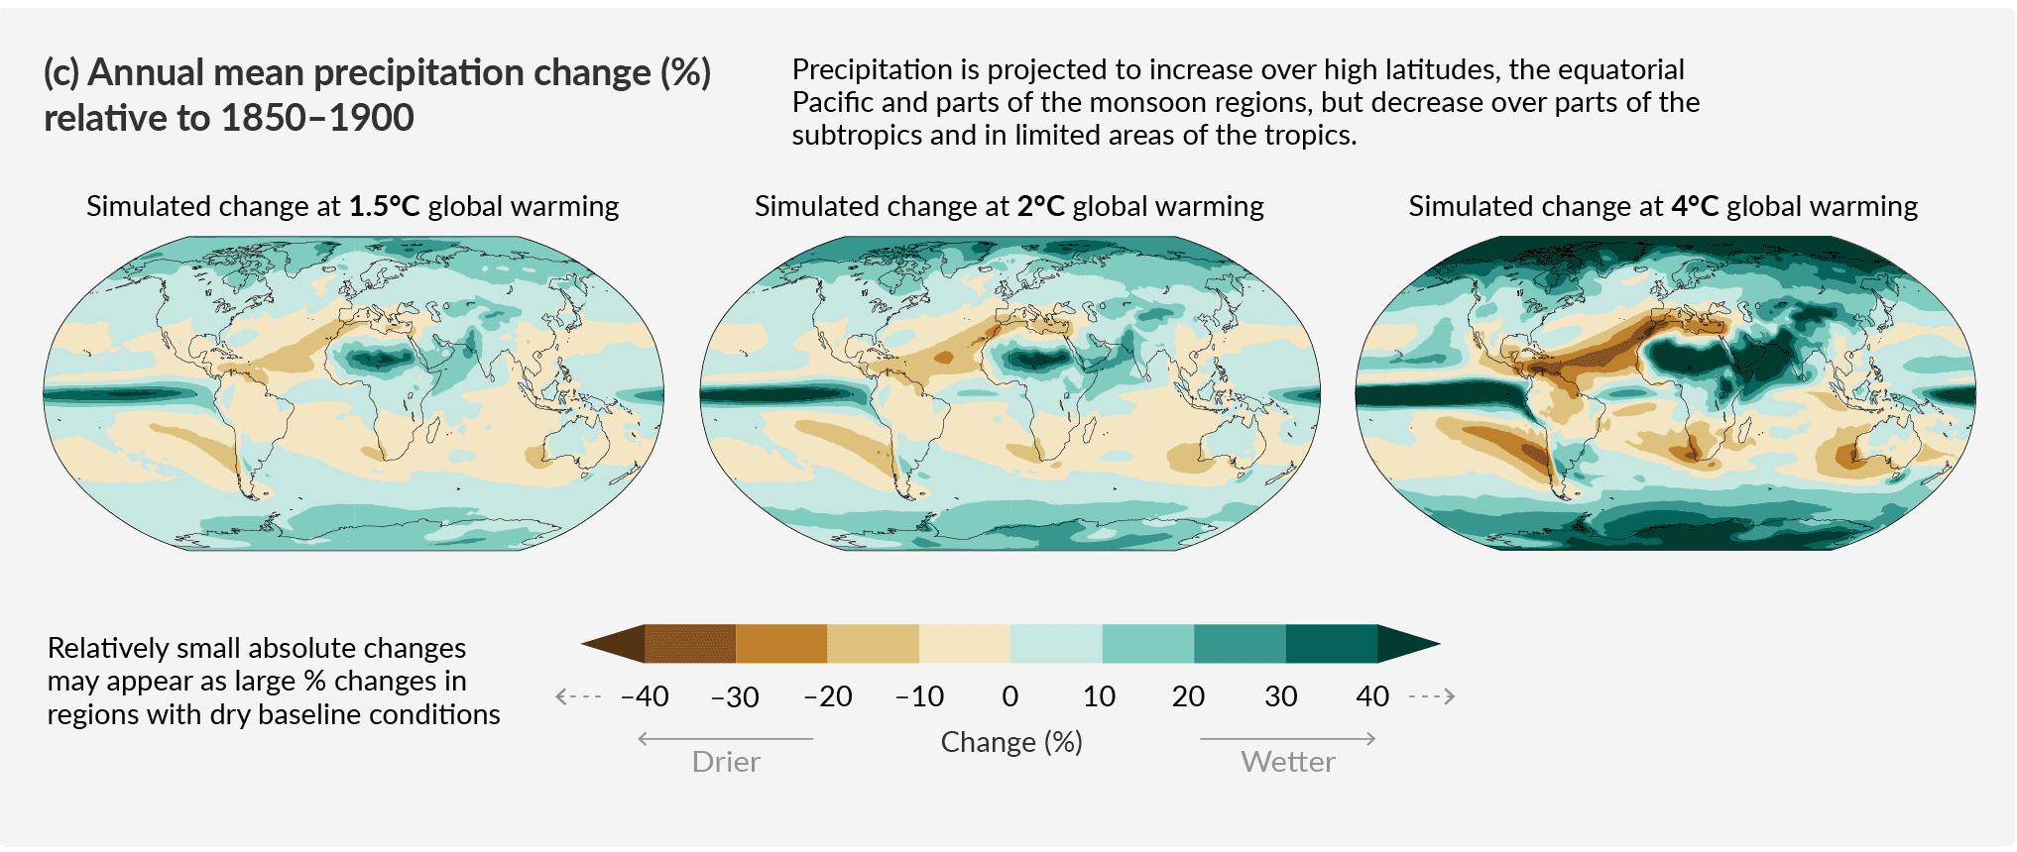
Climate change adaptation
Adaptation: Responding to the effects of a changing climate
Measuring and predicting risks
Risk: Impact x probability
Figure source: IPCC AR6 Summary for Policymakers (2021)
Notes:
The first step is by understanding the risks that we're actually going to face, meaning both the magnitude of impacts we might face and the probability that we’ll face them.
For instance, this plot from the IPCC is looking at the expected changes in annual mean precipitation globally at different levels of warming.

Slide 31
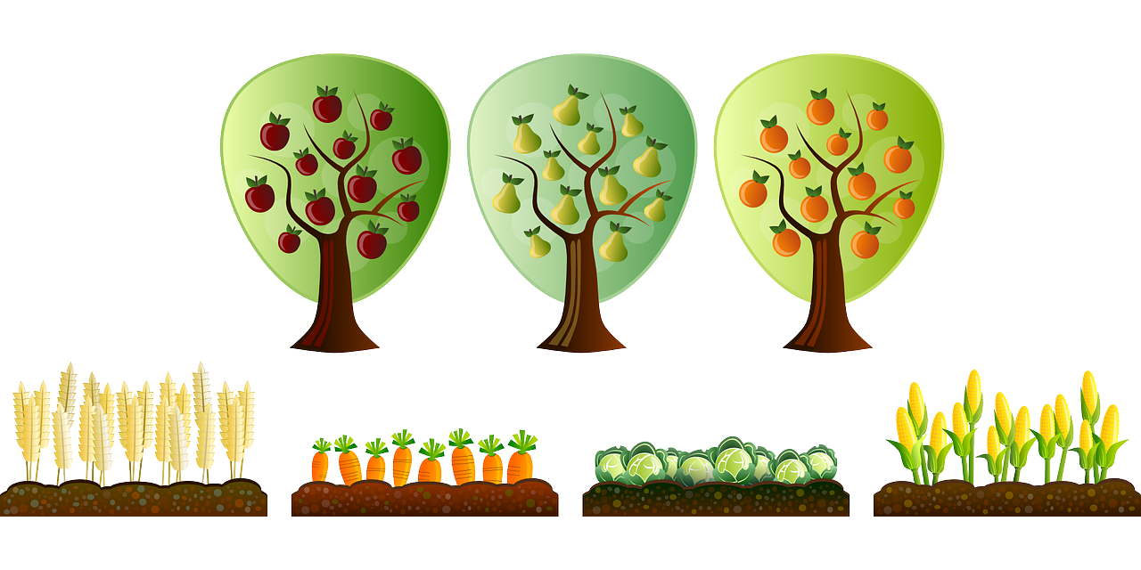







Climate change adaptation
Adaptation: Responding to the effects of a changing climate
Measuring and predicting risks
Risk: Impact x probability
Human & ecological systems
Strengthening adaptive capacity
Robustness: Withstanding a range of outcomes with no/minimal impact
Resilience: Recovering quickly after impact
Connections with UN SDGs
Figure source (bottom): United Nations
Notes:
Once you know what these risks might look like, the second step is strengthening adaptive capacity.
This involves both building robustness to potential outcomes - for instance, making sure your power grid doesn’t black out when there’s a big climate-induced storm - as well as building resilience - that is, if your power grid does go out, making sure you can bring it up more quickly.
These kinds of strategies need to be applied across human and ecological systems - considering food security, water security, resilient infrastructure, and ecological conservation and restoration - and have lots of synergies with (for instance) the UN Sustainable Development Goals.
While these adaptation strategies in some sense take climate impacts as a given...

Slide 32
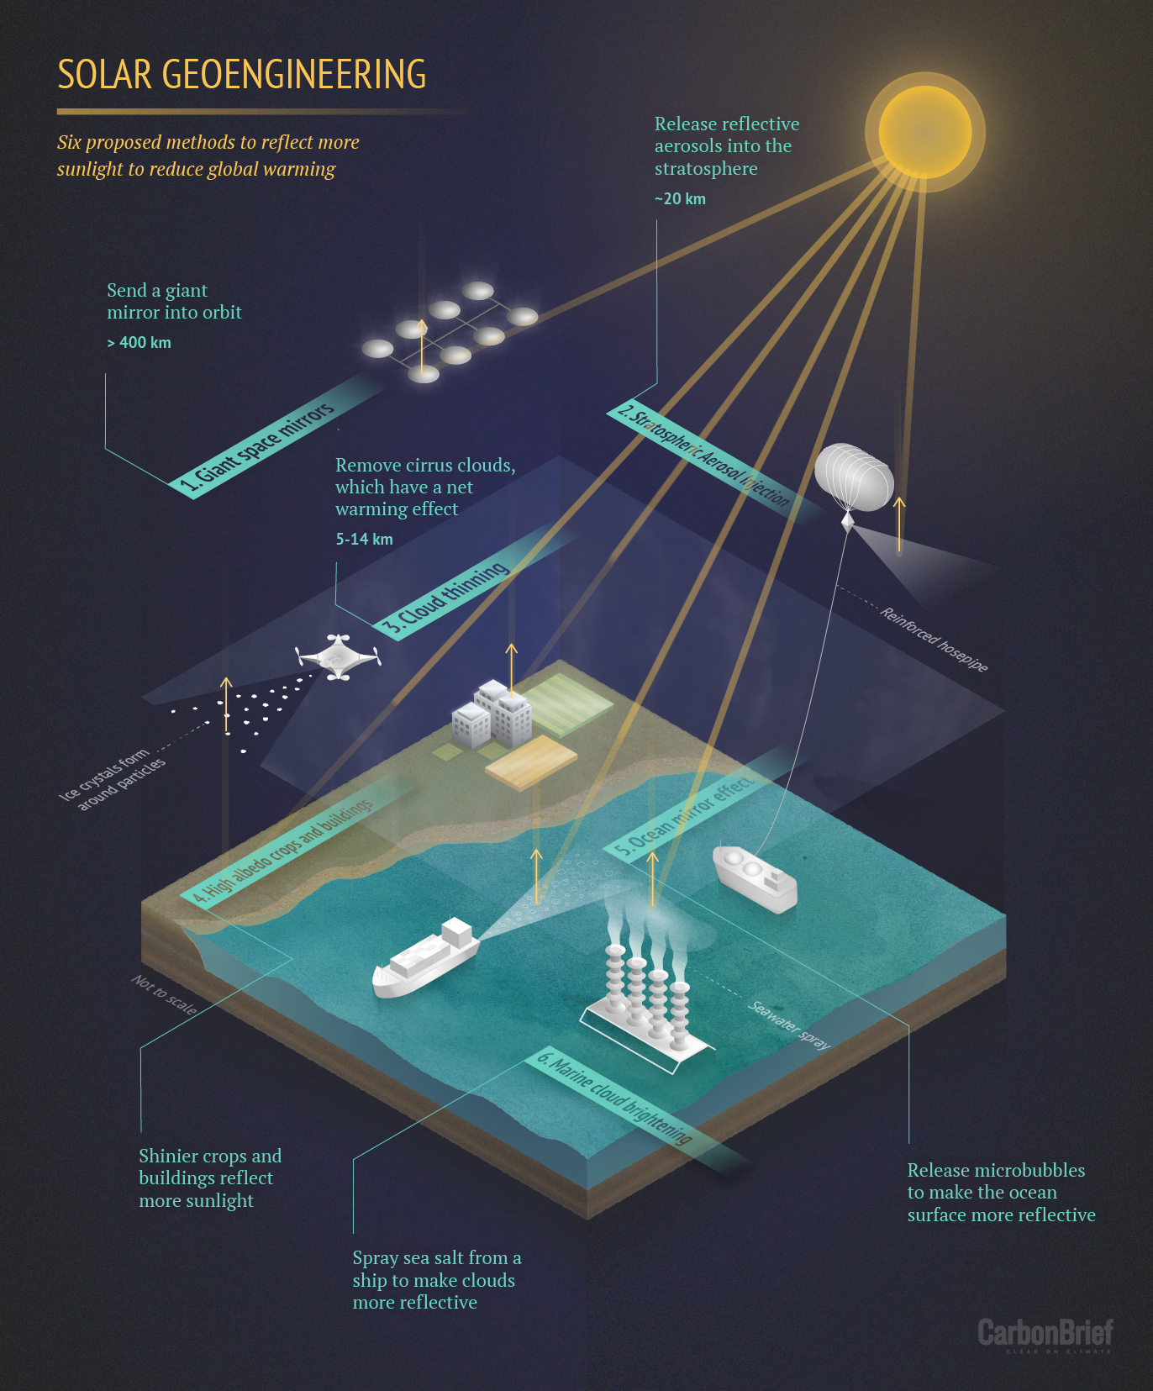
Solar geoengineering
“Cool the planet” by increasing the Earth’s albedo (reflectivity)
E.g., Release stratospheric aerosols to increase reflectance for a few years
Viewed as last resort: Uncertainty, moral hazard, termination shock, governance
Figure source: CarbonBrief.org
Notes:
... solar geoengineering, on the other hand, is an adaptation strategy that tries to slow warming directly - or “cool” the Earth - by increasing the Earth’s reflectance (or “albedo”).
The most common proposal here is to release sulfates into the stratosphere, mimicking what happens when a volcano erupts.
Solar geoengineering is a difficult and very contentious option, due to uncertainties in its actual effects, concerns that having this option may cause us to procrastinate on other strategies, the fact that the abrupt termination of such a system could lead to very rapid warming, and various governance issues - so solar geoengineering is often very much viewed as a last resort.

Slide 33
Takeaways: Introduction to climate change
Rapid action is needed on climate change
Climate science: Understanding and predicting climate change
Mitigation: Reducing or preventing greenhouse gas emissions
Adaptation: Responding to the effects of a changing climate
Important frameworks
Climate justice: An equity-centered approach to climate change
Co-benefits: Explicitly considering linkages between climate action and other UN Sustainable Development Goals (SDGs)
Notes:
So, to wrap up: The main takeaways here are that we need really rapid action to address climate change, and these axes of action include climate science, climate change mitigation, and climate change adaptation.
Doing these strategies “right” requires holistic thinking, for instance consideration of climate justice and interactions with sustainable development goals.
Many fields and sectors need to be involved in making these kinds of strategies successful - various fields of science and engineering, to economics and the social sciences, to public policy - and machine learning can potentially play a role in supplementing and strengthening these efforts.

Slide 34
Tutorial outline
Introduction to climate change
Opportunities for ML in climate action
Research challenges
Physics-informed and robust ML
Interpretable ML and uncertainty quantification
Generalization and causality
Example projects
Is ML a help or hindrance for climate action?
Considerations for research and deployment
Takeaways and how to get involved
Roles for ML in climate action
Considerations in evaluating applications

Slide 35
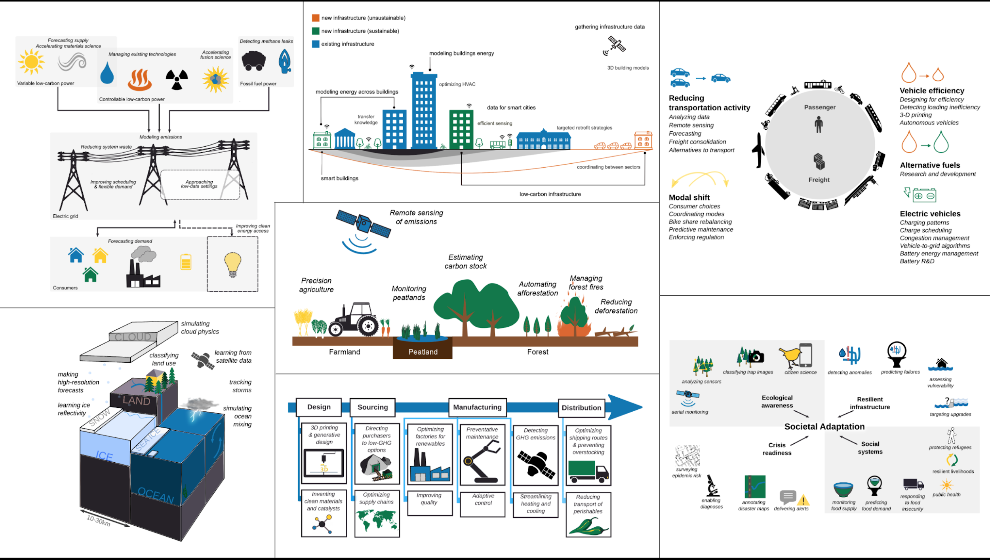
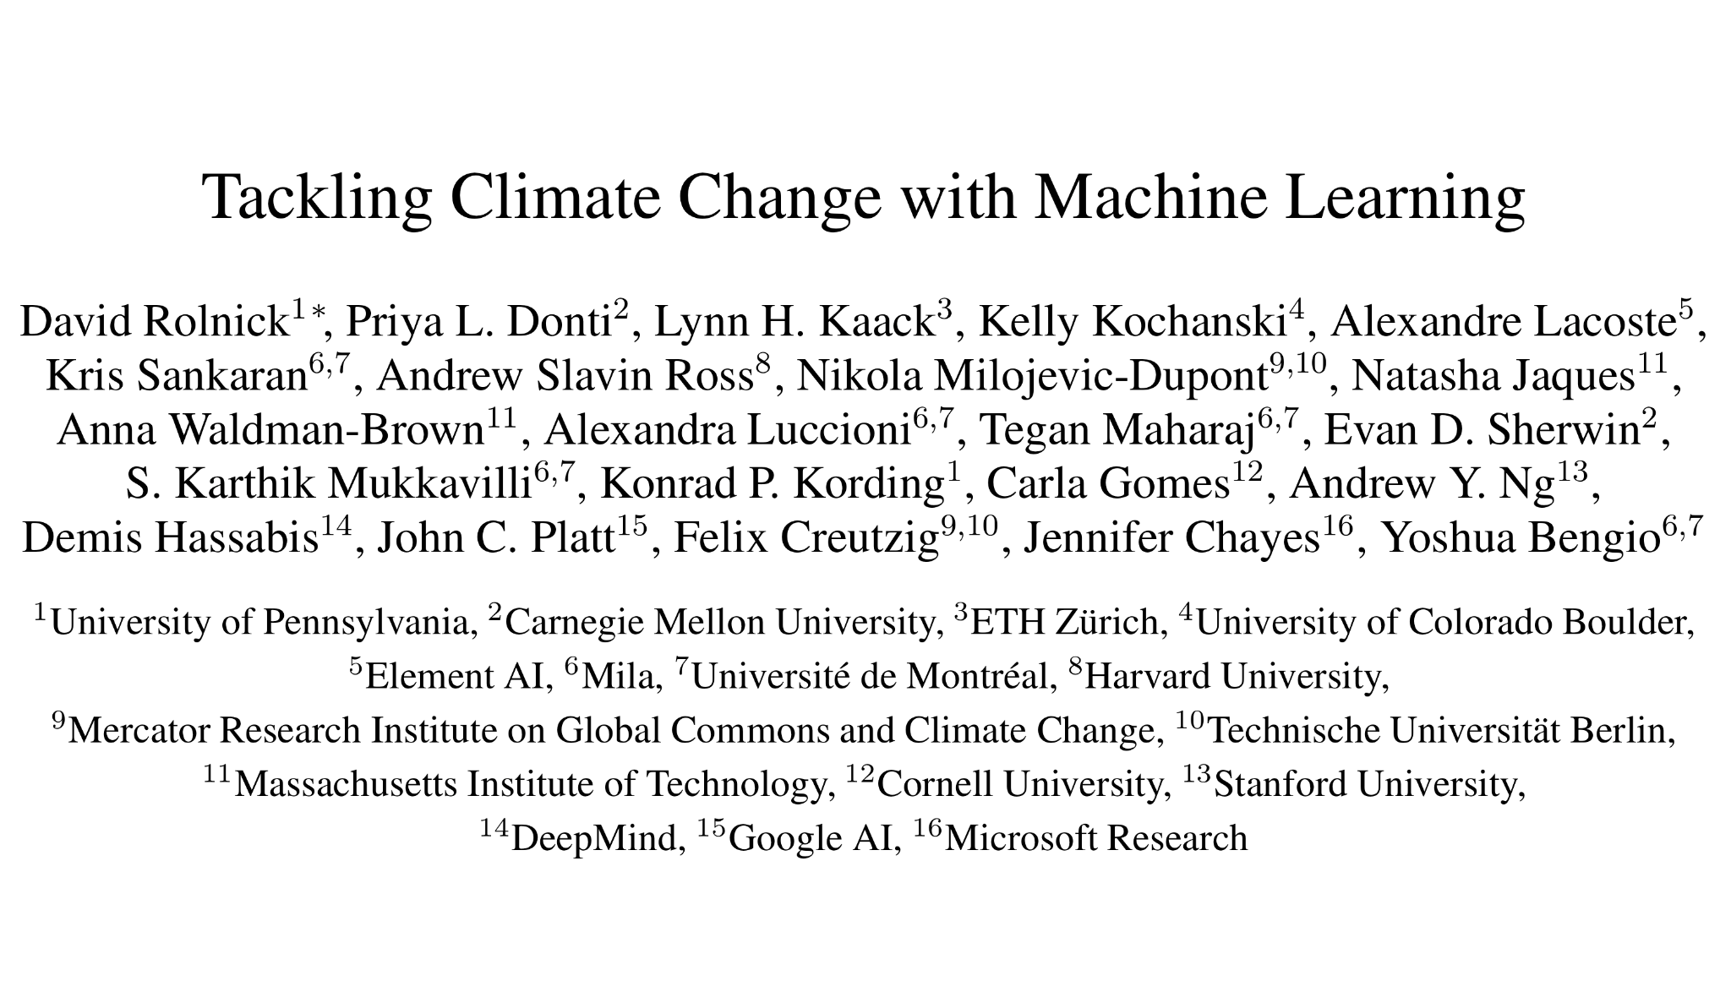
Electricity systems
Buildings
Transportation
Climate prediction
Industry
Societal adaptation

Slide 36
Electricity systems
Buildings
Transportation
Land use
Climate prediction
Industry
Societal adaptation

Slide 37
Electricity systems
Buildings
Transportation
Roles for ML in mitigation, adaptation, & climate science
Distilling raw data into actionable information
Optimizing complex systems
Improving predictions
Accelerating scientific discovery
Approximating time-intensive simulations
See also: https://www.climatechange.ai/summaries
Climate prediction
Industry
Societal adaptation

Slide 38

1. Distilling raw data
Role: Distilling raw data into actionable information
Some relevant ML areas: Computer vision, natural language processing
Examples
Mapping deforestation
Gathering data on building footprints/heights [M]
Evaluating coastal flood risk [A]
Parsing corporate disclosures for climate-relevant info [A]
and carbon stock [M]
Notes:
Accelerated experimentation: materials science (solar fuels, construction, ammonia catalysts, CO2 sorbents), nuclear fusion, additive manufacturing for vehicles and construction, batteries, alternative fuels
Remote sensing and automatic monitoring: detecting solar panels, monitoring emissions, gathering transport and infrastructure data, monitoring peatlands, deforestation management, identifying CO2 sequestration locations, ecosystem/biodiversity monitoring, securing food supplies
Improving efficiency: freight consolidation, food waste, predictive maintenance for electricity
Approximating time-intensive simulations: climate models, energy scheduling models, IAMs/multi-objective optimization
Need for interpretable, causal, and gray-box models: forecasting solar, disaster planning, informing policy-makers

Slide 39

2. Optimizing complex systems
Role: Improving efficient operation of complex, automated systems
Some relevant ML areas: Optimization, control, reinforcement learning
Examples
Controlling heating/cooling systems efficiently [M]
Optimizing rail and multimodal transport [M]
Demand response in electrical grids [M]
Note: Beware of misaligned objectives and rebound effects
Notes:
Accelerated experimentation: materials science (solar fuels, construction, ammonia catalysts, CO2 sorbents), nuclear fusion, additive manufacturing for vehicles and construction, batteries, alternative fuels
Remote sensing and automatic monitoring: detecting solar panels, monitoring emissions, gathering transport and infrastructure data, monitoring peatlands, deforestation management, identifying CO2 sequestration locations, ecosystem/biodiversity monitoring, securing food supplies
Improving efficiency: freight consolidation, food waste, predictive maintenance for electricity
Approximating time-intensive simulations: climate models, energy scheduling models, IAMs/multi-objective optimization
Need for interpretable, causal, and gray-box models: forecasting solar, disaster planning, informing policy-makers

Slide 40

3. Improving predictions
Role: Forecasts and time series predictions
Some relevant ML areas: Time series analysis, computer vision, Bayesian methods
Examples
“Nowcasting” for solar/wind power [M]
Forecasting electricity demand [M]
Predicting crop yield from remote sensing data [A]
Notes:
Accelerated experimentation: materials science (solar fuels, construction, ammonia catalysts, CO2 sorbents), nuclear fusion, additive manufacturing for vehicles and construction, batteries, alternative fuels
Remote sensing and automatic monitoring: detecting solar panels, monitoring emissions, gathering transport and infrastructure data, monitoring peatlands, deforestation management, identifying CO2 sequestration locations, ecosystem/biodiversity monitoring, securing food supplies
Improving efficiency: freight consolidation, food waste, predictive maintenance for electricity
Approximating time-intensive simulations: climate models, energy scheduling models, IAMs/multi-objective optimization
Need for interpretable, causal, and gray-box models: forecasting solar, disaster planning, informing policy-makers

Slide 41

4. Accelerating scientific discovery
Role: Suggesting experiments in order to speed up the design process
Some relevant ML areas: Generative models, active learning, reinforcement learning, graph neural networks
Examples
Identifying candidate materials for batteries, photovoltaics, and energy-related catalysts [M]
Algorithms for controlling fusion reactors [M]
Notes:
Accelerated experimentation: materials science (solar fuels, construction, ammonia catalysts, CO2 sorbents), nuclear fusion, additive manufacturing for vehicles and construction, batteries, alternative fuels
Remote sensing and automatic monitoring: detecting solar panels, monitoring emissions, gathering transport and infrastructure data, monitoring peatlands, deforestation management, identifying CO2 sequestration locations, ecosystem/biodiversity monitoring, securing food supplies
Improving efficiency: freight consolidation, food waste, predictive maintenance for electricity
Approximating time-intensive simulations: climate models, energy scheduling models, IAMs/multi-objective optimization
Need for interpretable, causal, and gray-box models: forecasting solar, disaster planning, informing policy-makers

Slide 42
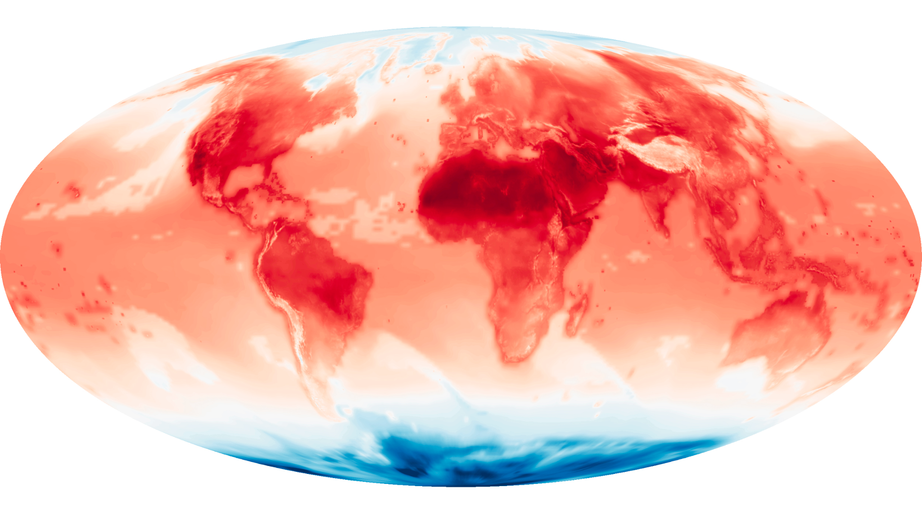
5. Approximating simulations
Role: Accelerating time-intensive, often physics-based, simulations
Some relevant ML areas: Physics-informed ML, computer vision, interpretable ML, causal ML
Examples
Superresolution of predictions from climate models [A]
Simulating portions of car aerodynamics [M]
Speeding up planning models for electrical grids [M]
Notes:
Accelerated experimentation: materials science (solar fuels, construction, ammonia catalysts, CO2 sorbents), nuclear fusion, additive manufacturing for vehicles and construction, batteries, alternative fuels
Remote sensing and automatic monitoring: detecting solar panels, monitoring emissions, gathering transport and infrastructure data, monitoring peatlands, deforestation management, identifying CO2 sequestration locations, ecosystem/biodiversity monitoring, securing food supplies
Improving efficiency: freight consolidation, food waste, predictive maintenance for electricity
Approximating time-intensive simulations: climate models, energy scheduling models, IAMs/multi-objective optimization
Need for interpretable, causal, and gray-box models: forecasting solar, disaster planning, informing policy-makers

Slide 43
Electricity systems
Buildings
Transportation
Roles for ML in mitigation, adaptation, & climate science
Distilling raw data into actionable information
Optimizing complex systems
Improving predictions
Accelerating scientific discovery
Approximating time-intensive simulations
See also: https://www.climatechange.ai/summaries
Climate prediction
Industry
Societal adaptation

Slide 44
Questions that we asked in identifying priorities
Is ML needed to address the problem?
What is the scope of the impact? (in rough terms)
What is the time horizon of the impact?
What is the likelihood that a solution can be found?
Can a solution feasibly be deployed?
What are the potential side effects of deploying the candidate solution?
Who are the relevant stakeholders who are involved in or affected by the application?
Notes:
Accelerated experimentation: materials science (solar fuels, construction, ammonia catalysts, CO2 sorbents), nuclear fusion, additive manufacturing for vehicles and construction, batteries, alternative fuels
Remote sensing and automatic monitoring: detecting solar panels, monitoring emissions, gathering transport and infrastructure data, monitoring peatlands, deforestation management, identifying CO2 sequestration locations, ecosystem/biodiversity monitoring, securing food supplies
Improving efficiency: freight consolidation, food waste, predictive maintenance for electricity
Approximating time-intensive simulations: climate models, energy scheduling models, IAMs/multi-objective optimization
Need for interpretable, causal, and gray-box models: forecasting solar, disaster planning, informing policy-makers

Slide 45
Key considerations
ML is not a silver bullet and is only relevant sometimes
High-impact applications are not always flashy
Sophisticated algorithms can be required, but aren't always
Interdisciplinary collaboration
Scoping the right problems
Incorporating relevant domain information
Shaping pathways to impact
Equity considerations
Empowering diverse stakeholders
Selecting and prioritizing problems
Ensuring data is representative
Notes:
Accelerated experimentation: materials science (solar fuels, construction, ammonia catalysts, CO2 sorbents), nuclear fusion, additive manufacturing for vehicles and construction, batteries, alternative fuels
Remote sensing and automatic monitoring: detecting solar panels, monitoring emissions, gathering transport and infrastructure data, monitoring peatlands, deforestation management, identifying CO2 sequestration locations, ecosystem/biodiversity monitoring, securing food supplies
Improving efficiency: freight consolidation, food waste, predictive maintenance for electricity
Approximating time-intensive simulations: climate models, energy scheduling models, IAMs/multi-objective optimization
Need for interpretable, causal, and gray-box models: forecasting solar, disaster planning, informing policy-makers

Slide 46
Tutorial outline
Introduction to climate change
Opportunities for ML in climate action
Research challenges
Physics-informed and robust ML
Interpretable ML and uncertainty quantification
Generalization and causality
Example projects
Is ML a help or hindrance for climate action?
Considerations for research and deployment
Takeaways and how to get involved
Example areas for ML innovation in climate work
How problem demands inform novel methods
Notes:
The overview you just saw of machine learning for climate action represents both a mix of projects that can be implemented today, and novel research challenges for the ML community.
During this part of the tutorial, we’re going to dive further into some of these research challenges.
Specifically, we’re going to highlight a few areas of machine learning innovation that are pertinent to climate action, and include examples of how the demands in different climate change domains might shape the directions of this innovation.
The areas we’re highlighting aren’t meant to be exhaustive, nor are they meant to be mutually exclusive - but represent a few core paradigms of ML research that may be particularly fruitful.

Slide 47
Tutorial outline
Introduction to climate change
Opportunities for ML in climate action
Research challenges
Physics-informed and robust ML
Interpretable ML and uncertainty quantification
Generalization and causality
Example projects
Is ML a help or hindrance for climate action?
Considerations for research and deployment
Takeaways and how to get involved
Notes:
To start, I’m going to talk about physics-informed and robust machine learning.

Slide 48
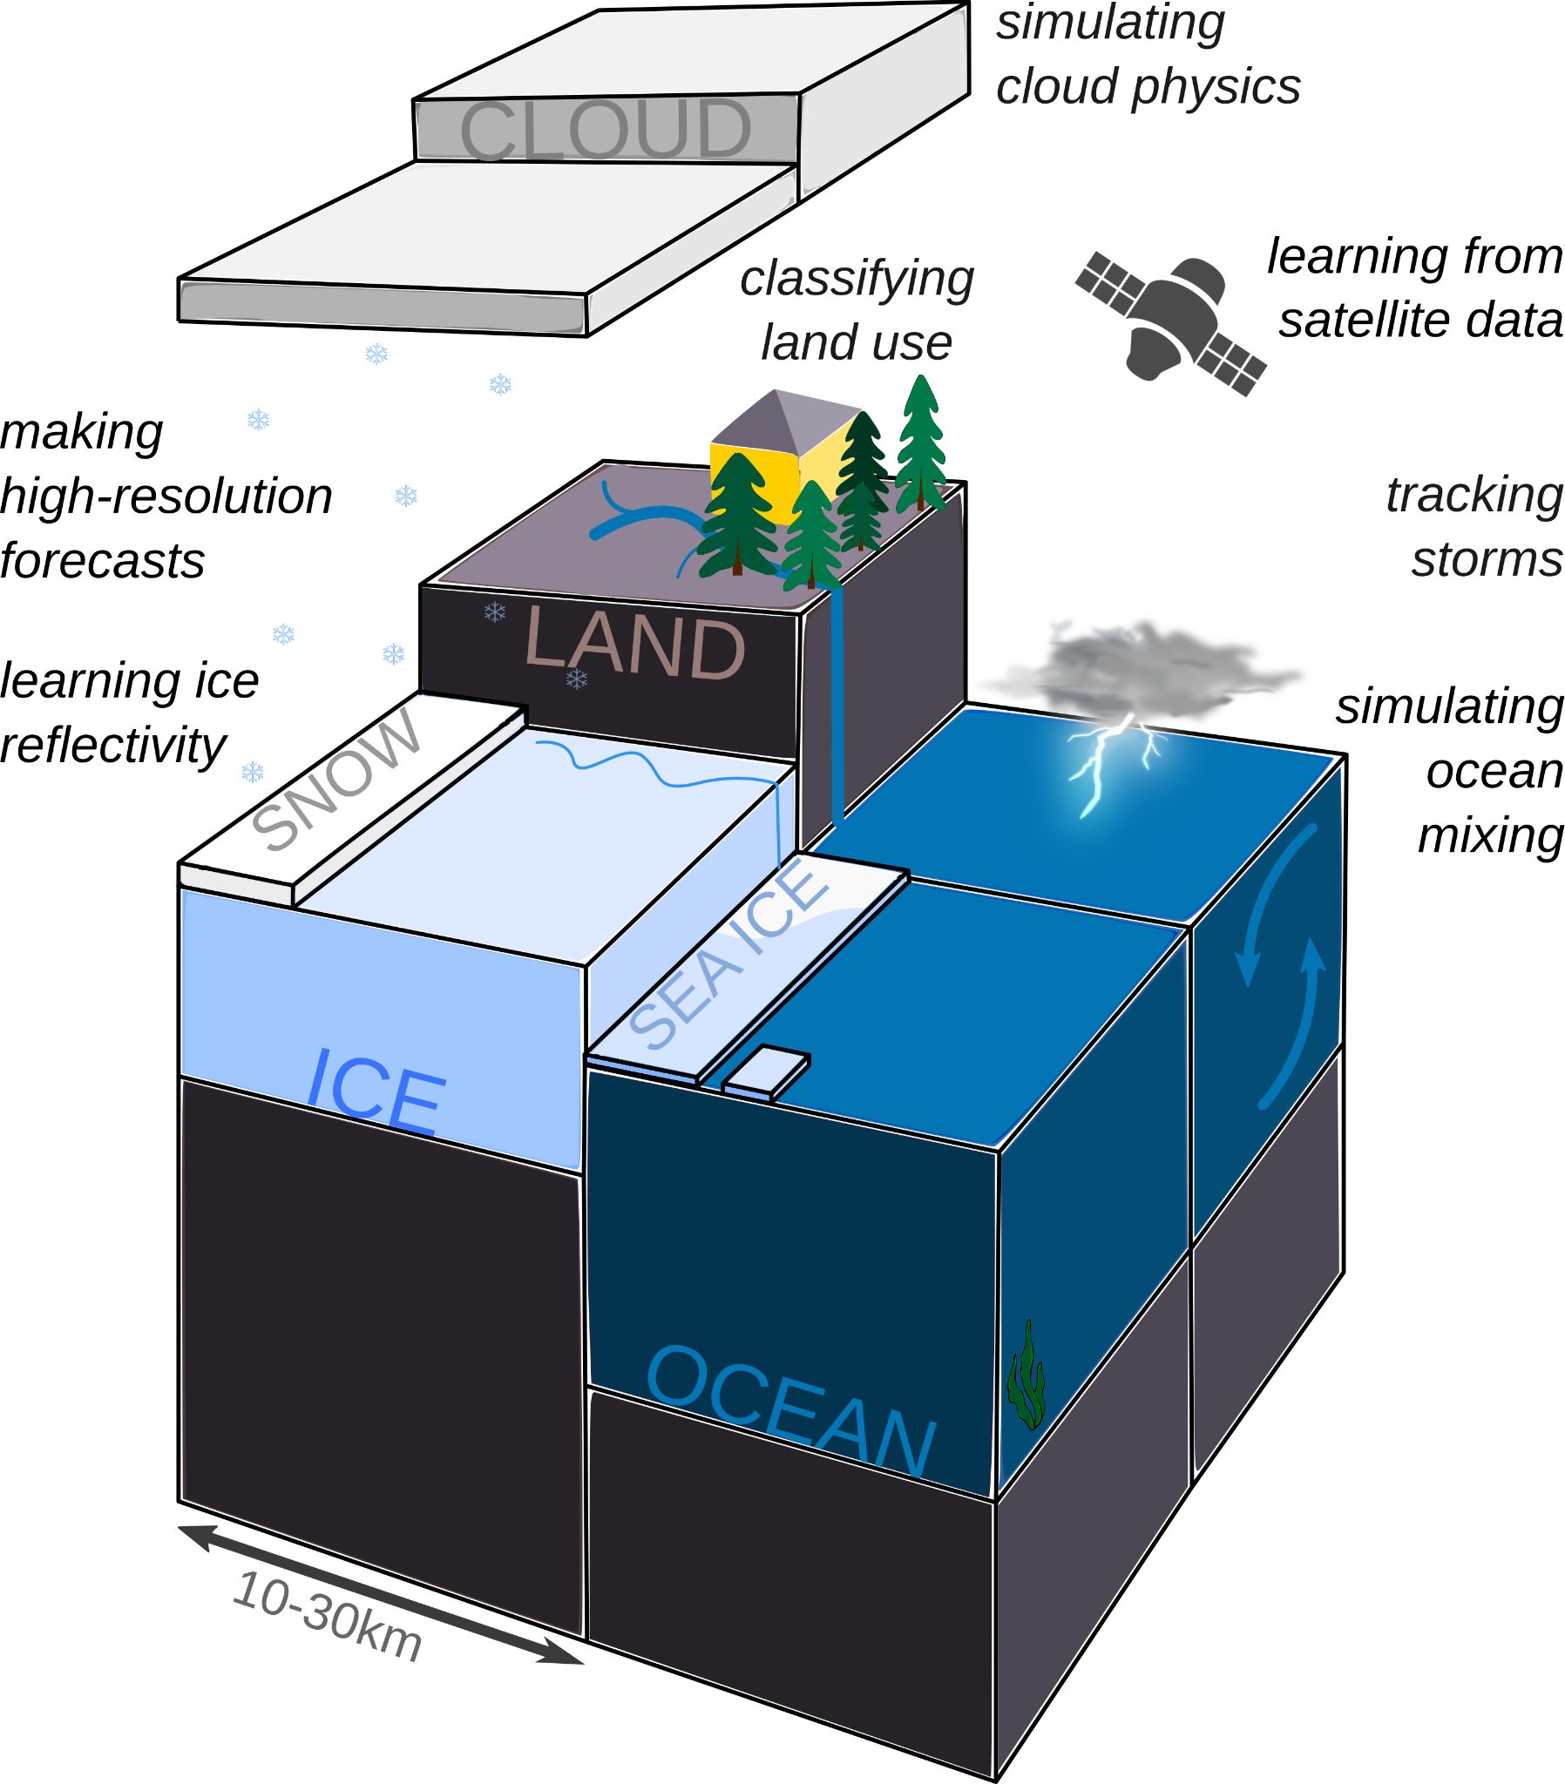
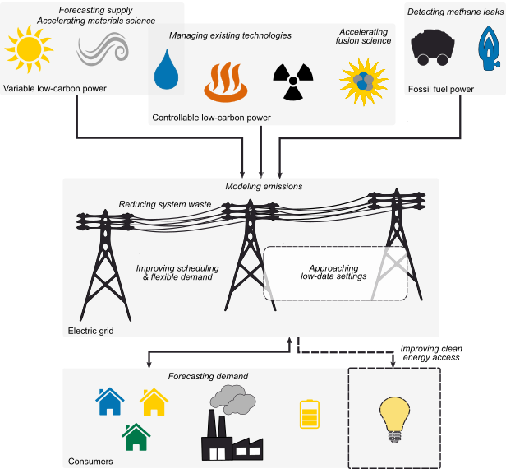
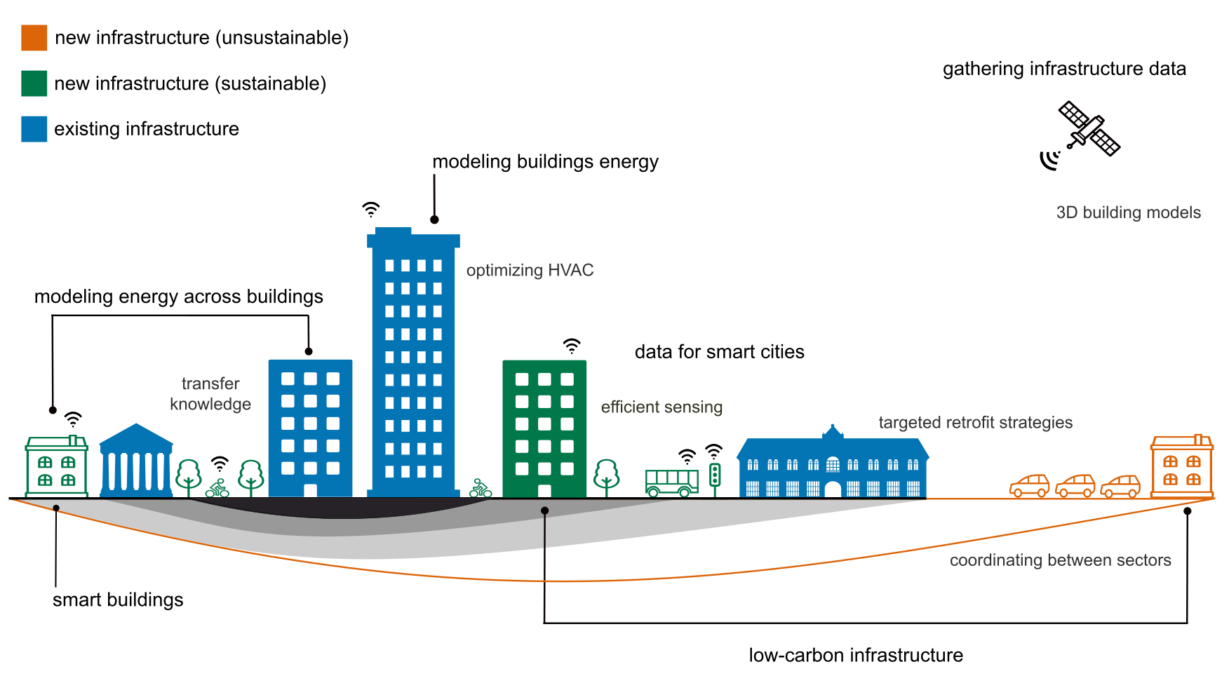
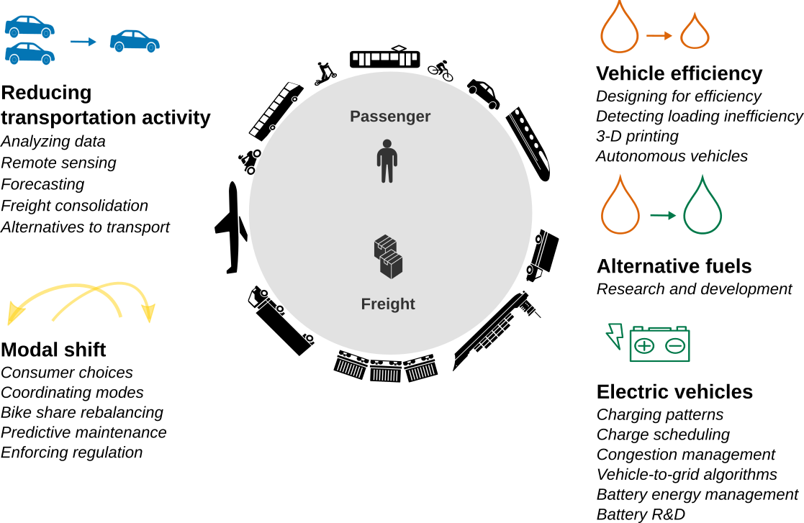
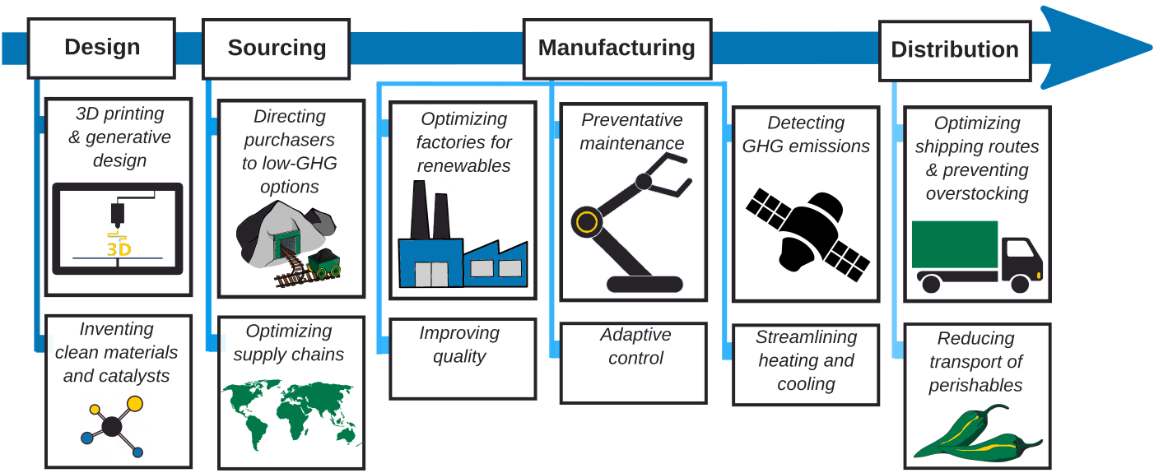
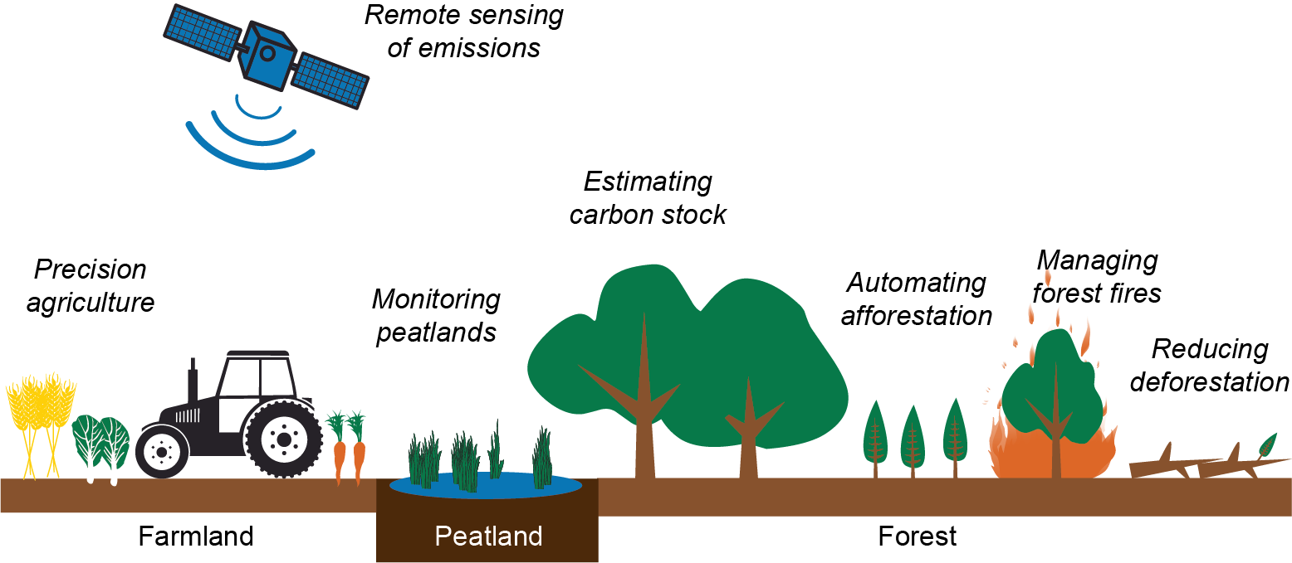
Physics & engineering are central to climate action
Climate prediction
Electricity systems
Buildings & cities
Earth, atmospheric, oceanic modeling
Wind farm optimization
Urban environmental simulations
Power system optimization & control
Building heating & cooling control
Transportation
Industry
Land use (agriculture)
Aerodynamic efficiency modeling
Equipment control & demand response
Precision agriculture
Battery and alternative fuel R&D
Design of low-materials structures
Cleaner ammonia production
Notes:
Many climate change-related sectors deeply involve science and engineering, for instance climate science; engineered sectors such as electricity systems, buildings, and transportation systems; and industrial sectors like heavy industry and agriculture.
Challenges in these areas include a combination of modeling problems, like modeling climatic processes or simulating wind flows through cities;
optimization and control problems like managing devices on the power grid or controlling agricultural equipment;
and accelerating discovery of things like alternative fuels or new low-materials construction techniques.

Slide 49
Types of {physics, engineering} + ML approaches
Physics-informed approaches:
Improve performance and/or data efficiency by employing physical knowledge or priors
Robust and safety-critical approaches:
Ensure adherence to system requirements (e.g., engineering constraints)
Notes:
In these areas, there are a lot of directions associated with merging the knowledge or requirements from these domains, with the development of machine learning tools.

Slide 50
Types of {physics, engineering} + ML approaches
Physics-informed approaches:
Improve performance and/or data efficiency by employing physical knowledge or priors
Robust and safety-critical approaches:
Ensure adherence to system requirements (e.g., engineering constraints)
Notes:
A major class of approaches here include physics-informed approaches.
These approaches involve designing ML methods that employ physical knowledge or priors within the ML workflow - for instance, in the data, loss functions, or architecture design in deep learning - to improve performance, or also attributes such as data efficiency.
This often occurs in (for instance) modeling and scientific discovery workflows.

Slide 51
Why physics-informed ML?
 | Physics-based approaches
Efficiently leverage physical knowledge | ✅
Transparent & robust behavior | ✅
Adaptive, data-driven | ❌
Fast to run | ❌
“Pure” ML approaches
❌
❌
✅
✅
Hybrid approaches
✅?
✅?
✅?
✅?
Caveat: This is an oversimplification!
Notes:
The reason we tend to want to pursue physics-informed ML is that it can blend the strengths of traditional physics-based and ML approaches, while potentially mitigating their weaknesses
For instance, physics-based models are good at efficiently leveraging existing knowledge in a way that doesn’t really depend on gathering and processing large amounts of data, and their outputs tend to be transparent and less brittle.
That said, these models struggle if their physical assumptions are incorrect, and are slow to run.
ML models on the other hand are often data-inefficient, physically inconsistent, black-box, and brittle - but they are good at learning about the “reality” of the underlying system from data, and are fast to run.
This has led to a lot of work in hybridizing these kinds of approaches.

Slide 52
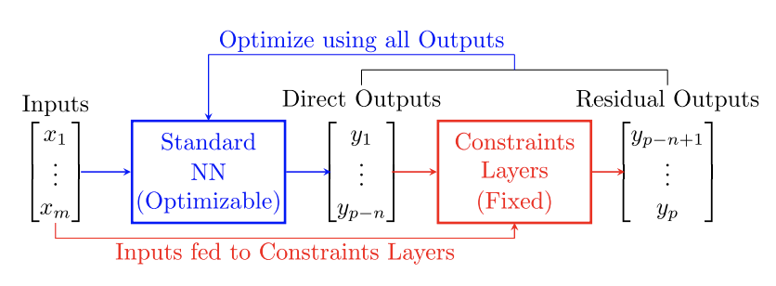
Example: Emulating subgrid-scale processes
Difficult to cheaply represent subgrid-scale processes in coarse-scale atmospheric models (“subgrid parameterization”), while respecting conservation laws
Approach: Design NN-based emulator, with architecture constrained to satisfy conservation laws
See related challenge: Climate Bench (emulating Earth System Models)
Beucler, T., et al. (2021). Enforcing analytic constraints in neural networks emulating physical systems. Physical Review Letters, 126(9), 098302.
See also: Kashinath, K., et al (2021). Physics-informed machine learning: case studies for weather and climate modelling. Philosophical Transactions of the Royal
Society A, 379(2194), 20200093.
Notes:
For example, in climate science, atmospheric models are really time-intensive to run, which means you can’t afford to exactly encode all the fine-grained atmospheric physics you would ideally encode - and this impacts the accuracy of the overall model.
Climate scientists as a result try to figure out ways to cheaply approximate these fine-grained processes, in ways that still respect important conservation laws.
For instance, recent work by Buecler et al. has said - well, let’s actually write down the conservation laws we want our approximator to satisfy, and embed a module into a neural network architecture that ensures these conservation laws are satisfied.
And this allows you to learn a neural network-based emulator for your fine-grained physics that satisfies your essential constraints.

Slide 53
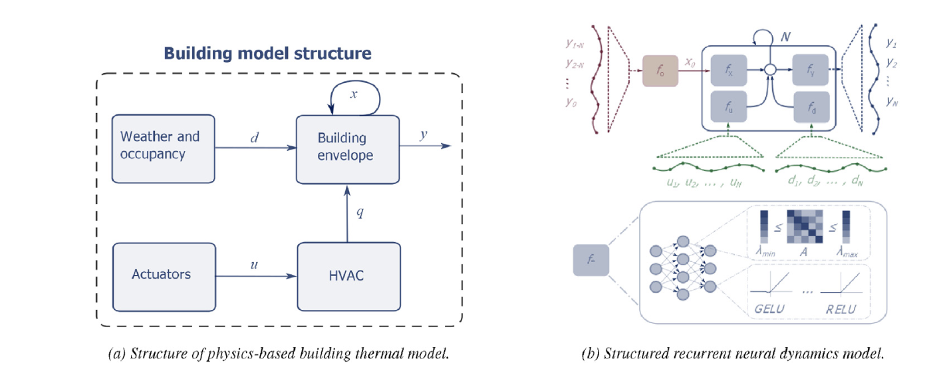
Example: Modeling building dynamics
Modeling dynamics of buildings can be difficult & expensive, but is needed for implementing simulators and/or control strategies
Approach: Learn differentiable surrogate using physics-informed ML model
Can employ within end-to-end “differentiable predictive control” workflow
See related platforms: COBS (building control) and City Learn (city-scale control)
Drgoňa, J., Tuor, A. R., Chandan, V., & Vrabie, D. L. (2021). Physics-constrained deep learning of multi-zone building thermal dynamics. Energy and Buildings, 243, 110992.
Drgoňa, J., Tuor, A., Skomski, E., Vasisht, S., & Vrabie, D. (2021). Deep learning explicit differentiable predictive control laws for buildings. IFAC-PapersOnLine, 54(6), 14-19.
Notes:
Another similar example comes up in the domain of buildings.
We often want a cheap model of how the dynamics of a particular building actually look in order to either enable the implementation of simulators for RL, or enable control strategies like model-predictive control that depend on some knowledge of the underlying dynamics.
One approach that's been pursued is to try to learn a differentiable surrogate for these physics.
For instance, Drgoňa et al. observe that there is a particular block-based structure exhibited by general building thermal dynamics models.
They then embed that structure alongside other constraints within a neural network architecture, and use it to learn an emulator of the dynamics.
By doing this, they’re able to learn a more reasonable emulator than when using pure data-driven approaches -
and since it’s differentiable, they can actually embed it within a broader end-to-end differentiable workflow for learning control policies.

Slide 54

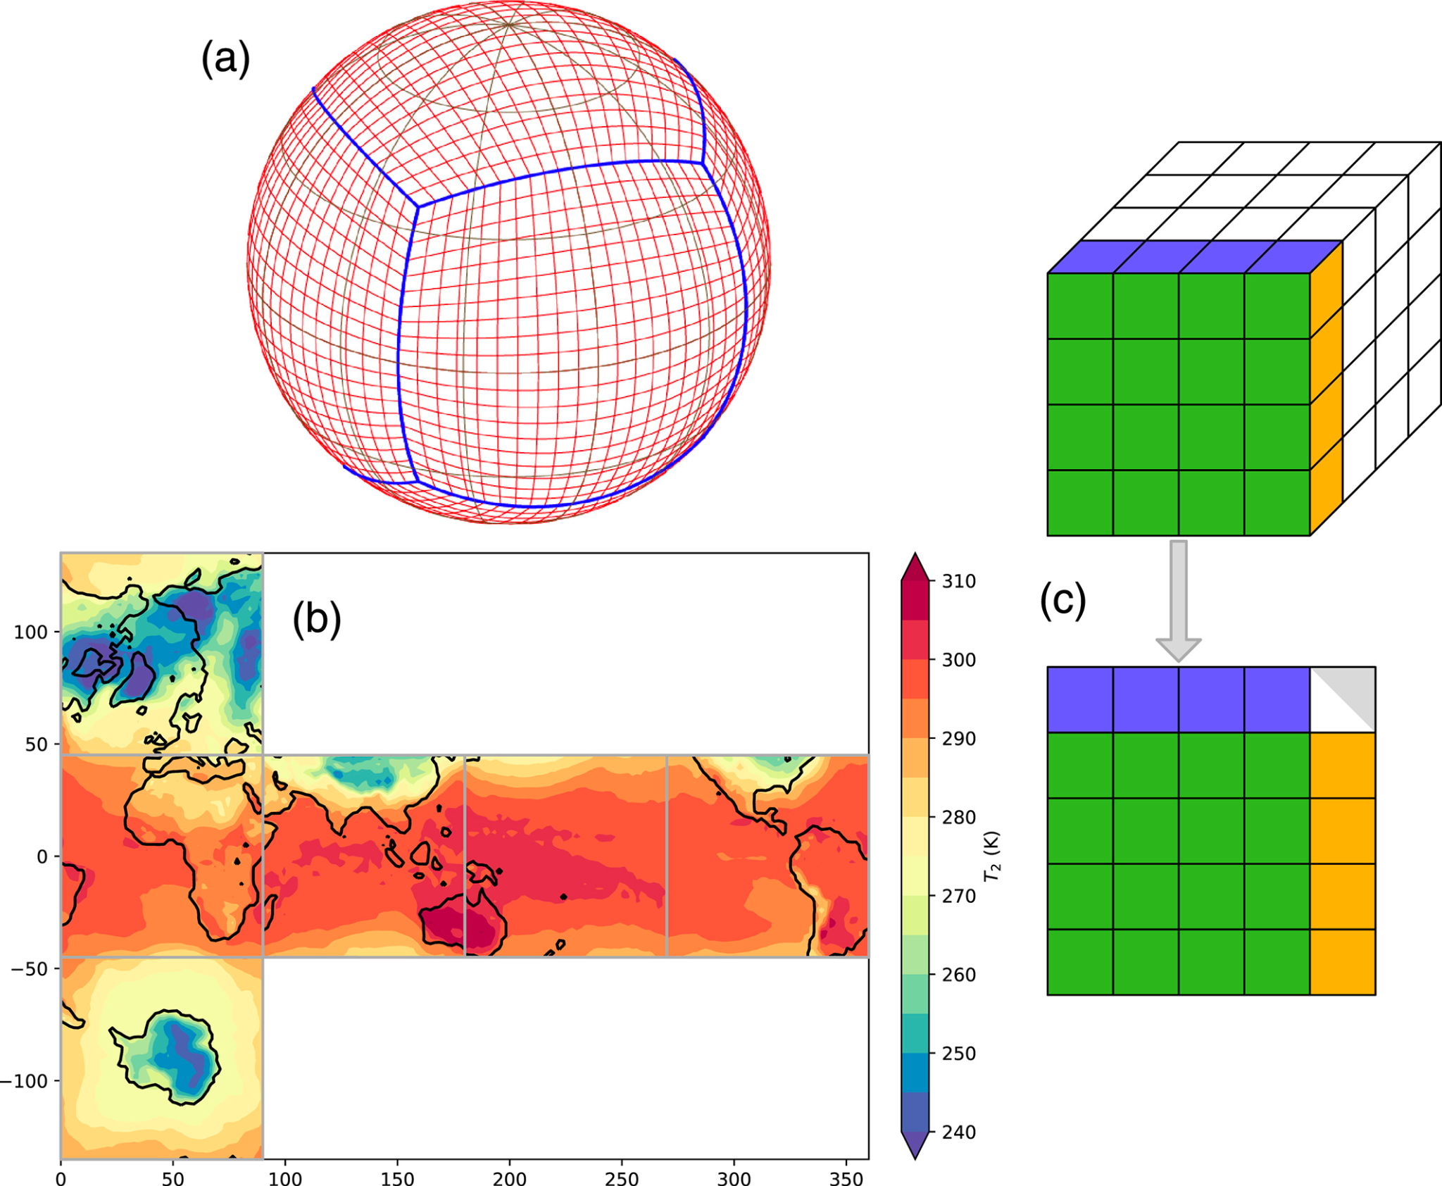
Directions: Physics-informed ML and climate change
Incorporating more complex constraints into architectures and losses
Improving stability & convergence of physics-informed model training
E.g., Power grids: DC power flow (linear) → AC power flow (nonlinear)
Improving data representations to capture physical considerations
Improving out-of-distribution generalization
(See also tutorial section: “Research challenges: Generalization and causality)
E.g., Cubed-sphere grid data representation
Cubed-sphere grid figure source: Weyn, J. A., Durran, D. R., & Caruana, R. (2020). Improving data‐driven global weather prediction using deep convolutional neural networks on a cubed sphere. Journal of Advances in Modeling Earth Systems, 12(9), e2020MS002109.
Notes:
There are many potentially fruitful directions in this area of physics-informed ML for climate change.
For instance, while the papers I just described deal with linear constraints, there are many cases that call for accommodating more complex constraints.
These include things like the physics of the power grid, which are nonlinear.
The resultant neural network architectures are harder to optimize, leading to some related directions in improving physics-informed neural network training.
In addition to physics-informed algorithms, there are also potentially interesting directions in structuring data in a physics-informed way.
For instance, several papers have shown that when representing Earth systems data, switching from a grid representation of the Earth to a cubed-sphere representation that better captures the Earth’s shape can actually improve performance.
And then, finally, there are lots of situations where one wants to generalize to unseen scenarios - for instance, predict long-term nonlinear dynamical processes that are changing over time - and there’s a school of thought that combining ML and physics can be one way to approach this.

Slide 55
Types of {physics, engineering} + ML approaches
Physics-informed approaches:
Improve performance and/or data efficiency by employing physical knowledge or priors
Robust and safety-critical approaches:
Ensure adherence to system requirements (e.g., engineering constraints)
Notes:
Switching gears, another major set of approaches here involves robust and safety-critical machine learning -
where we want to use ML to actively optimize or control a system, but it needs to satisfy various kinds of system requirements - for example engineering constraints or robustness constraints - to enable it to be deployed on that system.
On safety-critical systems like power grids, not satisfying these engineering requirements can mean blacking out the grid - leading to billions of dollars of losses and loss of lives - which is a non-starter for deployment.

Slide 56
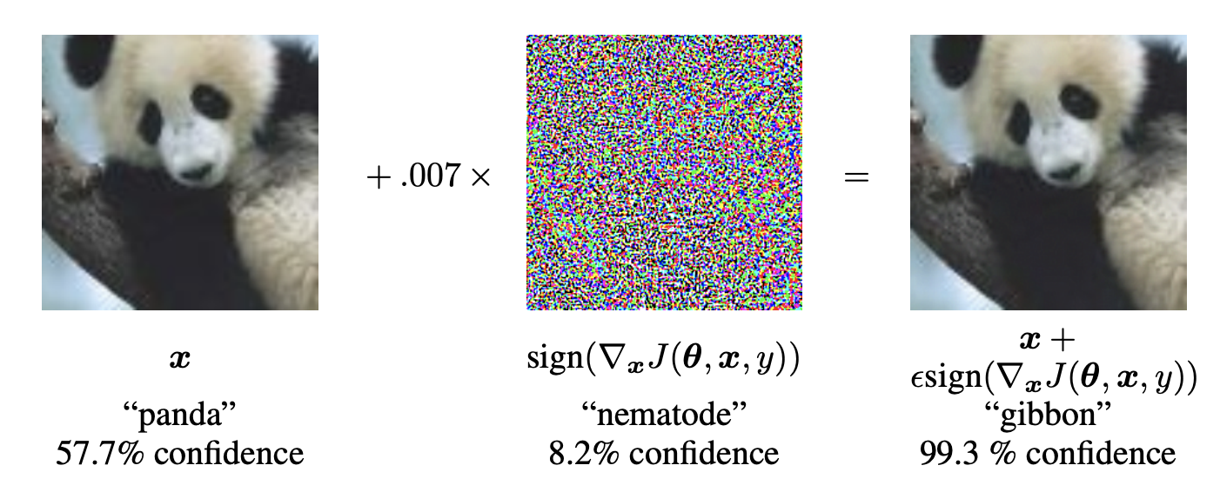
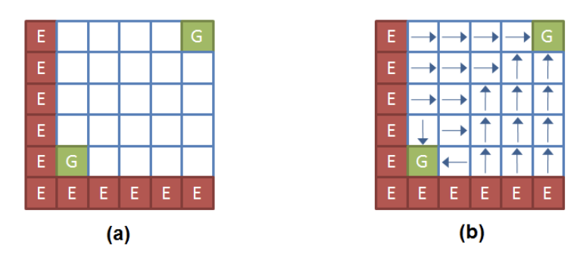

Example notions of “robustness” in ML and climate
Adversarial robustness [ML]: Robustness to perturbations of inputs
Safe reinforcement learning [ML]: Avoid error states or catastrophic scenarios
Robust control [e.g., power systems, buildings]: Bring system to an equilibrium (e.g., Lyapunov stability)
Adversarial robustness figure source: Goodfellow, I. J., Shlens, J., & Szegedy, C. (2015). Explaining and harnessing adversarial examples. ICLR.
Safe RL figure source: Garcıa, J., & Fernández, F. (2015). A comprehensive survey on safe reinforcement learning. JMLR, 16(1), 1437-1480.
Notes:
Interestingly, when we think about robustness in machine learning vs. the way we talk about robustness in climate-relevant domains, it’s often worth noting that these communities are talking about pretty different things.
So for example, in the deep learning literature, there's a lot of work on adversarially robust learning - how do you learn deep learning based models that are robust to various perturbations of their inputs.
In the RL community, there’s the notion of safe reinforcement learning - can you create an RL algorithm that doesn’t leave some space of states that have been determined to be safe?
And then on the engineering side, for instance in power systems and buildings, a common notion of robustness - called Lyapunov stability - comes from robust control - if I start my system in a given state, can I provably make sure my controller brings the system to some kind of equilibrium over time?
These are just some illustrative examples of different things that can be meant by “robustness.” It’s important to ensure one is implementing the correct notion of robustness for their domain.

Slide 57
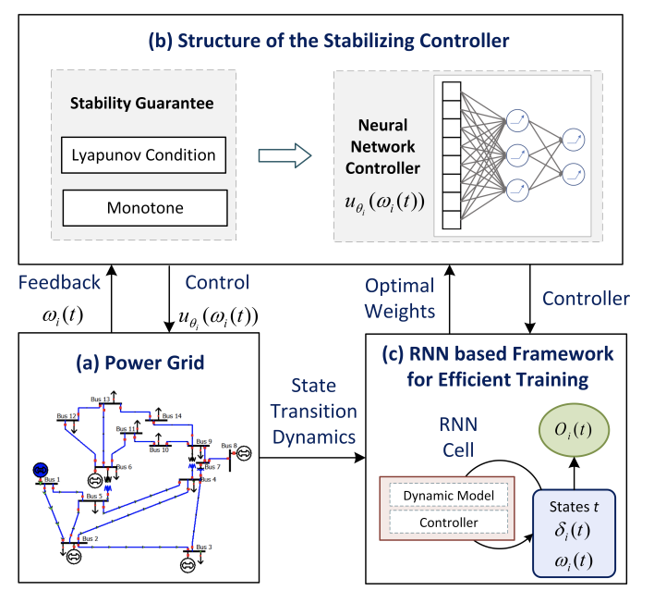
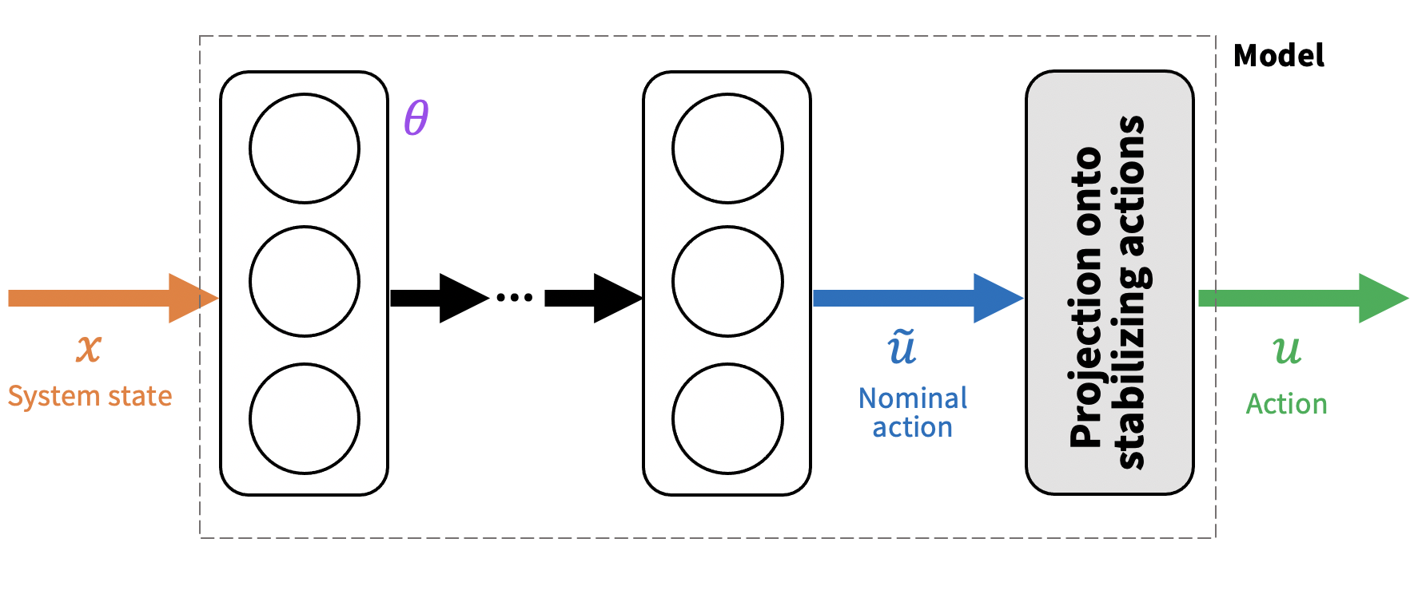
Example: RL for robust power grid control
Want to control power system devices in a robust manner
Notion of robustness: Lyapunov stability [robust control]
Ideas
Enforce Lyapunov stability guarantees in NN architecture
Mix between robust and untrusted controllers
❓Untrusted (performant)
✔ Trusted
(robust)
Cui, W., Jiang, Y., & Zhang, B. (2022). Reinforcement learning for optimal primary frequency control: A Lyapunov approach. IEEE Transactions on Power Systems.
Donti, P. L., Roderick, M., Fazlyab, M., & Kolter, J. Z. (2021). Enforcing robust control guarantees within neural network policies. ICLR.
Rutten, D., Christianson, N., Mukherjee, D., & Wierman, A. (2022). Online Optimization with Untrusted Predictions. arXiv preprint arXiv:2202.03519.
Notes:
For example, one line of work tries to build reinforcement learning methods for the control of components on electric power grids, in order to better enable the integration of renewable energy.
Since this kind of work is meant to be employed on power grids, it needs to provably enforce the Lyapunov stability notion of robustness that is common in power grids.
One approach to doing this entails designing neural network architectures that internally enforce Lyapunov stability -
for instance, Cui et al. structure their neural network controller to enforce a monotonicity property that ends up implying the enforcement of stability (in their setting of frequency control).
Some of my own work in the context of voltage control has used implicit layers (specifically optimization layers) to enforce Lyapunov stability constraints within a neural network architecture.
Another approach (for instance by Rutten et al.) is to somehow mix between the outputs of a trusted traditional robust controller and an untrusted (for instance RL) algorithm, in a way that gives you some kind of guarantee on both performance and robustness.
While this line of work basically says - let’s build an RL algorithm that satisfies an engineering-based notion of robustness...

Slide 58


Example: Adversarially robust power grid optimization
Intractable to dispatch power generators to be robust to k failures (N-k SCOPF)
Notion of robustness: Feasibility against contingency constraints [optimization]
Approach: Re-cast as an adversarially robust optimization problem [ML-style]
“Solve” using adversarial training techniques (plus implicit layers)
See related challenge: ARPA-E GO Competition (secure power system optimization)
minimize
maximize
( , )
l
Donti, P. L., Agarwal, A., Bedmutha, N. V., Pileggi, L., & Kolter, J. Z. (2021). Adversarially robust learning for security-constrained optimal power flow. NeurIPS.
Notes:
... it’s also possible to do this exchange in the other direction, where we translate notions of robustness used in the ML world to climate-relevant fields.
For instance, some of my own work has translated techniques from adversarially robust deep learning to the world of robustly optimizing power grids under the threat of multiple simultaneous outages, potentially caused by extreme events.
This problem, called N-k security-constrained optimal power flow, can force you to account for billions of scenarios, making the exact optimization problem intractable.
What we observe is that we can actually rewrite this problem in a way that looks a lot like adversarially robust training in deep learning - and then we can solve it heuristically using similar techniques.
This allows us to scalably address this problem for realistic-scale systems, for among the first time in the literature.

Slide 59
Takeaways: Physics-informed and robust ML
Many fruitful directions for merging physics & engineering knowledge with ML approaches, with benefits across many climate-relevant areas
Physics-informed approaches: Accommodate new and more complex physics within data, deep learning architectures, and loss functions
Robust and safety-critical approaches: Implement, exchange, and/or combine notions of robustness from ML and climate-relevant domains
Deep domain understanding can yield new methodological directions
Notes:
To summarize - there are many different fruitful directions for merging physics and engineering knowledge with ML approaches, and these can have benefits across many climate relevant areas.
This includes physics-informed approaches, where there are lots of directions to (for instance) accommodate new and more complex physical constraints.
And approaches in robust and safety-critical settings, where there are many opportunities to implement, exchange, and combine the different notions of robustness used in different domains.
Across all of these, a key takeaway is that deeply understanding the climate change-related domain can provide insights about the kinds of physics and engineering constraints that are useful to satisfy, and this can lead to new methodological directions for ML.

Slide 60
Tutorial outline
Introduction to climate change
Opportunities for ML in climate action
Research challenges
Physics-informed and robust ML
Interpretable ML and uncertainty quantification
Generalization and causality
Example projects
Is ML a help or hindrance for climate action?
Considerations for research and deployment
Takeaways and how to get involved
Notes:
To start, I’m going to talk about physics-informed and robust machine learning.

Slide 61
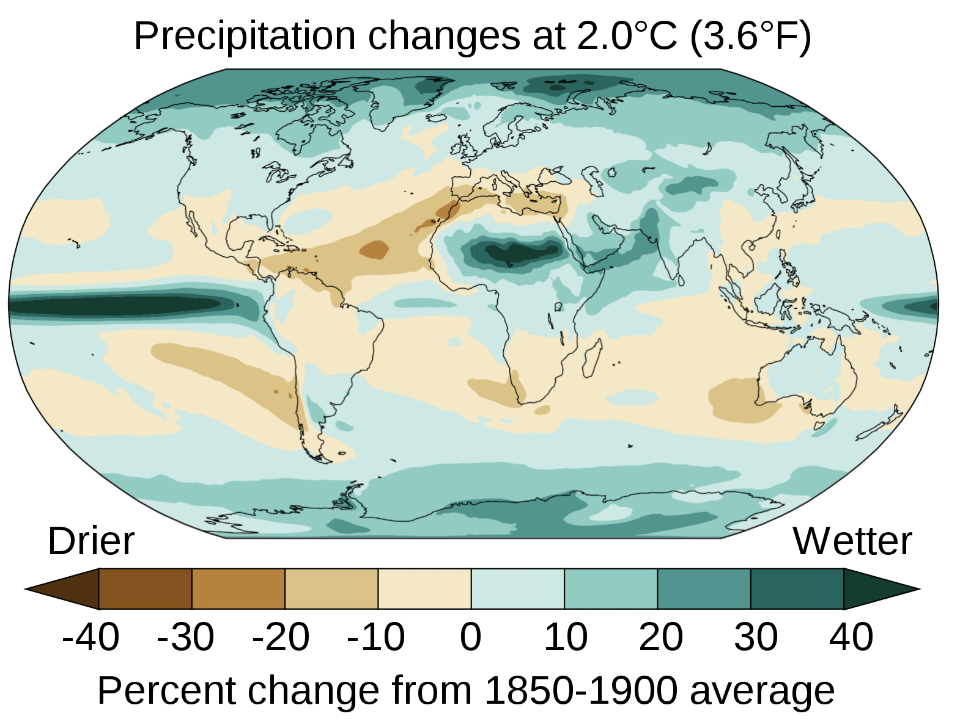
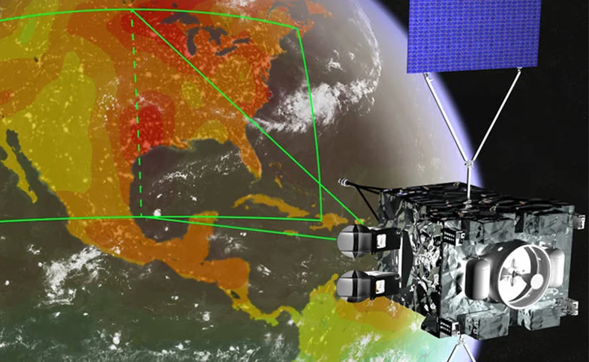
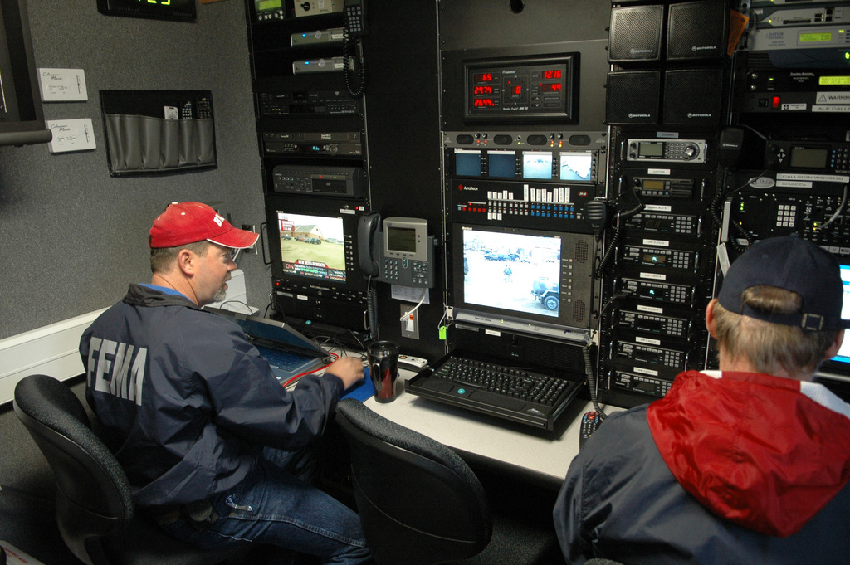
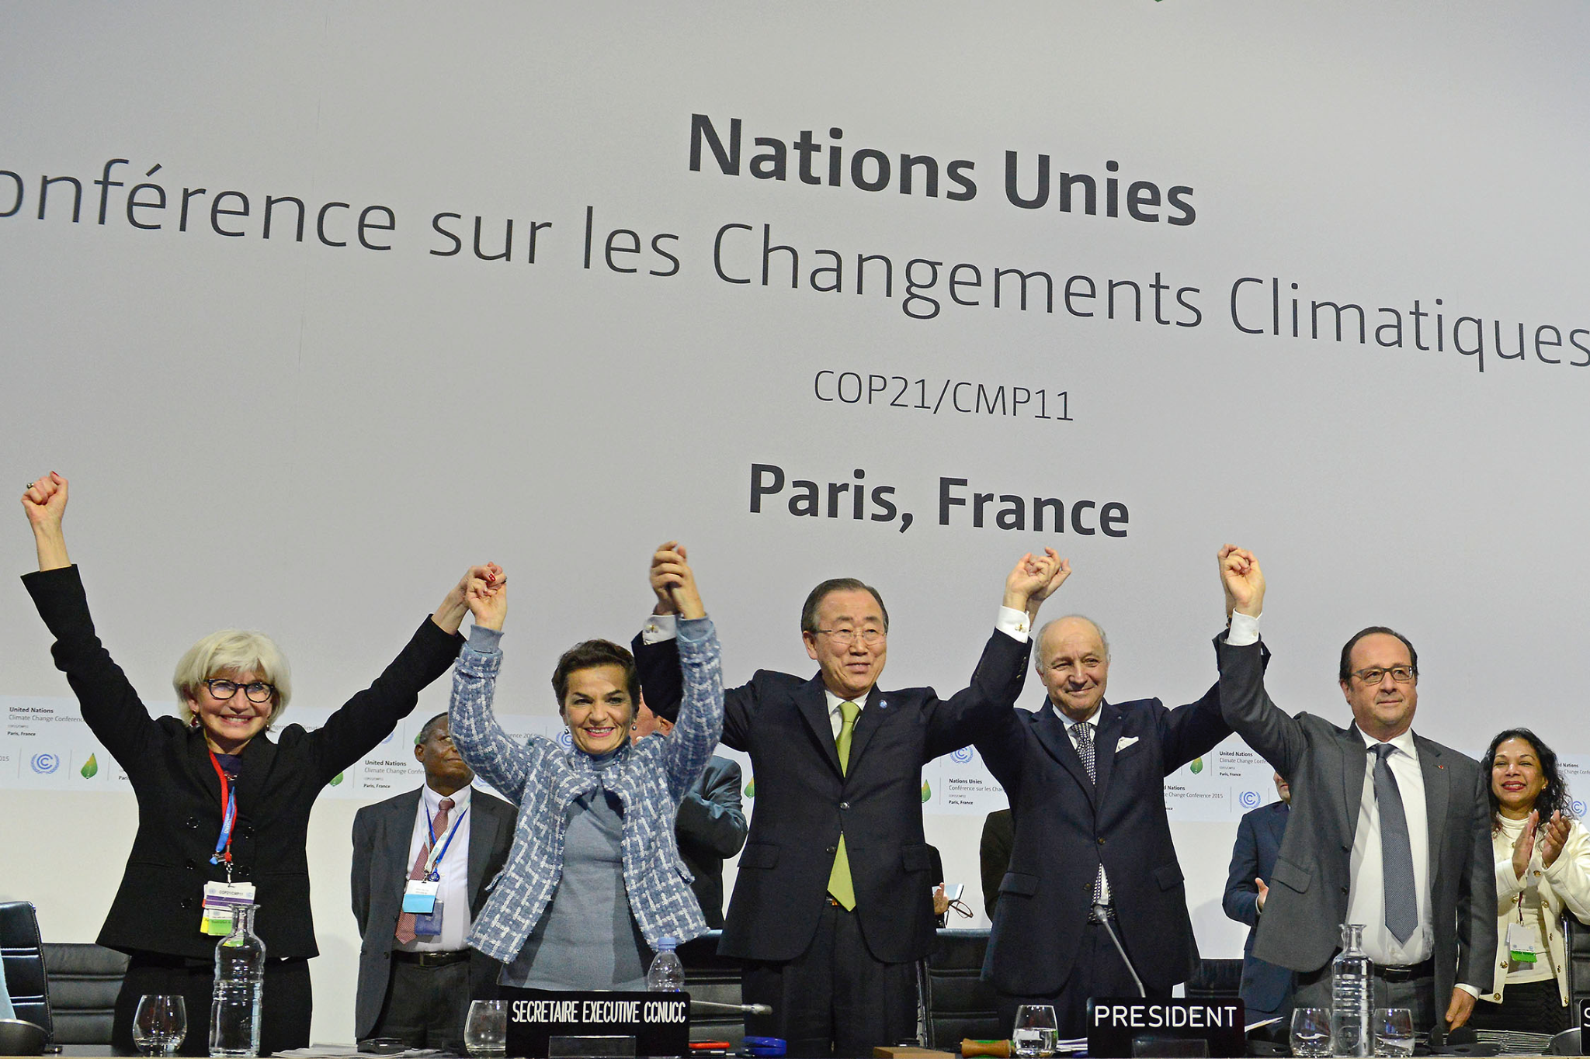
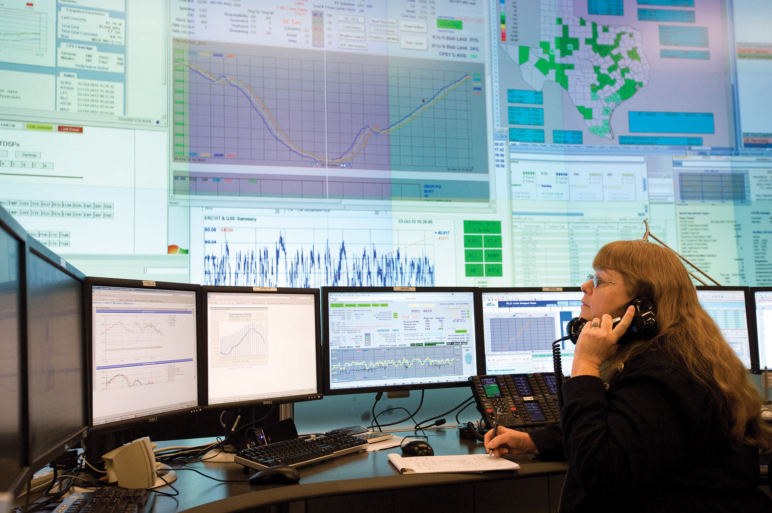

Interpretability and uncertainty in climate change
Climate change mitigation and adaptation require trust and robust decision-making
Scientific understanding and predictions of climate change
Monitoring, reporting, and verification of emissions and climate change effects
Early warning and emergency response
Orange C. Sheriff's Department via AP
Policy-making on international, national, and local levels
Planning and operation of critical infrastructure
Innovation and technology assessment
Notes:
Script:
Climate change mitigation and adaptation require trust and robust decision-making
For example, we still need a better scientific understanding of how climate change will play out with all its uncertainties, especially at higher spatial and temporal resolutions
With the Paris Agreement, the world is now gearing up for extensive global reporting on climate action and effects. These data are often highly uncertain and that needs to be appropriately communicated when informing international policy making
As the effects of climate change manifest and society adapts to new challenges, also emergency response plays an increasingly important role. Human decision-makers need to trust models and know when to override an output.
One cannot emphasize enough how much of a central role policy plays to shape climate change mitigation and adaptation around the world. Robust and scientifically informed decision-making is more important than ever for guiding this process
Critical infrastructure, such as electricity grids, water supply, or digital infrastructure, are the backbone for both mitigation and adaptation. Operators are increasingly relying on data and forecasts to make their decisions but humans are always in the loop.
As we are rapidly developing new low-carbon technologies such as electric vehicles, we also need to have a good understanding of the effects and risks of these innovations
You can already see how different the areas of application are, and this also comes with very specific user needs. Interpretability and uncertainty can provide answers to different usage needs, but there is a lot to be done to understand how to make this work in practice.

Slide 62


Interpretability and uncertainty in climate change
Interpretability aims:
Oversight | Regulatory oversight and recourse Real-time settings: Intervening & overriding model outputs Domain-informed model debugging
Credibility | Allowing stakeholders to decide whether to trust
Scientific discovery | Working with and expanding domain knowledge
Uncertainty quantification aims:
Assessing risks | Input to making robust decisions
Communication | Avoiding overconfidence and increasing credibility
Notes:
Script:
For example, understanding what the model does and how it works also allows for recourse and regulatory oversight
They can also allow humans interacting with the model to intervene and override model outputs because they understand when a prediction is to be mistrusted
And some approaches can also enables better domain-informed debugging
This way, interpretable models may allow decision-makers and affected stakeholders to decided in an informed way if they trust in the model
A last point is that interpretable models can also help with discovering new scientific contexts
Uncertainty estimates in turn are essential for assessing risks and making robust decisions across a variety of contexts
And they are also important for credibility. For example in estimating the carbon stock for offset credits: buyers deserve to know how large the uncertainty of possible emissions reductions is for their purchase

Slide 63

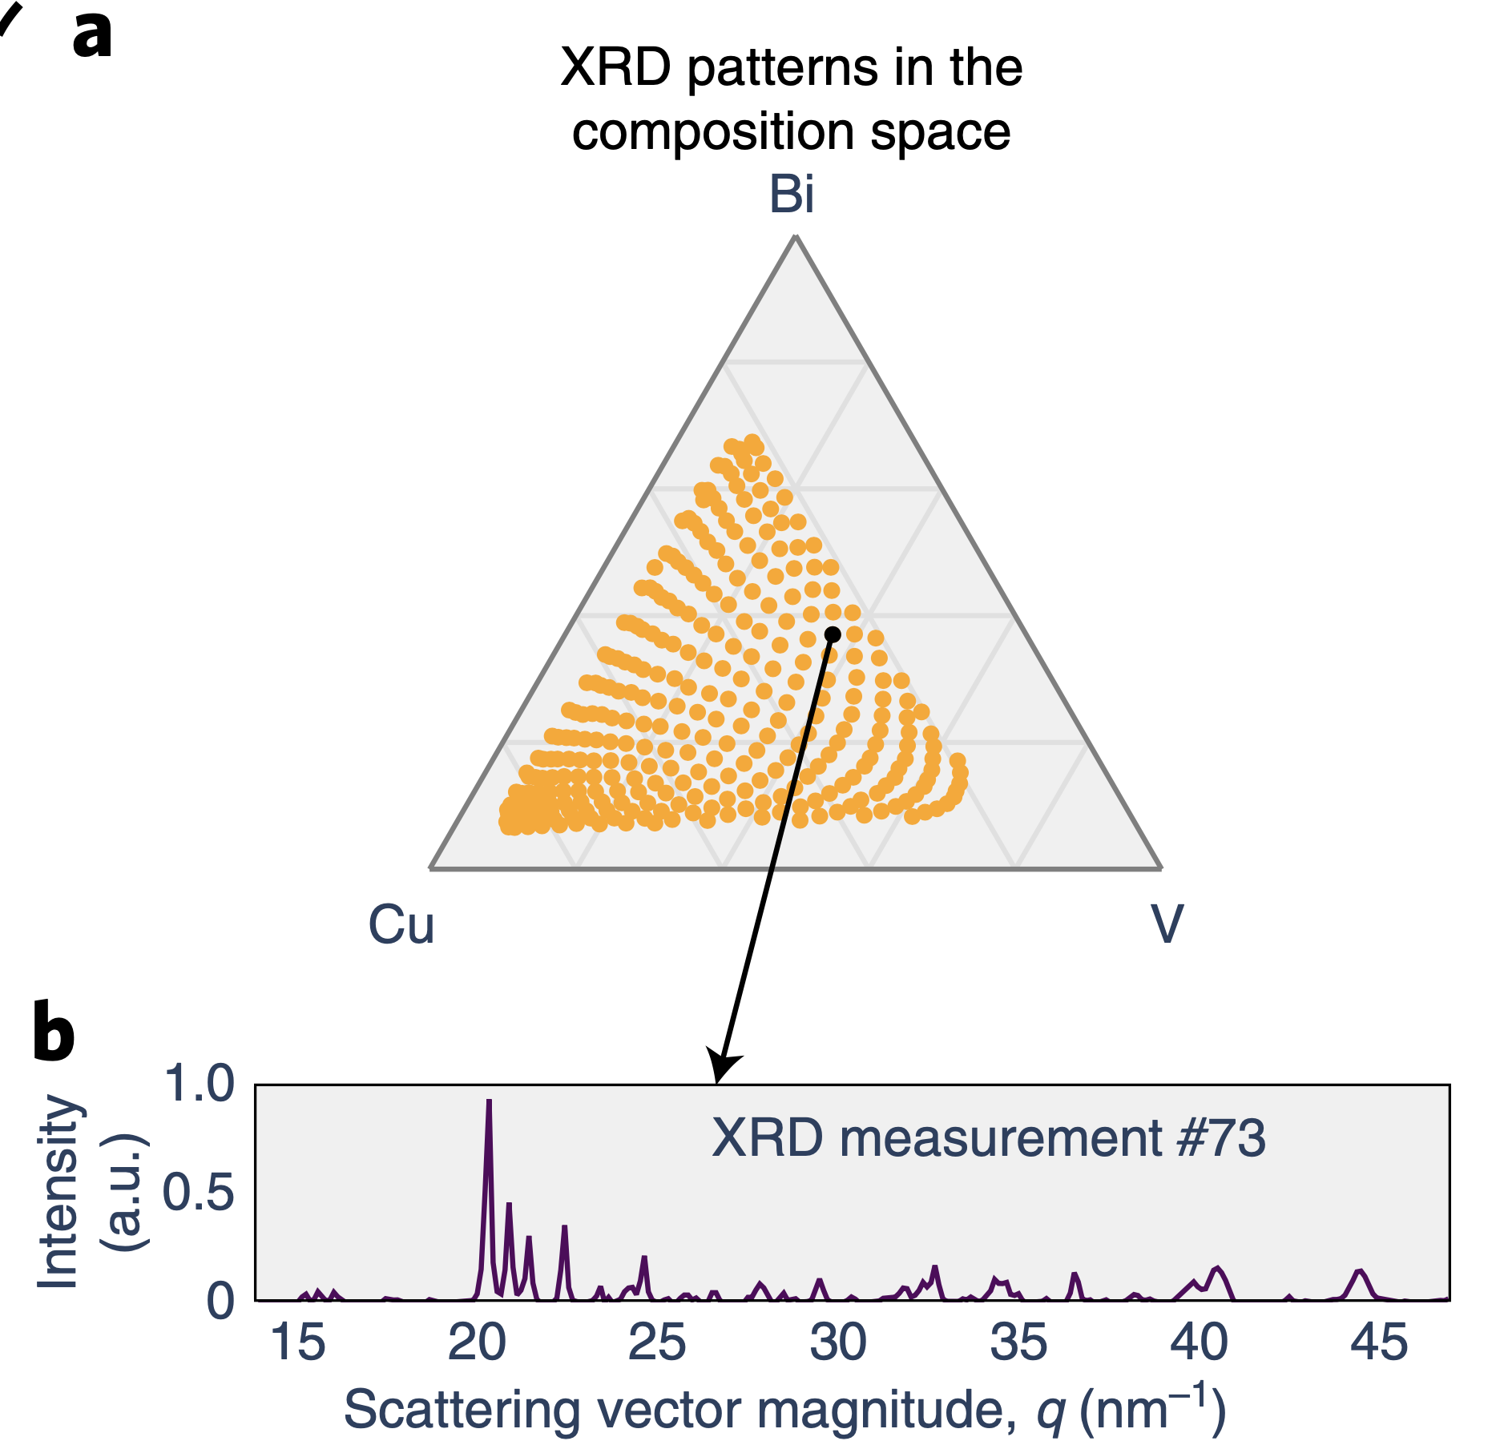
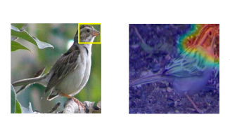
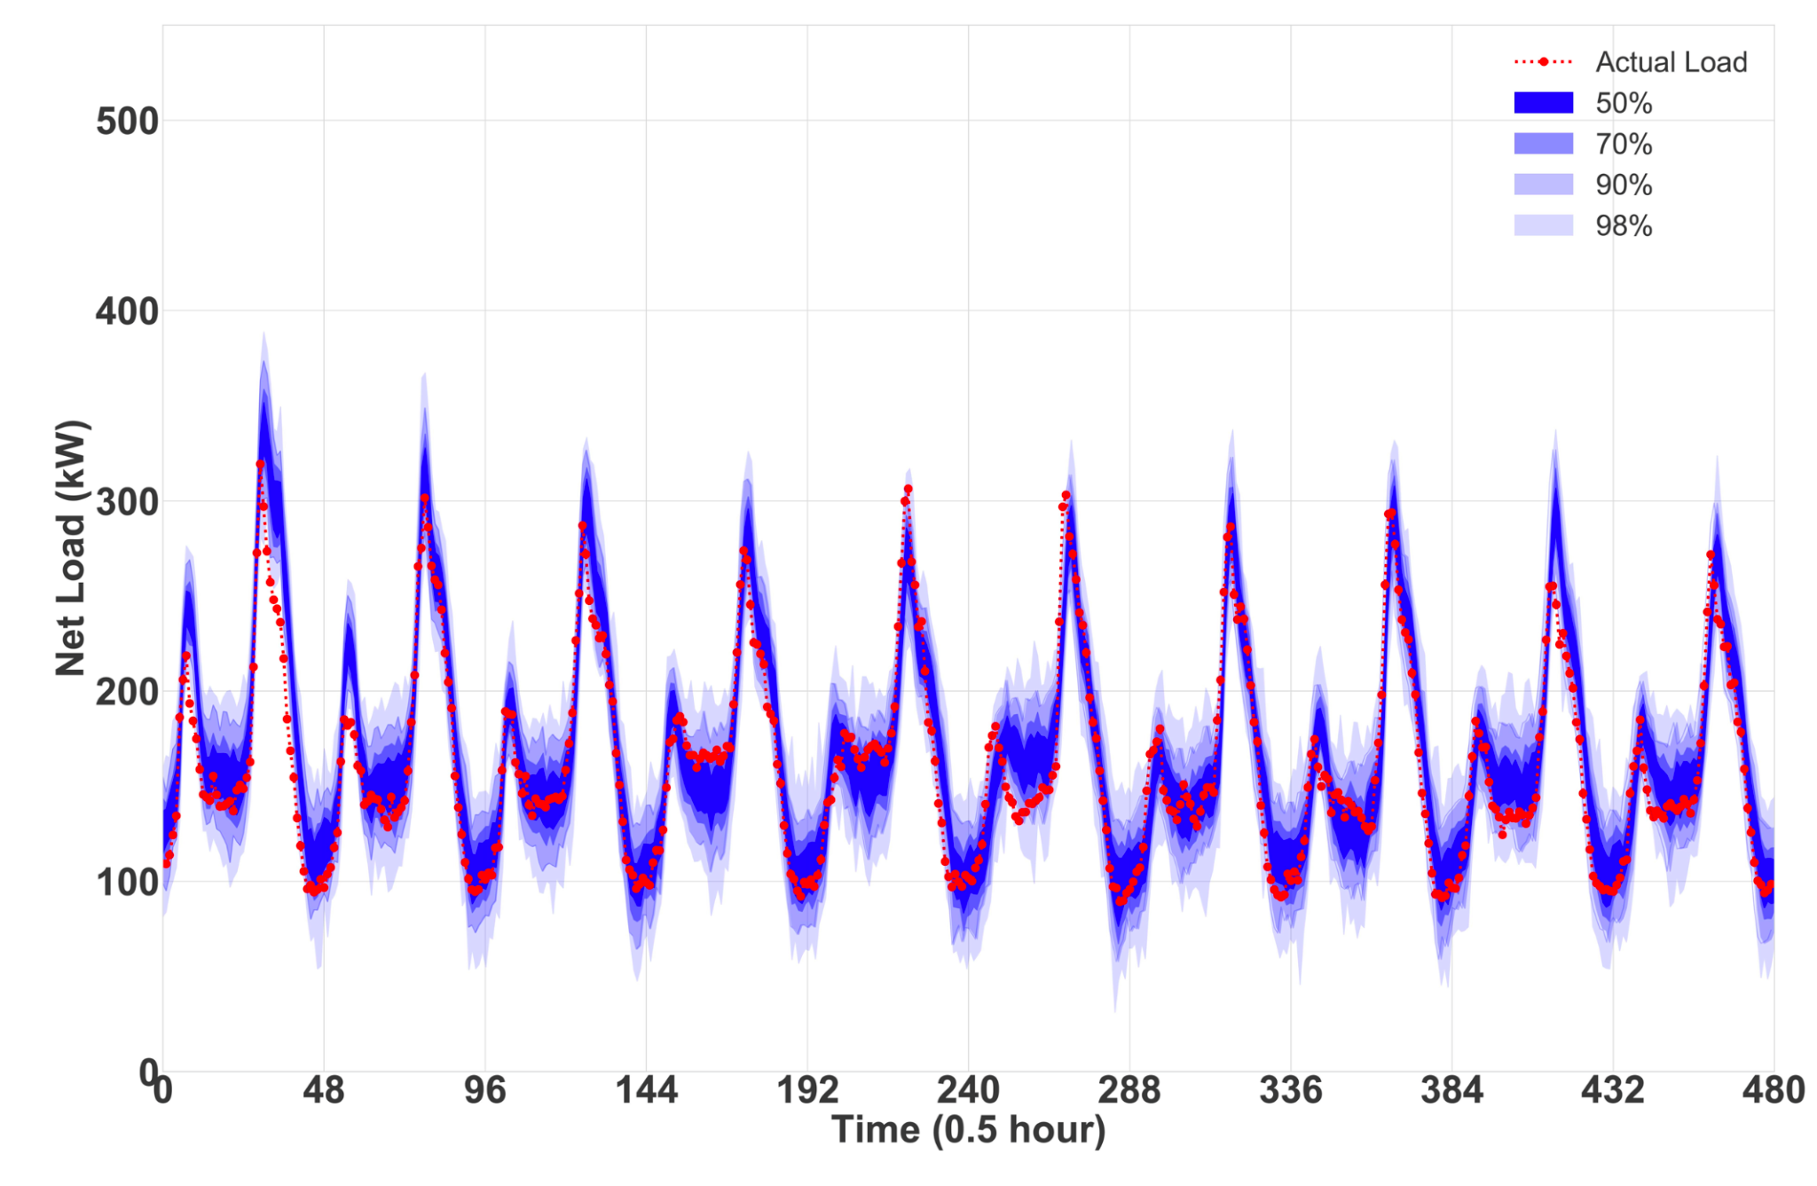
Examples
Ocean sub-grid scale modeling with equation-discovery
Crystal-structure phase mapping with deep reasoning networks
Bird species classification with a prototypical part network
Net load forecasting with Bayesian deep learning
Notes:
Script:
I will introduce 4 examples of recent work in these areas that show the importance for problems in climate change
The 3 first ones are different examples from climate modeling, energy innovation and species monitoring that developed interpretable models to solve different challenges
And then I briefly speak about an example of probabilistic forecast from the electricity sector

Slide 64
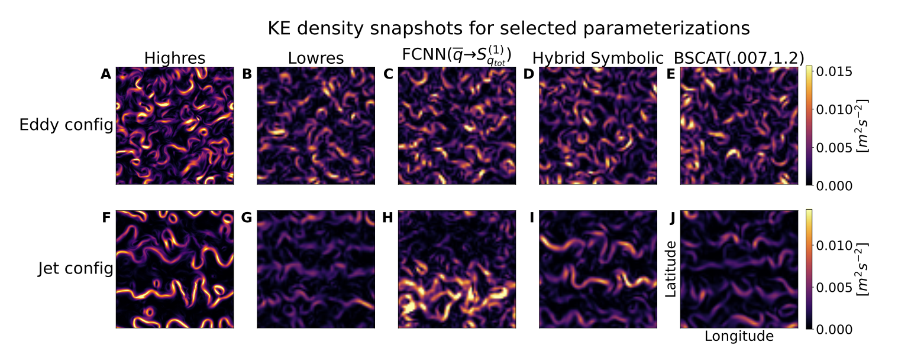
Example 1: Ocean sub-grid scale modeling with equation-discovery
Human-in-the-loop guidance and scientific interpretation may help improve ML-based emulators for subgrid-scale processes within coarse-grained climate models
Approach: (Interpretable) hybrid symbolic equation-discovery approach
Compared to (physics constrained) neural networks, generalizes better to unseen flow regimes
Ross, Li, Perezhogin, Fernandez-Granda & Zanna (in review) Benchmarking of machine learning ocean subgrid parameterizations in an idealized model
Notes:
Script:
Climate models, such as those modeling ocean processes, solve geophysical fluid equations on large grid cells of more than 25 km.
To alleviate computational bottlenecks for finer resolution, and ML is used to help model subgrid-scale processes
Incorporating the rich knowledge about climate systems may help with generalization, and interpretable model may also allow for new scientific discovery
In recent work, Ross et al. propose an equation-discovery approach for ocean sub-grid modeling and they find that it can generalize better, it allows for human-in-the-loop guidance in online learning approaches and for scientific interpretation.
Such turbulence modeling is relevant in many areas of climate change, for example also in vehicle engineering, urban design, and for industrial processes.
ML is used to learn parameters from observations and high-resolutions simulations to improve the low-resolution climate models
Besides Earth Sciences, turbulence modeling is also relevant in vehicle engineering, urban design, industrial processes, and many more areas related to climate change
Take it as given that there's some set of continuous nonlinear differential equations that you're discretizing and you want to use ML/equations to account for the discretization error
Instead of optimizing a model to maximize it in the vain hope that will lead to more realistic online simulations, it's better to tweak the actual prediction problem you're solving / the dataset to make the offline problem a better proxy for the online problem
12:29
Or do what Priya does and backprop through the online model
12:30
(But even then you've got a vast quantity of possible performance metrics, and also you can't evaluate them until you've let it run for many many steps)
12:31
(So you almost have the RL extreme delayed reward problem… on a system that takes massively intense resources to run)
12:31
(That's why we focus on equation discovery, because it's so much likelier to transfer)
Generalization: symbolic expressions, found using a new algorithm that we de- veloped, generalized better than neural networks, which are infamously sensitive
to even minor distributional shifts (Recht et al., 2018). With sufficiently diverse training data, FCNNs might perform much better in practice (Bolton & Zanna, 2019; O’Gorman & Dwyer, 2018).
Figure 20. Randomly chosen snapshots of kinetic energy density for selected parameteriza- tions on eddy (A-E) and jet configuration (F-J). On jet configuration, the symbolic parameteri- zation (J) matches high-resolution (F) reasonably well, while the FCNN (I) deviates significantly and backscatter (H) does not appear to have any effect or modify the low-resolution (G). See Figures E1 and E2 for more.

Slide 65
Example 2: Crystal-structure phase mapping with deep reasoning networks
Discovery of solar fuel materials requires separating noisy mixtures of X-ray diffraction patterns into source signals of the corresponding crystal structures (unsupervised pattern demixing problem)
Approach: (Interpretable) deep reasoning network
Exploiting scientific prior knowledge about rules that govern the mixtures of crystals
Interpretable latent space constructed with scientific variables that are learned in an unsupervised setting
Chen, D., Bai, Y., Ament, S., Zhao, W., Guevarra, D., Zhou, L., ... & Gomes, C. P. (2021). Automating crystal-structure phase mapping by combining deep learning with constraint reasoning. Nature Machine Intelligence, 3(9), 812-822.
Notes:
Script:
Scientific discovery with interpretable models is also deployed in for developing new energy technologies
For discovering new solar fuel materials for example, crystal-structure phase mapping is an important step
This is an unsupervised pattern demixing problem where a noisy mixture of X-ray diffraction patterns is decomposed into source signals that correspond to the crystal structures
Chen et al. solve this problem with deep reasoning networks where they make use of prior scientific knowledge about thermodynamic rules that govern the mixtures of crystals
Specifically, for this unsupervised problem they construct an interpretable formulation of a latent space using scientifically meaningful variables, and then learn the values of these variables form the data
The challenge of our demixing tasks is that the domain rules capturing prior knowledge involve variables that we do not have direct access to in our problem formulation. In fact, discovering those variables and their values is part of the interpretation task that we are trying to solve. The challenge is further complicated by the fact that we are operating in an unsupervised setting (no labelled training data). However, in standard unsupervised deep learning approaches, such as neural network autoencoders, the latent space is generally uninterpretable and therefore does not provide a means to express the domain constraints or enforce that the latent patterns conform to the generative model. Furthermore, domain rules are often captured by combinatorial constraints that are not differentiable, and therefore cannot be easily embedded in a deep learning framework. The DRNets strategy to overcome these challenges involves five key components, commencing with (1) specifying an intended semantics for the latent space, which means that the latent space is constructed using variables that have a specific interpretation that can be used in the formulation of the domain rules.
then we (2) express the domain rules that control the encoding of the latent space in a form amenable to continuous optimization using entropy-based continuous relaxations, (3) employ an optimization formulation whose objective balances the dual needs of minimizing a reconstruction loss of the input data and a reasoning loss that captures the domain constraints (local constraints involving a single data point or global constraints involving many data points), (4) use a data-driven approach to jointly solve multiple related (unlabelled) data instances and (5) solve the data-driven constrained optimization problem using constraint-aware stochastic gradient descent (SGD).

Slide 66
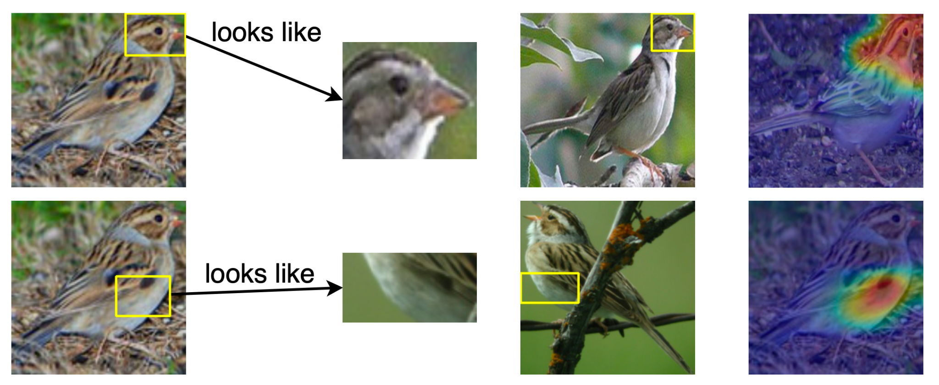
Example 3: Bird species identification
with a prototypical part network
Computer vision can help with ecosystem monitoring as the habitats of species change with a changing climate
Approach: Interpretable prototypical part network for bird species identification reasons in a similar way to ornithologists
Explanations generated are used during classification and are not created posthoc
Chen, C., Li, O., Tao, D., Barnett, A., Rudin, C., & Su, J. K. (2019). This looks like that: deep learning for interpretable image recognition. Advances in neural information processing systems, 32.
Notes:
Script:
Interpretability is also important for expert oversight. In this example, Chen et al built an image classification model for bird species identification that reasons in a similar way to ornithologists.
Typically, species monitoring requires a lot of manual labor and automated approaches with image data can help monitor biodiversity at scale
They develop what they entitled a prototypical part network that compares parts of the image to be classified with images in the training data like you can see in this figure
These interpretable comparisons are also actually used for classification
You see that we have a lot of examples from natural sciences. In general, there are fewer examples available for decision-making for example in policy making, but it would be tremendously helpful if more work would become available
Uncertainty estimation plays an important role for decision-making, and we will now turn to an example from the electricity sector
https://arxiv.org/pdf/1806.10574.pdf
The model thus reasons in a way that is qualitatively similar to the way ornithologists, physicians, and others would explain to people on how to solve challenging image classification tasks.
All of these posthoc visualization methods do not explain the reasoning process of how a network actually makes its decisions. In contrast, our network has a built-in case-based reasoning process, and the explanations generated by our network are actually used during classification and are not created posthoc.
In addition, we propose to constrain each convolutional filter to be identical to some latent training patch.

Slide 67
Example 4: Net load forecasting with Bayesian deep learning
Residential net electricity load is uncertain due to climate variability, variable power generation, and aperiodic human activities
Approach: Bayesian theory combined with deep LSTM networks for probabilistic day-ahead net load forecasts
Using smart meter data and (partially available) PV output data
Sun, M., Zhang, T., Wang, Y., Strbac, G., & Kang, C. (2019). Using Bayesian deep learning to capture uncertainty for residential net load forecasting. IEEE Transactions on Power Systems, 35(1), 188-201.
Notes:
Script:
Forecasting the residential net load in electricity grids - so generation minus load from residential customers- is difficult because it is subject to a lot of stochastic uncertainty.
This can be due to weather, variable power generation, and aperiodic human activities that influence for example rooftop solar PV generation or how much AC is used
Power system operators need good probabilistic forecasts to plan their dispatch of power plants such that they can meet the load at any time
Here Sun et al. use Bayesian theory combined with deep LSTM networks to create their forecasts with uncertainty, making use of smart-meter data and some PV output data
stochastic (aleatoric) uncertainty

Slide 68
Takeaways: Interpretable ML &
uncertainty quantification
Decision-making and discovery crucial for many areas of climate change: need for interpretability and uncertainty quantification
Domain-specific goals should drive the specific notion of interpretability used
Lack of documented use cases from practice where interpretability and uncertainty quantification in ML is used for improving decision-making
Research challenge: user-focused method development
Rudin, C. (2019). Stop explaining black box machine learning models for high stakes decisions and use interpretable models instead. Nat. Machine Intelligence, 1(5), 206-215.
Amarasinghe, K., Rodolfa, K., Lamba, H., & Ghani, R. (2020). Explainable machine learning for public policy: Use cases, gaps, and research directions. arXiv:2010.14374.
Notes:
Script
To summarize, decision-making, trust, and scientific discovery is crucial for many areas of climate change, and there is a clear need for interpretable models and uncertainty quantification
One thing that we see is that the notion of interpretability is so different for different use cases and domains (and different stakeholders have such different understanding of what these terms even mean) that harmonizing this is in and itself a big challenge
The selected examples show that some more work exists in engineering systems such as with power grids (where the decision maker is power system operator). However, especially in policy there are not as many documented use cases involving actual decision-makers.
A big need and challenge is to develop intepretable models and quantify uncertainty in a way that it is useful for decision-makers (and it is used in practice)

Slide 69
Tutorial outline
Introduction to climate change
Opportunities for ML in climate action
Research challenges
Physics-informed and robust ML
Interpretable ML and uncertainty quantification
Generalization and causality
Example projects
Is ML a help or hindrance for climate action?
Considerations for research and deployment
Takeaways and how to get involved
Notes:
To start, I’m going to talk about physics-informed and robust machine learning.

Slide 70
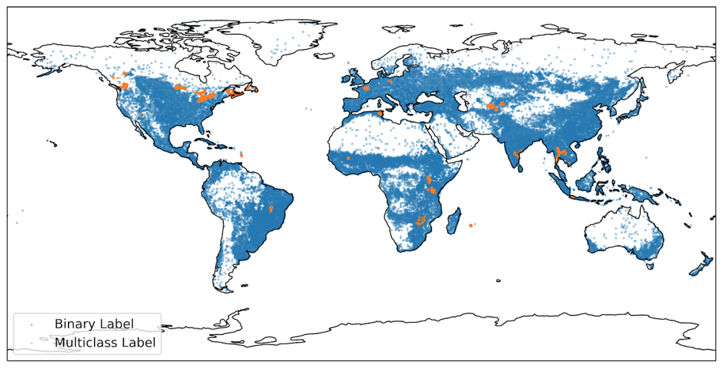
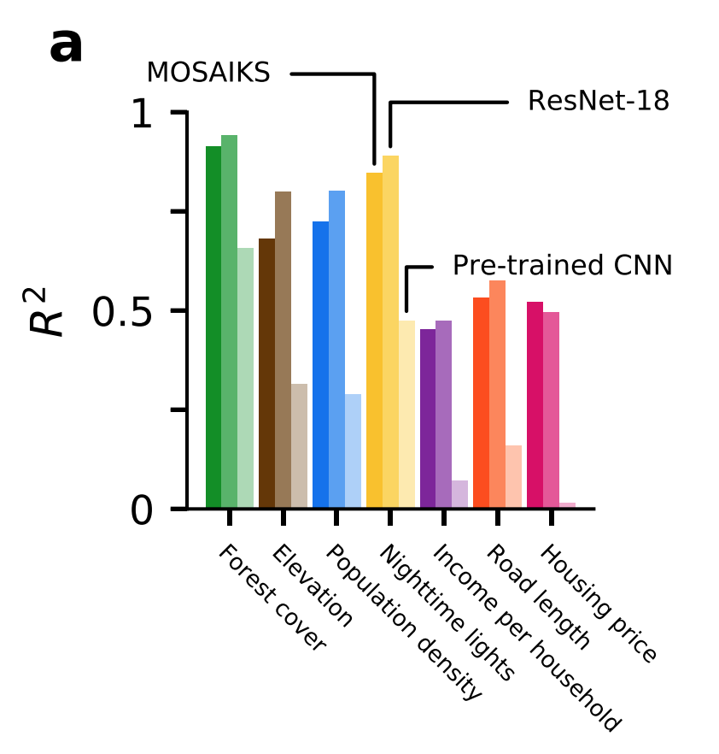
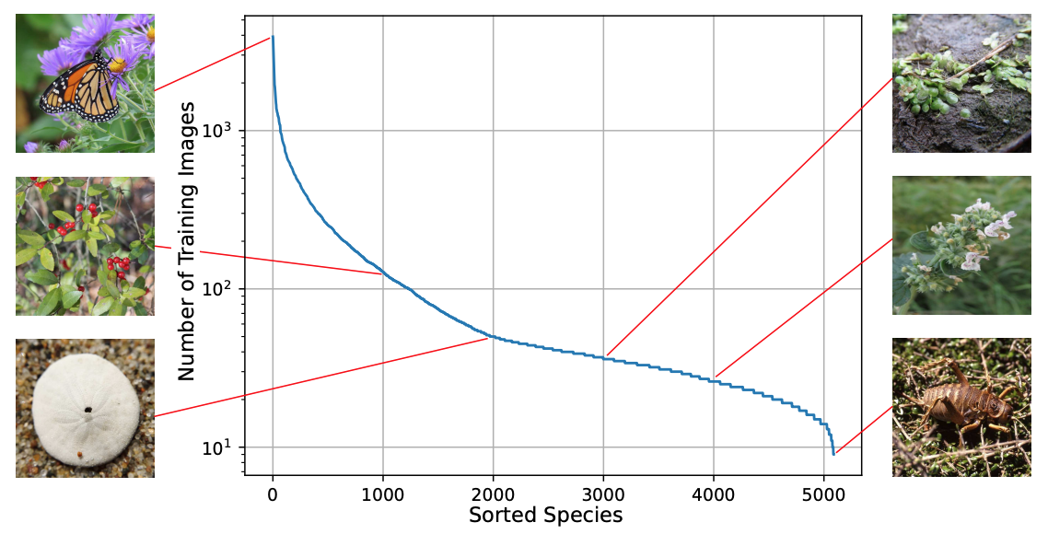
Several notions of generalization
Generalization across tasks
Generalization under concept drift
Generalization from limited data
Notes:
Accelerated experimentation: materials science (solar fuels, construction, ammonia catalysts, CO2 sorbents), nuclear fusion, additive manufacturing for vehicles and construction, batteries, alternative fuels
Remote sensing and automatic monitoring: detecting solar panels, monitoring emissions, gathering transport and infrastructure data, monitoring peatlands, deforestation management, identifying CO2 sequestration locations, ecosystem/biodiversity monitoring, securing food supplies
Improving efficiency: freight consolidation, food waste, predictive maintenance for electricity
Approximating time-intensive simulations: climate models, energy scheduling models, IAMs/multi-objective optimization
Need for interpretable, causal, and gray-box models: forecasting solar, disaster planning, informing policy-makers

Slide 71
Generalization across tasks
Contexts include:
Performing a similar task across geographies or communities, e.g. classifying land cover or predicting power demand
Notes:
Accelerated experimentation: materials science (solar fuels, construction, ammonia catalysts, CO2 sorbents), nuclear fusion, additive manufacturing for vehicles and construction, batteries, alternative fuels
Remote sensing and automatic monitoring: detecting solar panels, monitoring emissions, gathering transport and infrastructure data, monitoring peatlands, deforestation management, identifying CO2 sequestration locations, ecosystem/biodiversity monitoring, securing food supplies
Improving efficiency: freight consolidation, food waste, predictive maintenance for electricity
Approximating time-intensive simulations: climate models, energy scheduling models, IAMs/multi-objective optimization
Need for interpretable, causal, and gray-box models: forecasting solar, disaster planning, informing policy-makers

Slide 72
Generalization across tasks
Contexts include:
Performing a similar task across geographies or communities, e.g. classifying land cover or predicting power demand
Strategies include:
Data embeddings designed for fast transfer to new tasks
Meta-learning algorithms
Notes:
Accelerated experimentation: materials science (solar fuels, construction, ammonia catalysts, CO2 sorbents), nuclear fusion, additive manufacturing for vehicles and construction, batteries, alternative fuels
Remote sensing and automatic monitoring: detecting solar panels, monitoring emissions, gathering transport and infrastructure data, monitoring peatlands, deforestation management, identifying CO2 sequestration locations, ecosystem/biodiversity monitoring, securing food supplies
Improving efficiency: freight consolidation, food waste, predictive maintenance for electricity
Approximating time-intensive simulations: climate models, energy scheduling models, IAMs/multi-objective optimization
Need for interpretable, causal, and gray-box models: forecasting solar, disaster planning, informing policy-makers

Slide 73
Generalization across tasks
Contexts include:
Performing a similar task across geographies or communities, e.g. classifying land cover or predicting power demand
Strategies include:
Data embeddings designed for fast transfer to new tasks
Meta-learning algorithms
Notes:
Accelerated experimentation: materials science (solar fuels, construction, ammonia catalysts, CO2 sorbents), nuclear fusion, additive manufacturing for vehicles and construction, batteries, alternative fuels
Remote sensing and automatic monitoring: detecting solar panels, monitoring emissions, gathering transport and infrastructure data, monitoring peatlands, deforestation management, identifying CO2 sequestration locations, ecosystem/biodiversity monitoring, securing food supplies
Improving efficiency: freight consolidation, food waste, predictive maintenance for electricity
Approximating time-intensive simulations: climate models, energy scheduling models, IAMs/multi-objective optimization
Need for interpretable, causal, and gray-box models: forecasting solar, disaster planning, informing policy-makers

Slide 74
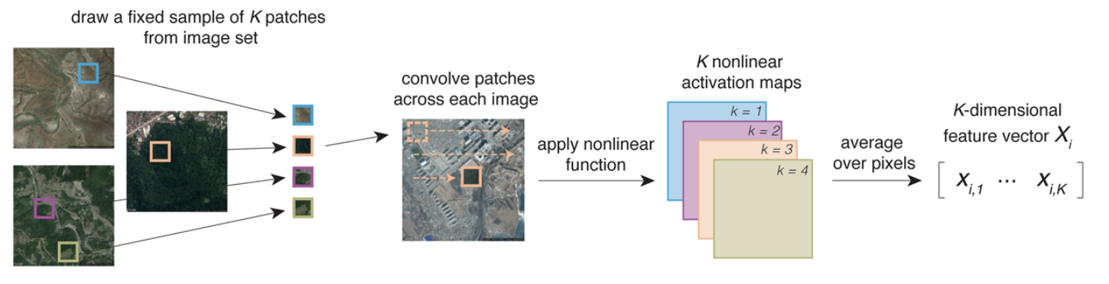
Example: Task-agnostic features for satellite images
Unsupervised featurization of satellite images
MOSAIKS: Convolutional "random kitchen sink," then apply nonlinear function & average over pixels
Ridge regression on features almost matches task-specific ResNets on wide array of tasks
E. Rolf et al., "A generalizable and accessible approach to machine learning with global satellite imagery," Nature Communications 2021.
Notes:
Accelerated experimentation: materials science (solar fuels, construction, ammonia catalysts, CO2 sorbents), nuclear fusion, additive manufacturing for vehicles and construction, batteries, alternative fuels
Remote sensing and automatic monitoring: detecting solar panels, monitoring emissions, gathering transport and infrastructure data, monitoring peatlands, deforestation management, identifying CO2 sequestration locations, ecosystem/biodiversity monitoring, securing food supplies
Improving efficiency: freight consolidation, food waste, predictive maintenance for electricity
Approximating time-intensive simulations: climate models, energy scheduling models, IAMs/multi-objective optimization
Need for interpretable, causal, and gray-box models: forecasting solar, disaster planning, informing policy-makers

Slide 75
Generalization across tasks
Contexts include:
Performing a similar task across geographies or communities, e.g. classifying land cover or predicting power demand
Strategies include:
Data embeddings designed for fast transfer to new tasks
Meta-learning algorithms (see upcoming discussion on TIML)
Notes:
Accelerated experimentation: materials science (solar fuels, construction, ammonia catalysts, CO2 sorbents), nuclear fusion, additive manufacturing for vehicles and construction, batteries, alternative fuels
Remote sensing and automatic monitoring: detecting solar panels, monitoring emissions, gathering transport and infrastructure data, monitoring peatlands, deforestation management, identifying CO2 sequestration locations, ecosystem/biodiversity monitoring, securing food supplies
Improving efficiency: freight consolidation, food waste, predictive maintenance for electricity
Approximating time-intensive simulations: climate models, energy scheduling models, IAMs/multi-objective optimization
Need for interpretable, causal, and gray-box models: forecasting solar, disaster planning, informing policy-makers

Slide 76
Generalization across tasks
Contexts include:
Performing a similar task across geographies or communities, e.g. classifying land cover or predicting power demand
Strategies include:
Data embeddings designed for fast transfer to new tasks
Meta-learning algorithms
Treating tasks separately and ensuring enough data for each
See Birhane et al. "The Values Encoded in Machine Learning Research," FAccT 2022.
Notes:
Accelerated experimentation: materials science (solar fuels, construction, ammonia catalysts, CO2 sorbents), nuclear fusion, additive manufacturing for vehicles and construction, batteries, alternative fuels
Remote sensing and automatic monitoring: detecting solar panels, monitoring emissions, gathering transport and infrastructure data, monitoring peatlands, deforestation management, identifying CO2 sequestration locations, ecosystem/biodiversity monitoring, securing food supplies
Improving efficiency: freight consolidation, food waste, predictive maintenance for electricity
Approximating time-intensive simulations: climate models, energy scheduling models, IAMs/multi-objective optimization
Need for interpretable, causal, and gray-box models: forecasting solar, disaster planning, informing policy-makers

Slide 77
Generalization under concept drift
Contexts include:
Climate & weather data
Things affected by climate change, e.g. mapping crops, assessing species distributions, predicting energy supply
Strategies include:
Physics-informed models that generalize better to new regimes (see also tutorial section: “Research challenges: Physics-informed & robust ML”)
Synthetic data from physics-based simulations
Notes:
Accelerated experimentation: materials science (solar fuels, construction, ammonia catalysts, CO2 sorbents), nuclear fusion, additive manufacturing for vehicles and construction, batteries, alternative fuels
Remote sensing and automatic monitoring: detecting solar panels, monitoring emissions, gathering transport and infrastructure data, monitoring peatlands, deforestation management, identifying CO2 sequestration locations, ecosystem/biodiversity monitoring, securing food supplies
Improving efficiency: freight consolidation, food waste, predictive maintenance for electricity
Approximating time-intensive simulations: climate models, energy scheduling models, IAMs/multi-objective optimization
Need for interpretable, causal, and gray-box models: forecasting solar, disaster planning, informing policy-makers

Slide 78
Generalization from limited data
Contexts include:
Long-tailed data distributions, e.g. identifying species from photos
Rare or extreme events, e.g. predicting wildfires or hurricanes
Strategies include:
Algorithms designed to learn from imbalanced/few-shot data
Unsupervised or self-supervised algorithms for anomaly detection
Notes:
Accelerated experimentation: materials science (solar fuels, construction, ammonia catalysts, CO2 sorbents), nuclear fusion, additive manufacturing for vehicles and construction, batteries, alternative fuels
Remote sensing and automatic monitoring: detecting solar panels, monitoring emissions, gathering transport and infrastructure data, monitoring peatlands, deforestation management, identifying CO2 sequestration locations, ecosystem/biodiversity monitoring, securing food supplies
Improving efficiency: freight consolidation, food waste, predictive maintenance for electricity
Approximating time-intensive simulations: climate models, energy scheduling models, IAMs/multi-objective optimization
Need for interpretable, causal, and gray-box models: forecasting solar, disaster planning, informing policy-makers

Slide 79
Generalization from limited data
Contexts include:
Long-tailed data distributions, e.g. identifying species from photos
Rare or extreme events, e.g. predicting wildfires or hurricanes
Strategies include:
Algorithms designed to learn from imbalanced/few-shot data
Unsupervised or self-supervised algorithms for anomaly detection
Notes:
Accelerated experimentation: materials science (solar fuels, construction, ammonia catalysts, CO2 sorbents), nuclear fusion, additive manufacturing for vehicles and construction, batteries, alternative fuels
Remote sensing and automatic monitoring: detecting solar panels, monitoring emissions, gathering transport and infrastructure data, monitoring peatlands, deforestation management, identifying CO2 sequestration locations, ecosystem/biodiversity monitoring, securing food supplies
Improving efficiency: freight consolidation, food waste, predictive maintenance for electricity
Approximating time-intensive simulations: climate models, energy scheduling models, IAMs/multi-objective optimization
Need for interpretable, causal, and gray-box models: forecasting solar, disaster planning, informing policy-makers

Slide 80
Example: Data from citizen science observations
iNaturalist dataset: citizen-science observations of animals, plants, etc. used to assess changing biodiversity, labeled by domain experts
Fine-grained classification: 859,000 images, 5,000 classes, many very similar
Long tails in distribution from rare or rarely observed species
Benchmark for highly imbalanced visual classification & localization
G. Van Horn et al., "The iNaturalist species classification and detection dataset," CVPR 2018.
Notes:
Accelerated experimentation: materials science (solar fuels, construction, ammonia catalysts, CO2 sorbents), nuclear fusion, additive manufacturing for vehicles and construction, batteries, alternative fuels
Remote sensing and automatic monitoring: detecting solar panels, monitoring emissions, gathering transport and infrastructure data, monitoring peatlands, deforestation management, identifying CO2 sequestration locations, ecosystem/biodiversity monitoring, securing food supplies
Improving efficiency: freight consolidation, food waste, predictive maintenance for electricity
Approximating time-intensive simulations: climate models, energy scheduling models, IAMs/multi-objective optimization
Need for interpretable, causal, and gray-box models: forecasting solar, disaster planning, informing policy-makers

Slide 81
Generalization from limited data
Contexts include:
Long-tailed data distributions, e.g. identifying species from photos
Rare or extreme events, e.g. predicting wildfires or hurricanes
Strategies include:
Algorithms designed to learn from imbalanced/few-shot data
Unsupervised or self-supervised algorithms for anomaly detection
Notes:
Accelerated experimentation: materials science (solar fuels, construction, ammonia catalysts, CO2 sorbents), nuclear fusion, additive manufacturing for vehicles and construction, batteries, alternative fuels
Remote sensing and automatic monitoring: detecting solar panels, monitoring emissions, gathering transport and infrastructure data, monitoring peatlands, deforestation management, identifying CO2 sequestration locations, ecosystem/biodiversity monitoring, securing food supplies
Improving efficiency: freight consolidation, food waste, predictive maintenance for electricity
Approximating time-intensive simulations: climate models, energy scheduling models, IAMs/multi-objective optimization
Need for interpretable, causal, and gray-box models: forecasting solar, disaster planning, informing policy-makers

Slide 82
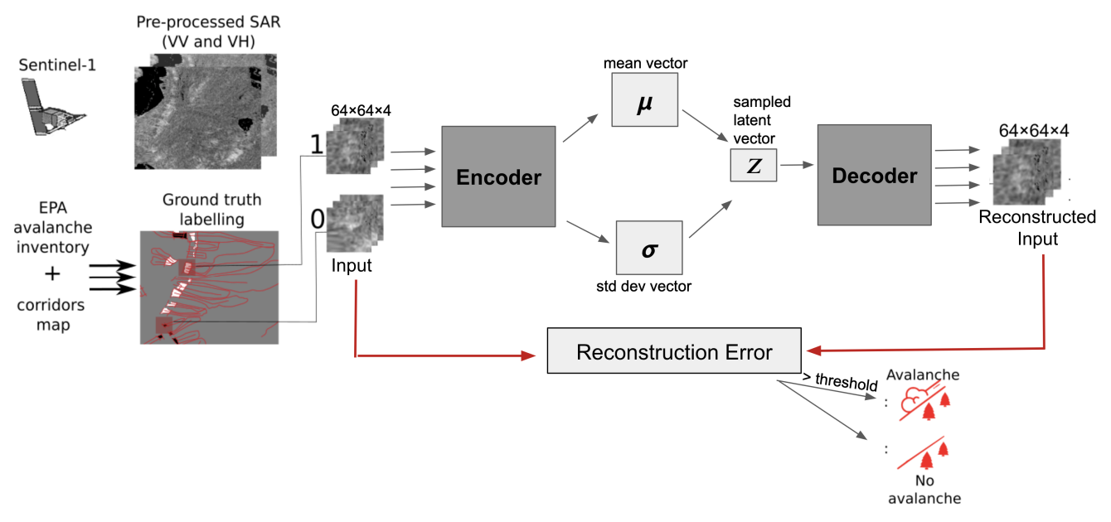
Example: Detecting avalanches using VAEs
Can use VAE reconstruction error to find anomalies, often avalanches
Avalanches are rare events, so few annotated images of them
S. Sinha et al, "Detecting avalanche deposits using variational autoencoder on sentinel-1 satellite imagery," Tackling Climate Change with Machine Learning workshop at NeurIPS 2019.
Notes:
Accelerated experimentation: materials science (solar fuels, construction, ammonia catalysts, CO2 sorbents), nuclear fusion, additive manufacturing for vehicles and construction, batteries, alternative fuels
Remote sensing and automatic monitoring: detecting solar panels, monitoring emissions, gathering transport and infrastructure data, monitoring peatlands, deforestation management, identifying CO2 sequestration locations, ecosystem/biodiversity monitoring, securing food supplies
Improving efficiency: freight consolidation, food waste, predictive maintenance for electricity
Approximating time-intensive simulations: climate models, energy scheduling models, IAMs/multi-objective optimization
Need for interpretable, causal, and gray-box models: forecasting solar, disaster planning, informing policy-makers

Slide 83
Causality and ML
In complicated physical systems, e.g. climate & weather models
Identifying causal relations between variables, e.g. teleconnections
Attributing causes to rare/extreme events
Assessing the strength of relations in a known causal graph
In settings where policy decisions must be made
Predicting optimal interventions under known or inferred causal models
Estimating the causal effect of implemented policies
J. Runge et al., "Inferring causation from time series in Earth system sciences," Nature Communications.
S. Athey. Beyond prediction: "Using big data for policy problems," Science.
Notes:
Accelerated experimentation: materials science (solar fuels, construction, ammonia catalysts, CO2 sorbents), nuclear fusion, additive manufacturing for vehicles and construction, batteries, alternative fuels
Remote sensing and automatic monitoring: detecting solar panels, monitoring emissions, gathering transport and infrastructure data, monitoring peatlands, deforestation management, identifying CO2 sequestration locations, ecosystem/biodiversity monitoring, securing food supplies
Improving efficiency: freight consolidation, food waste, predictive maintenance for electricity
Approximating time-intensive simulations: climate models, energy scheduling models, IAMs/multi-objective optimization
Need for interpretable, causal, and gray-box models: forecasting solar, disaster planning, informing policy-makers

Slide 84
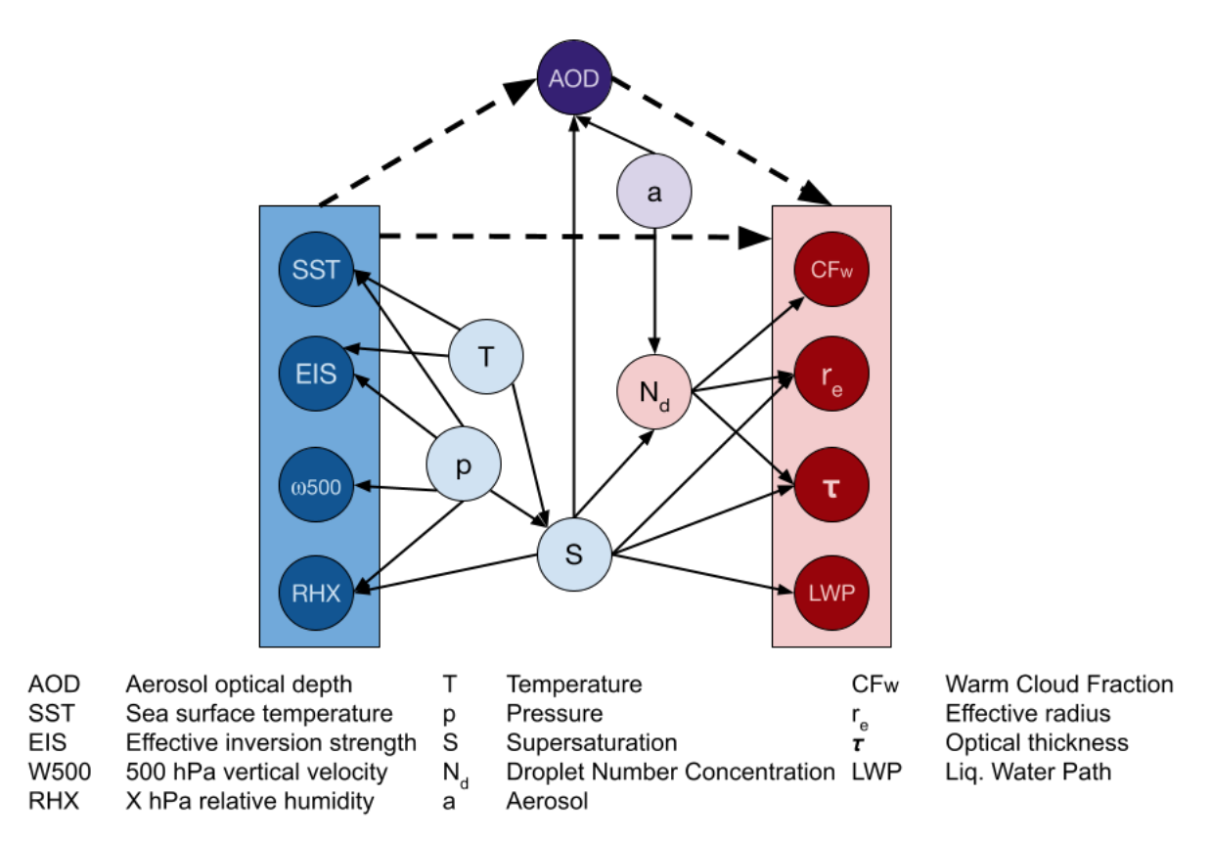
Example: Quantifying aerosol-cloud interactions
Clouds affect the climate and are in turn affected by aerosols in the atmosphere
Causal graph structure for aerosol-cloud interactions is known, but is mediated by the local environment in unknown ways
The Quince deep learning-based causal-effect estimator can predict the strengths of these causal relations from data
A. Jesson et al., "Using non-linear causal models to study aerosol-cloud interactions in the southeast Pacific," Tackling Climate Change with Machine Learning workshop at NeurIPS 2021.
A. Jesson et al., "Quantifying ignorance in individual-level causal-effect estimates under hidden confounding," ICML 2021.
Notes:
Accelerated experimentation: materials science (solar fuels, construction, ammonia catalysts, CO2 sorbents), nuclear fusion, additive manufacturing for vehicles and construction, batteries, alternative fuels
Remote sensing and automatic monitoring: detecting solar panels, monitoring emissions, gathering transport and infrastructure data, monitoring peatlands, deforestation management, identifying CO2 sequestration locations, ecosystem/biodiversity monitoring, securing food supplies
Improving efficiency: freight consolidation, food waste, predictive maintenance for electricity
Approximating time-intensive simulations: climate models, energy scheduling models, IAMs/multi-objective optimization
Need for interpretable, causal, and gray-box models: forecasting solar, disaster planning, informing policy-makers

Slide 85
Takeaways: Generalization and causality
Important climate change applications lead to interesting methodological challenges related to generalization and causality
Generalization-related challenges can arise from geographic variation, nonstationarity, and imbalanced data or rare events
Causality-related challenges can arise in understanding complicated physical systems and in working with policy interventions
Notes:
Accelerated experimentation: materials science (solar fuels, construction, ammonia catalysts, CO2 sorbents), nuclear fusion, additive manufacturing for vehicles and construction, batteries, alternative fuels
Remote sensing and automatic monitoring: detecting solar panels, monitoring emissions, gathering transport and infrastructure data, monitoring peatlands, deforestation management, identifying CO2 sequestration locations, ecosystem/biodiversity monitoring, securing food supplies
Improving efficiency: freight consolidation, food waste, predictive maintenance for electricity
Approximating time-intensive simulations: climate models, energy scheduling models, IAMs/multi-objective optimization
Need for interpretable, causal, and gray-box models: forecasting solar, disaster planning, informing policy-makers

Slide 86
Tutorial outline
Introduction to climate change
Opportunities for ML in climate action
Research challenges
Physics-informed and robust ML
Interpretable ML and uncertainty quantification
Generalization and causality
Example projects
Is ML a help or hindrance for climate action?
Considerations for research and deployment
Takeaways and how to get involved
Notes:
To start, I’m going to talk about physics-informed and robust machine learning.

Slide 87
Opportunities for ML in climate action
Improving operational efficiency
e.g. optimizing HVAC control or steel/cement manufacture
Gathering information
e.g. estimating carbon stock or parsing financial disclosures
Forecasting
e.g. nowcasting electricity supply or predicting demand
Speeding up simulations
e.g. emulating parts of climate models or grid planning models
Accelerating scientific discovery
e.g. suggesting materials for use in batteries and perovskites

Slide 88
Opportunities for ML in climate action
Improving operational efficiency
e.g. optimizing HVAC control or steel/cement manufacture
Gathering information
e.g. estimating carbon stock or parsing financial disclosures
Forecasting
e.g. nowcasting electricity supply or predicting demand
Speeding up simulations
e.g. emulating parts of climate models or grid planning models
Accelerating scientific discovery
e.g. suggesting materials for use in batteries and perovskites

Slide 89
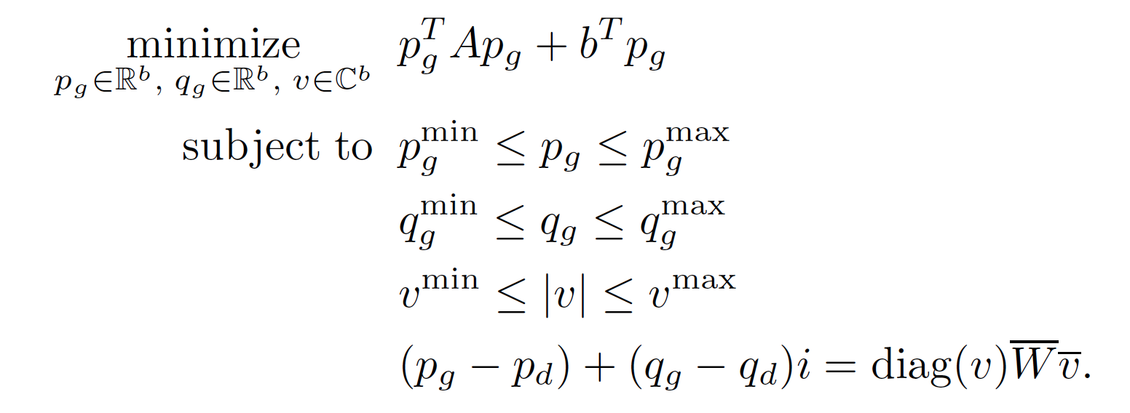
Constrained deep learning for grid optimization
Balancing the electrical grid requires solving a nonconvex opt problem, AC Optimal Power Flow
Exact solutions take too long, so typically grid operators simplify the problem, wasting large amounts of power, especially w/ solar and wind
Typical DL fails (soft penalty for constraint violation), since even slight infeasibility renders useless
We design a DL approach to approximately solve non-convex optimization problems while satisfying hard constraints
P. Donti, D. Rolnick, Z. Kolter, DC3: A learning method for optimization with hard constraints, ICLR 2021.

Slide 90



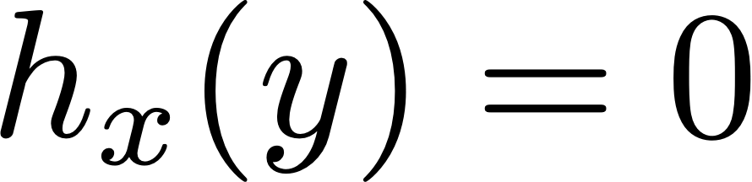
Approximate optimization w/ hard constraints
Goal: Approximate mapping from $x$ to $y$, while satisfying constraints

Slide 91

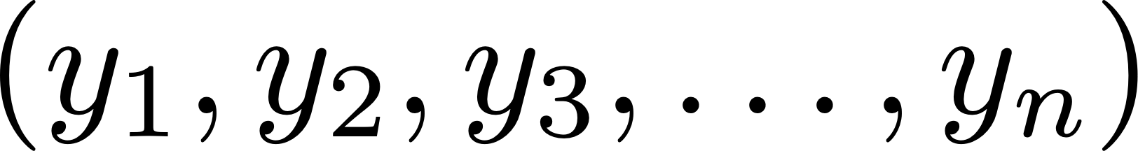


DC3: Deep Constraint Completion & Correction
Loss
Output
Input x
correction
( ≤ )
completion
( = )
neural
network
P. Donti, D. Rolnick, J.Z. Kolter, DC3: A learning method for optimization with hard constraints, ICLR 2021.

Slide 92
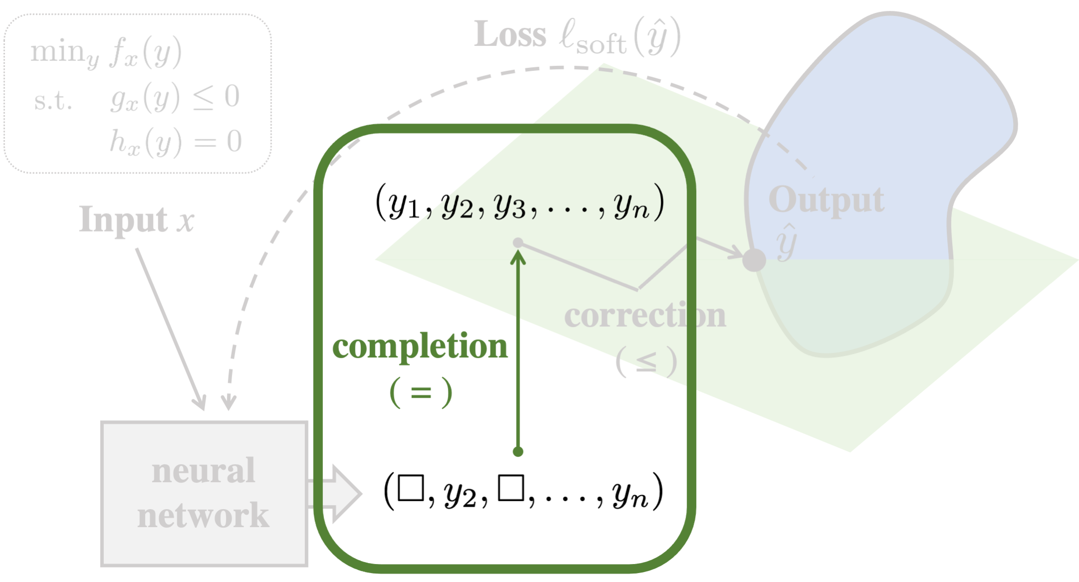

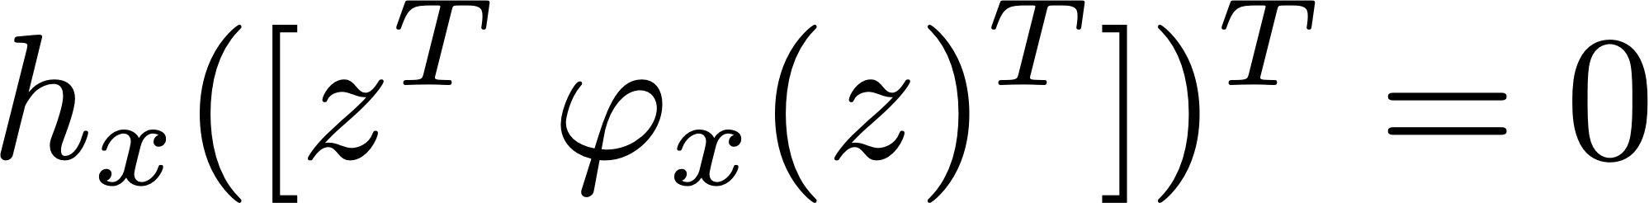

Equality completion
Output subset of variables
Then solve for rest:
where
s.t.
Procedure is differentiable (either explicitly or via implicit function thm)
P. Donti, D. Rolnick, J.Z. Kolter, DC3: A learning method for optimization with hard constraints, ICLR 2021.

Slide 93
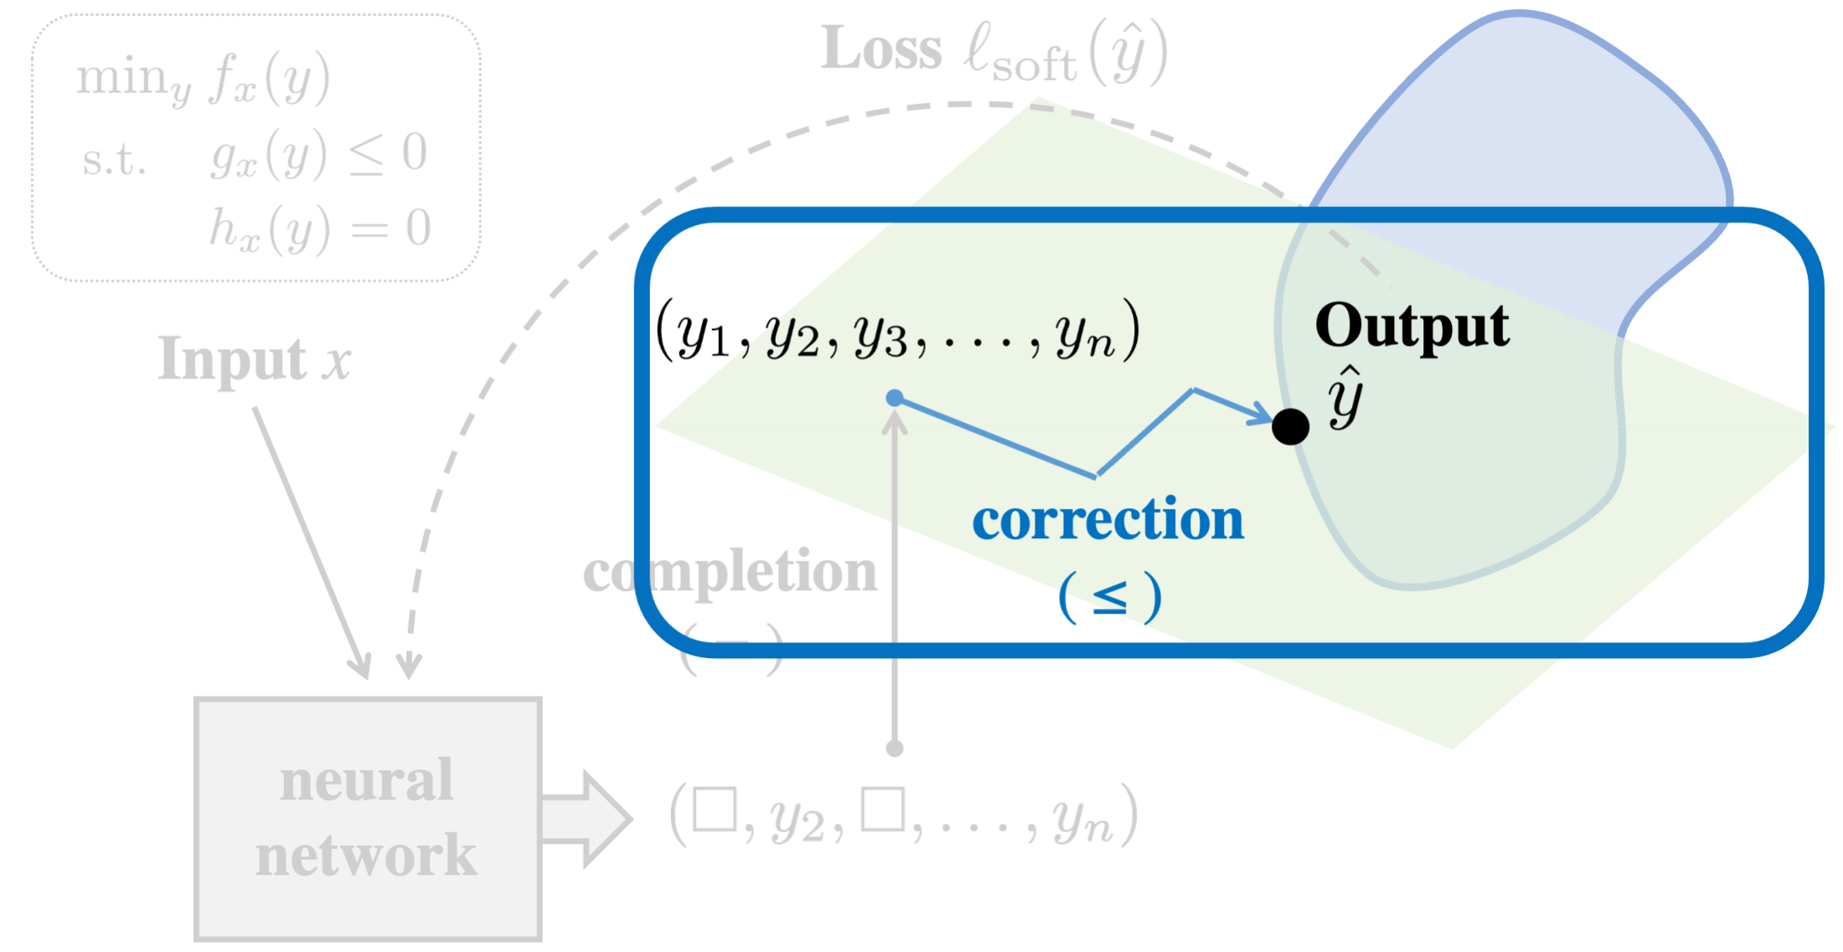
Inequality correction
Gradient steps along manifold defined by equality constraints:
P. Donti, D. Rolnick, J.Z. Kolter, DC3: A learning method for optimization with hard constraints, ICLR 2021.

Slide 94
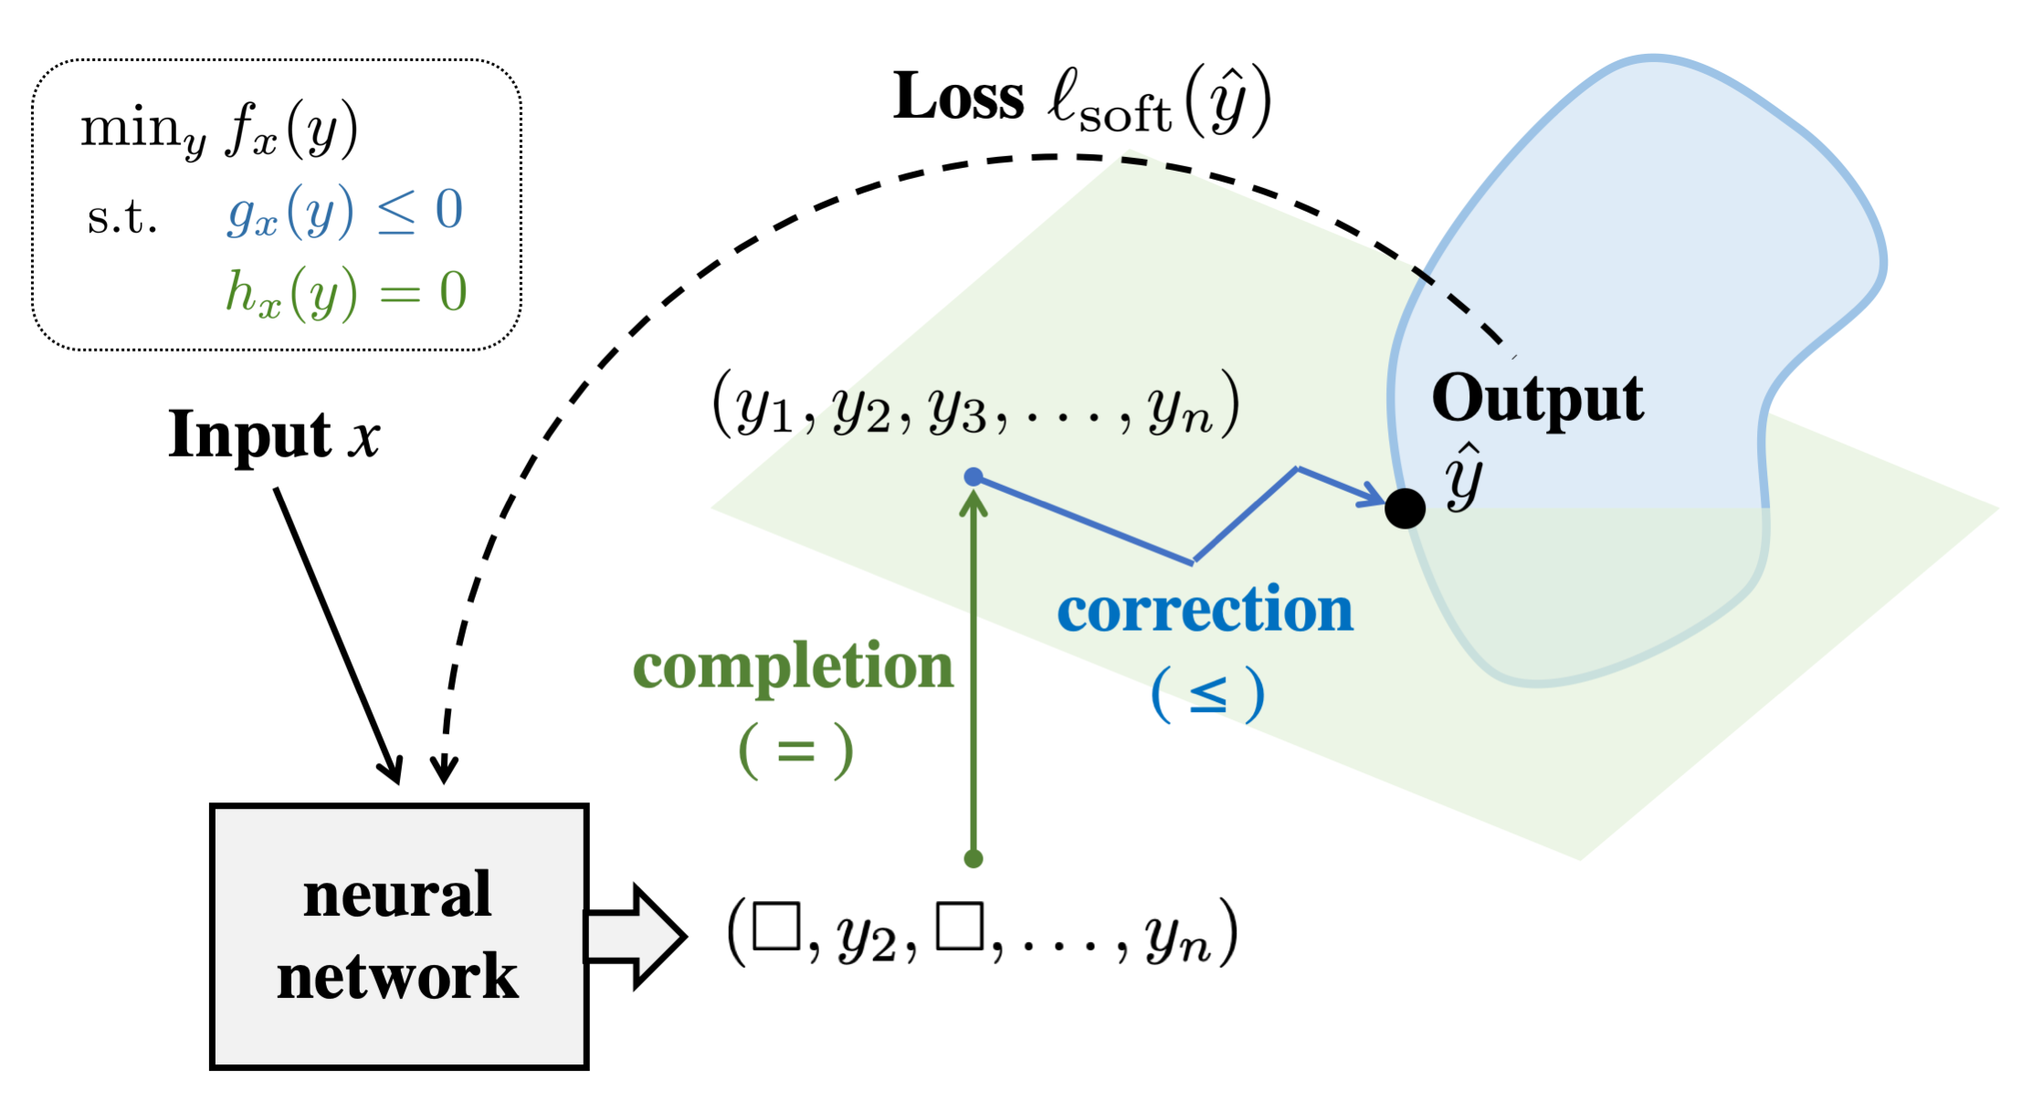
End-to-end training with soft loss
Loss
Output
Input x
correction
( ≤ )
completion
( = )
neural
network
P. Donti, D. Rolnick, J.Z. Kolter, DC3: A learning method for optimization with hard constraints, ICLR 2021.

Slide 95
DC3: Deep Constraint Completion & Correction
Loss
Output
Input x
correction
( ≤ )
completion
( = )
neural
network
P. Donti, D. Rolnick, J.Z. Kolter, DC3: A learning method for optimization with hard constraints, ICLR 2021.

Slide 96
Performance on AC Optimal Power Flow
Satisfies all constraints (unlike other DL methods)
10x faster than optimizer, 0.22% optimality gap
and even faster in practice thanks to GPU parallelization
P. Donti, D. Rolnick, J.Z. Kolter, DC3: A learning method for optimization with hard constraints, ICLR 2021.

Slide 97
Opportunities for ML in climate action
Improving operational efficiency
e.g. optimizing HVAC control or steel/cement manufacture
Gathering information
e.g. estimating carbon stock or parsing financial disclosures
Forecasting
e.g. nowcasting electricity supply or predicting demand
Speeding up simulations
e.g. emulating parts of climate models or grid planning models
Accelerating scientific discovery
e.g. suggesting materials for use in batteries and perovskites

Slide 98


Remote sensing for agriculture
Mapping crops & forecasting yield are essential to averting food insecurity under climate change.
But agricultural data are sparse & imbalanced across crops & locations.
We develop meta-learning algorithms for remote sensing that label crops & predict yield, while generalizing fast to new locations.
Gabriel Tseng, Hannah Kerner, David Rolnick, TIML: Task-Informed Meta-Learning for agriculture, preprint arXiv 2202.02124.

Slide 99
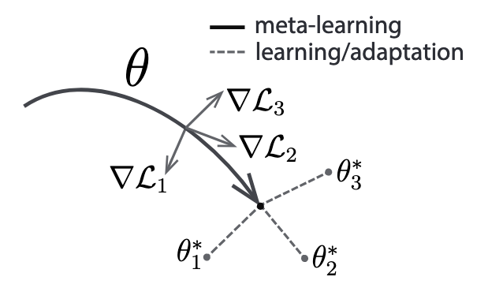
Background on meta-learning
Meta-learning refers to learning in such a way that the model can quickly adapt to a new task with new data
Model-agnostic meta-learning (MAML) is a popular framework in which a neural network is trained specifically to maximize the effectiveness of gradient updates on new tasks
MAML is a training paradigm so can run across network architectures and tasks
Figure from Finn et al. 2017

Slide 100

Task-informed meta-learning
Task-informed meta-learning (TIML) can be added to a meta-learning framework (e.g. MAML)
1. Learned task encoder: auxiliary network uses task metadata (e.g. lat-long, crop type) to modulate hidden representations in meta-learner
2. Forgetfulness: tasks that the model memorizes (performs almost perfectly on) dropped from training to enhance generalization in other regimes
Gabriel Tseng, Hannah Kerner, David Rolnick, TIML: Task-Informed Meta-Learning for agriculture, preprint arXiv 2202.02124.

Slide 101

Performance on crop type classification

Slide 102
Performance on crop type classification

Slide 103


Effect of training set size

Slide 104

Performance on crop yield prediction

Slide 105
Opportunities for ML in climate action
Improving operational efficiency
e.g. optimizing HVAC control or steel/cement manufacture
Gathering information
e.g. estimating carbon stock or parsing financial disclosures
Forecasting
e.g. nowcasting electricity supply or predicting demand
Speeding up simulations
e.g. emulating parts of climate models or grid planning models
Accelerating scientific discovery
e.g. suggesting materials for use in batteries and perovskites

Slide 106

Meaningful representations of remote-sensing data
Agriculture, forest management, and many other climate-relevant applications of ML involve remote sensing from satellite imagery
Algorithms have often used computer vision methods developed/pretrained on natural images
But such methods are often (1) not generalizable, (2) computationally intensive, (3) sensor-specific
G. Tseng, I. Zvonkov, M. Purohit, David Rolnick, H. Kerner, Lightweight, Pre-trained Transformers for Remote Sensing Timeseries, preprint arXiv:2304.14065.

Slide 107

Pretrained Transformers for Remote Sensing Timeseries (Presto)
Insight: Not same as natural images, temporal / multimodal data structure
Training:
Inference: Regression / random forest on encoding for each input pixel
Average pixel-wise predictions over entire input image

Slide 108


Evaluation of Presto
Varying number of input channels and timesteps
Variety of training-set sizes (from very small to very large)
Variety of task types
Variety of geographies
Presto outperforms larger models on data modalities it was not trained on

Slide 109




Evaluation of Presto
TreeSat
EuroSAT

Slide 110
Opportunities for ML in climate action
Improving operational efficiency
e.g. optimizing HVAC control or steel/cement manufacture
Gathering information
e.g. estimating carbon stock or parsing financial disclosures
Forecasting
e.g. nowcasting electricity supply or predicting demand
Speeding up simulations
e.g. emulating parts of climate models or grid planning models
Accelerating scientific discovery
e.g. suggesting materials for use in batteries and perovskites

Slide 111



Machine learning for super-resolving climate data
Accurate climate predictions are vital in responding to climate change and motivating emissions reduction
Physics-based climate models are very accurate but computationally intensive
This means predictions may be very coarse-grained, e.g. resolution of hundreds of km, making local responses hard
ML can help by downscaling (= super-resolving) a low-resolution prediction into a high-resolution one
Q. Yang, A. Hernandez-Garcia, P. Harder, V. Ramesh, P. Sattegeri, D. Szwarcman, C.D. Watson, D. Rolnick, “Fourier Neural Operators for arbitrary resolution climate data downscaling”, preprint arXiv:2305.14452.
P. Harder, Q. Yang, V. Ramesh, P. Sattigeri, A. Hernandez-Garcia, C. Watson, D. Szwarcman, D. Rolnick, “Generating physically-consistent high-resolution climate data with hard-constrained neural networks”, preprint arXiv:2208.05424.

Slide 112



Downscaling with conservation laws
Physics-based conservation laws: Mass, energy, momentum
If pixel in low-res image subdivided, then subpixel values should sum / average to original value
Useful to improve accuracy and enforce plausibility
Hard constraint with softmax to normalize outputs + ensure positivity
Low-res water mass
High-res
water mass

Slide 113
Downscaling at arbitrary resolution
A functional operator is a map between functions
One can consider an image as a discretization of a function – the function is the “infinite-resolution” version of the image
Fourier neural operators (FNOs) use a neural network to parameterize a functional operator by working with coefficients in the Fourier domain
Have been used to learn “infinite-resolution” solutions to differential eqns such as Navier-Stokes, Fourier domain well-suited to processes like fluid flow, climate & weather patterns
We adapt the FNO framework to downscaling: input = low-res image, output = “infinite-res” image
Can perform arbitrarily high-resolution downscaling
We find also improves upon standard fixed-res downscaling, as well as the original FNO paper

Slide 114


Results
ERA5 reanalysis data Total column water
Global, hourly, ~25 km resolution
Navier-Stokes eqn. viscous, incompressible fluid in vorticity form (original FNO problem)

Slide 115
Opportunities for ML in climate action
Improving operational efficiency
e.g. optimizing HVAC control or steel/cement manufacture
Gathering information
e.g. estimating carbon stock or parsing financial disclosures
Forecasting
e.g. nowcasting electricity supply or predicting demand
Speeding up simulations
e.g. emulating parts of climate models or grid planning models
Accelerating scientific discovery
e.g. suggesting materials for use in batteries and perovskites

Slide 116




Graph neural networks to evaluate electrocatalysts
Currently fossil fuels are required for many settings in heavy industry and transportation.
Electrocatalysts can allow low-carbon electricity to be used in place of fossil fuels or converted into hydrogen or other electrofuels
However, simulations using Density Functional Theory (DFT) are computationally expensive, so ML is increasingly being used
Currently SoTA methods use graph neural networks (GNNs), but remain somewhat time-intensive, limiting their utility in evaluating the combinatorially large space of candidate catalysts
Main site: https://opencatalystproject.org/ See also: Chanussot et. al, 2020
A. Duval, V. Schmidt, A. Hernández-García, F.D. Malliaros, Y. Bengio, S. Miret, D. Rolnick, FAENet: Frame Averaging Equivariant GNN for materials modelling, International Conference on Machine Learning (ICML) 2023.
A. Duval, V. Schmidt, A. Hernández-García, S. Miret, Y. Bengio, D. Rolnick, PhAST: Physics-Aware, Scalable, and Task-specific GNNs for accelerated catalyst design, preprint arXiv:2211.12020.

Slide 117


Invariance / equivariance
Challenge in GNNs for materials modeling: Same configuration may occur with rotation or translation, want the model to be able to ignore this.
Invariance means output preserved under transformation of input (e.g. predicting energy), equivariance means when input is transformed, the output changes too (e.g. with forces)
Common solution: transform inputs so they don’t depend on the spatial orientation, e.g. radial / Bessel basis functions, Clebsch-Gordan tensor product
However, can be (i) computationally expensive, (ii) hard to understand, (iii) limiting for the model architecture
Instead, we can outsource equivariance to the data
One can always make a function equivariant via symmetrization:
Frame averaging (FA) is a cheaper way when the group G of transformations is infinite – instead, can symmetrize by choosing specific “frames” to represent the group (Puny et. al, 2022)
We introduce a FA-based architecture that provably retains invariance/equivariance, while allowing us to directly pass useful directional information between input atoms. Stochastic FA speeds up still further.

Slide 118


Accuracy-scalability tradeoff
Open Catalyst dataset
QM9 dataset

Slide 119
Opportunities for ML in climate action
Improving operational efficiency
e.g. optimizing HVAC control or steel/cement manufacture
Gathering information
e.g. estimating carbon stock or parsing financial disclosures
Forecasting
e.g. nowcasting electricity supply or predicting demand
Speeding up simulations
e.g. emulating parts of climate models or grid planning models
Accelerating scientific discovery
e.g. suggesting materials for use in batteries and perovskites

Slide 120





Analysis of implicit design of ML tools
ML continues to rely on benchmarks like ImageNet-1k to evaluate models and pre-train for applied settings.
Such benchmarks are often derived from Internet data, chosen & labeled without relevant experts in the room.
Example: We worked with ecologists to analyze the 27% of ImageNet-1k that is wild animals.
12% of the images are wrong, 12% of categories are contradictory.
Species heavily biased towards United States.
Exemplary of ML innovations developed without stakeholders relevant to societal impact.
Alexandra Sasha Luccioni and David Rolnick, Bugs in the Data: How ImageNet Misrepresents Biodiversity, AAAI 2023.

Slide 121
Tutorial outline
Introduction to climate change
Opportunities for ML in climate action
Research challenges
Physics-informed and robust ML
Interpretable ML and uncertainty quantification
Generalization and causality
Example projects
Is ML a help or hindrance for climate action?
Considerations for research and deployment
Takeaways and how to get involved
What is ML’s carbon footprint?
What can one do to shape the overall impact?
Notes:
This part of the tutorial will explore in which way ML is a help or hindrance for climate action
We will discuss how to think about measuring the carbon footprint of ML
And what everyone can do to shape the overall impact of ML

Slide 122
ML’s carbon footprint
ML applications in climate change mitigation
Emissions from ML computation & hardware
ML’s system-level impacts
ML applications that increase emissions
Kaack, L. H., Donti, P. L., Strubell, E., Kamiya, G., Creutzig, F., & Rolnick, D. (2022). Aligning artificial intelligence with climate change mitigation. Nature Climate Change, 1-10.
122
Notes:
Script:
We've talked so far about how ML can help with addressing climate change. But are there also ways that ML can potentially hurt the climate?
Many of you have probably thought about the computational emissions from ML – while this a problem it is not the only way that ML can increase emissions
ML is a multi-purpose technology and can be applied in ways that decrease or increase emissions
And lastly, ML interacts with the larger, technological, social and economic system in ways that can help or hinder climate change mitigation
This is part, we will talk about all of these aspects in more detail to understand how ML affects emissions
And in an earlier part of this tutorial, we learned about how ML can be applied to help mitigate climate change by reducing emissions

Slide 123
ML’s carbon footprint
ML applications in climate change mitigation
Emissions from ML computation & hardware
ML’s system-level impacts
ML applications that increase emissions
Kaack, L. H., Donti, P. L., Strubell, E., Kamiya, G., Creutzig, F., & Rolnick, D. (2022). Aligning artificial intelligence with climate change mitigation. Nature Climate Change, 1-10.
123
Notes:
So let’s start with the emissions from ML computation and hardware

Slide 124

Emissions from ML computation
Dodge, J., Prewitt, T., Tachet des Combes, R., Odmark, E., Schwartz, R., Strubell, E., ... & Buchanan, W. (2022, June). Measuring the Carbon Intensity of AI in Cloud Instances. In 2022 ACM Conference on Fairness, Accountability, and Transparency (pp. 1877-1894).
Notes:
Script:
Emissions from ML training differ significantly between model types, and depend on whether a model is fine-tuned or trained from scratch.
This graphic from a recent paper illustrates how large the CO2 emissions are from training different models and compares those to the emissions from other typical activities such as driving a car for a mile.
Notice the log-scale: The most energy-intensive model here with 6 Billion parameters emits as much as powering a typical home for a year.
On the other side, fine-tuning BERT, a common activity in practice, compares to consuming less than a liter of gasoline
The size of the model matters a lot for how much energy is consumed for training (see example of the Vision Transformer)
What the authors measure here are operational emissions….
______
Notes:
https://huggingface.co/EleutherAI/gpt-j-6B
https://huggingface.co/EleutherAI/gpt-j-6B

Slide 125





Impacts from ML computation & hardware
Efficient compute, cooling, and waste heat use
Operational emissions from energy consumed during computation
Renewable energy and demand flexibility
Embodied emissions from production and end-of-life of hardware
Mining and production
Transportation
Disposal and recycling
Notes:
Script:
…which come from the energy consumed while running the algorithm on the hardware. They depend on
The energy efficiency. Data center efficiency can be improved with more efficient hardware, better cooling, or the use of waste heat for heating homes
The type of electricity used. Using renewable energy improves the carbon footprint considerably. Data centers also have the opportunity help integrate more renewable energy into the grid by providing a load that is flexible
You may wonder if there is even a need for energy efficiency if a data centers uses 100% renewables: The answer is a clear yes - think about all the other stuff that low-carbon electricity could productively do if not consumed wastefully in a data center.
But operational emissions are not the only part. There are embodied emissions too. As hardware becomes more efficient, the “embodied emissions” also may become more important. What do we mean by that?
Producing computer hardware also emits greenhouse gas emissions. For example through
Mining, manufacturing
Transportation
Or disposing of unused hardware.
This last picture illustrates how important are also other environmental and social impacts from hardware
Currently data center infrastructure is replaced fast as new and more efficient hardware becomes available. There is clearly a trade-off between operational efficiency and embodied emissions, so replacing hardware fast may not always be the best strategy.
Now let’s come back to the issue of how to measure computing-related emissions from ML as a whole
Notes:
https://anatomyof.ai/img/ai-anatomy-map.pdf
https://www.flickr.com/photos/peteropaliu/5053727771
https://www.flickr.com/photos/fairphone/12830951233

Slide 126

Computing-related emissions from ML
Kaack, L. H., Donti, P. L., Strubell, E., Kamiya, G., Creutzig, F., & Rolnick, D. (2022). Aligning artificial intelligence with climate change mitigation. Nature Climate Change, 1-10.
Notes:
This figure illustrates in an abstract way how one can think about the energy consumption during different life-cycle phases of the algorithm
As you may all know, developing an algorithm is most energy intensive – but also not done very often in practice
In contrast, performing inference on a single data point is not very energy-intensive but depending on the application can happen billions of times a day
That energy adds up: Google and Facebook report that their energy consumption from inference is larger than from training and development
In addition to the energy consumption of training an individual model, what matters as well is the frequency and use patterns in practice

Slide 127
Computing-related emissions from ML
Kaack, L. H., Donti, P. L., Strubell, E., Kamiya, G., Creutzig, F., & Rolnick, D. (2022). Aligning artificial intelligence with climate change mitigation. Nature Climate Change, 1-10.
Notes:
To assess the overall compute-related energy consumption of ML, one can also take a top-down perspective
Information and communication technologies account for around 1 to 2% of global GHG emissions of which only a part is due to AI.
Unfortunately we don’t know how many loads on data centers can be attributed to ML and therefore don’t understand how large the AI-related part is, and how it is developing over time

Slide 128
ML’s carbon footprint
ML applications in climate change mitigation
Emissions from ML computation & hardware
ML’s system-level impacts
ML applications that increase emissions
Kaack, L. H., Donti, P. L., Strubell, E., Kamiya, G., Creutzig, F., & Rolnick, D. (2022). Aligning artificial intelligence with climate change mitigation. Nature Climate Change, 1-10.
128
Notes:
So let’s take another look at the application impacts of ML

Slide 129

Immediate application impacts
See tutorial section “Opportunities for ML in climate action”
Kaack, L. H., Donti, P. L., Strubell, E., Kamiya, G., Creutzig, F., & Rolnick, D. (2022). Aligning artificial intelligence with climate change mitigation. Nature Climate Change, 1-10.
Notes:
Script:
Earlier in this tutorial, we learnt about the different ways ML can be used to reduce emissions, which are summarized in this figure
As indicated by the red bubble, ML can also increase emissions, for example if it is applied in the oil and gas sector to improve exploration and therefore helps increase the amount oil or gas that is extracted
Currently, there don’t exist standard ways to measure such application-related impacts of ML.
While for single case studies that may be quite easy to assess, such as for energy efficiency measures, for other application areas that is much more difficult (for example for battery R&D)

Slide 130

AI applications increasing emissions
AI use in emissions-intensive industries (e.g., oil and gas)
Example: Oil and gas applications
AI has boosted production levels in some cases by as much as 5%
AI could generate $425 billion in value for oil and gas sector by 2025
Notes:
For instance, a recent report detailed ways in which large tech companies are using AI to help oil and gas companies identify and model extraction sites; optimize pipelines to expand fossil fuel transportation and storage capabilities; improve refining processes; and facilitate the marketing and sale of fossil fuel-derived products [Greenpeace 2020]

Slide 131
ML’s carbon footprint
ML applications in climate change mitigation
Emissions from ML computation & hardware
ML’s system-level impacts
ML applications that increase emissions
Kaack, L. H., Donti, P. L., Strubell, E., Kamiya, G., Creutzig, F., & Rolnick, D. (2022). Aligning artificial intelligence with climate change mitigation. Nature Climate Change, 1-10.
131
Notes:
And this is what we mean with this last point of ML’s system level impacts

Slide 132
System-level impacts of ML
Rebound effects | Reducing energy consumption reduces costs → money saved may be used and cause more emissions Example: ML for optimizing systems
Lock-in and path dependency | Technologies compete and dominate → lock-in to suboptimal technologies hampering decarbonization Example: Autonomous driving and car use
Consumer behavior | Trends and advertising may change consumption patterns → embodied emissions in those products Example: ML in advertising and social media
Communication and education | Societal support for climate action essential Example: ML on social media
Notes:
Script:
Such system-level effects can be for example something called rebound effects, …. [explain], some aspect of this will likely happen also if we reduce costs in refineries
The next example refers to lock-in effects, technologies compete…., when oil refining and oil products are made cheaper, we are at risk of remaining locked into oil products. Another example of this may occur with AVs, that can lock us into individualized and energy-intensive driving
[consumer behavior]
Communication and education-related effects could for example lead to increased polarization, and opposition to climate policies. ML can contribute to the spread of misinformation and amplifying controversy, for example on social media.

Slide 133
ML’s carbon footprint
ML applications in climate change mitigation
Emissions from ML computation & hardware
ML’s system-level impacts
ML applications that increase emissions
Kaack, L. H., Donti, P. L., Strubell, E., Kamiya, G., Creutzig, F., & Rolnick, D. (2022). Aligning artificial intelligence with climate change mitigation. Nature Climate Change, 1-10.
133
Notes:
Script:
So to recap, the major categories of ways that ML affects emissions its through it’s computation and hardware, the immediate impacts of its applications (both good and bad), and the system-wide changes that ML induces.

Slide 134

Overall framework
Kaack, L. H., Donti, P. L., Strubell, E., Kamiya, G., Creutzig, F., & Rolnick, D. (2022). Aligning artificial intelligence with climate change mitigation. Nature Climate Change, 1-10.
Notes:
Script:
in a recent paper as a framework for impact assessment with three levels of impacts.
The framework that is intended to help researchers and practitioners develop better impact assessment for ML

Slide 135
Takeaways: Climate change impacts of ML
Computing-related:
Measure your footprint with tools such as ML CO2 Impact, Carbontracker, CodeCarbon, or tools specifically for Azure or Hugging Face
Reduce your impacts by choosing more efficient models, and reducing wasteful model retraining and execution
Application-related:
Quantify and evaluate the application impacts where possible
Be transparent about impacts in publications and with stakeholders (quantitatively and qualitatively)
Shape the impacts through your work
Notes:
Script:
Measure….
Reduce your impact by choosing more efficient models (such as DistillBert instead of Bert), and reducing wasteful model retraining and execution
…

Slide 136
Takeaways: Climate change impacts of ML
Consider the system-level impacts of your work:
All ML applications may potentially have an effect on the climate (e.g. recommender systems)
Choose what you (or the ML community) works on
Bring climate considerations into how you build an application
Initiate company-wide policies such as internal carbon pricing or conditions on the projects or products realized
Don’t forget about other social and other environmental impacts

Slide 137
Tutorial outline
Introduction to climate change
Opportunities for ML in climate action
Research challenges
Physics-informed and robust ML
Interpretable ML and uncertainty quantification
Generalization and causality
Example projects
Is ML a help or hindrance for climate action?
Considerations for research and deployment
Takeaways and how to get involved
Considerations for ML-for-climate
Considerations for ML as a whole
Notes:
Having talked about these different intersections of ML and climate change, I now want to turn to some important considerations for research and deployment.

Slide 138
ML-for-climate: Pathway to impact
Domain identification
Project scoping
Development
Analysis
Deployment
Downstream effects
Not an “easy benchmark” field...
Other tools
... but yields many opportunities to ask important & novel research questions
Dataset/Env
ML
Notes:
When working on ML for climate action, it’s important to understand the broader “pathway to impact” in which the ML work is situated.
In particular, it’s necessary to scope the problem, understand what other tools and approaches already exist, and understand how the ML (if it’s needed at all) will interact with these existing tools and approaches.
Downstream from the ML, it’s important to understand how the solution will be analyzed and deployed, and what potential other consequences or side-effects it may also have - in terms of things like rebound effects, equity impacts, and so forth - and to incorporate these considerations when developing algorithms in the first place.
What this means in practice is that ML-for-climate isn’t, in some sense, a field where the lion’s share of problems will be solved by picking up a benchmark and running with it (though of course, benchmarks are a great way to get one’s feet wet).
It’s a field where the process of understanding the problems and the domain, and going through the process of gathering data and setting up the problem yourself, is extremely important.
While this can be a lot of work, ultimately, this kind of domain understanding can yield a lot of insights and opportunities to ask important and novel research questions that others may not be asking - that is, it can lead to a lot of really interesting directions for ML research.
These include, but aren’t limited to, some of the directions we covered earlier in this tutorial.

Slide 139
Developing data, simulators, and metrics
Data: Collection, annotation, collation, inference, and/or licensing
Note: “Data” can mean different things to different communities
Simulators: Needed for innovations in physical domains
E.g., power systems, transport, buildings, heavy industry
Evaluation metrics: Need agreement and iteration from ML researchers, domain researchers, deployers, and other affected stakeholders
Resources and venues
CCAI dataset wishlist (www.climatechange.ai/dataset-wishlist.pdf)
Lacuna Fund funding for climate datasets
NeurIPS Datasets and Benchmarks track
Notes:
A part of developing this domain understanding involves getting a sense of what data, simulators, and evaluation metrics may already exist, as well as what needs to be created.
On the data side, “creating data” can entail different kinds of things, depending on what’s available - data collection, but also annotation or collation, inferring information from proxies, or even just figuring out how to properly license data that already exist.
It’s worth noting here that different communities have very different notions of what “data” or a “dataset” look like, so it’s important to work together and calibrate expectations in this respect.
In addition to static datasets, simulators or test beds are particularly important for control and optimization problems on physical domains like power grids, buildings, and heavy industry.
And then importantly, evaluation metrics are key.
These metrics should cover what it means for the method to directly be successful, but also measure potential side-effects, negative consequences, or other factors needed to holistically understand the solution.
Developing good metrics requires involvement from multiple kinds of stakeholders, as well as consistent re-evaluation to make sure the metrics continue to make sense.
A few resources I’ll point out here include the Climate Change AI dataset wishlist, which poses different kinds of datasets it could be useful to create;
entities like the Lacuna Fund, which provide funding for dataset creation particularly in low- and middle-income contexts;
and the NeurIPS Datasets and Benchmarks track, which is a potential venue to publish and disseminate datasets to spur further work.

Slide 140
Responsible AI for climate action
Mitigating biases in data and models
E.g., buildings data: Housing discrimination, geographic disparities in availability
E.g., weather models: Calibration may be optimized for particular regions
Improving trustworthiness and accountability
Safety and robustness: Critical in, e.g., power systems and industrial operations
Interpretability and auditability: Critical in, e.g., policymaking contexts
Centering equity and climate justice
Centering diverse stakeholders: E.g., industrial ag vs. smallholder farmers
Avoiding centralization: Democratized capacity and compute, digital divide
Avoiding digital colonialism: E.g., smart meters, analysis of remote sensing data
Notes:
When developing data, metrics, and algorithms, the broader conversation on responsible AI is also very applicable, and can play out in important ways in climate change contexts.
For instance, there are many places where data and algorithms can create or perpetuate bias.
For instance, when working to pinpoint ways to make buildings more efficient, it’s important to understand how factors like housing discrimination and generational wealth have affected the current state of which buildings are efficient.
Data on buildings is also unevenly available across geographies, which can potentially bias interventions.
Modeling choices can also perpetuate bias - for instance, physics-based weather models are often calibrated based on observational data, and the choice of calibration data affects who the model performs well for.
In addition to bias, trustworthiness and accountability are also important considerations - some aspects of which we discussed earlier in this tutorial.
And then equity considerations are of course extremely important, considering the intersection of responsible AI and climate justice.
Important actions in this area include centering diverse stakeholders - for instance not just working with wealthy industrial agriculture stakeholders, but also smallholder farmers.
Ensuring that ML capacity, compute, expertise, and access are not just concentrated within a few institutions and geographies, but making sure they’re democratized so a broad set of stakeholders can participate in and benefit from ML-for-climate work.
And avoiding digital colonialism, which is when those in developed countries use data from developing countries with little involvement from or benefit for the populations whose data are being used -
for instance, by exploiting differences in privacy regulations around personal energy usage data, or by analyzing satellite imagery from afar without deeply engaging local populations.

Slide 141

Importance of stakeholder engagement
Stakeholder types (e.g.)
Researchers (tech & social sciences)
Implementing entities and industries
End users
Policymakers
Other affected parties
Meaningful engagement required
Arnstein’s Ladder of Citizen Participation
Figure source: Arnstein, S. R. (1969). A ladder of citizen participation. Journal of the American Institute of Planners, 35(4), 216-224.
Notes:
This can be a lot to keep in mind, so if I had to impart one meta-level tip here, it would be to work with the correct stakeholders to make sure these considerations come to the fore.
This includes researchers from other disciplines, deployment partners, end users, policymakers, and also other parties who may not be directly on the deployment path but may nonetheless be affected by the deployment or use of a particular technology.
And importantly, it’s not just about engagement, but in fact meaningful engagement where different stakeholders are really able to drive and shape progress -
I’d refer you to the classic stakeholder engagement paper on Arnstein’s Ladder of Citizen Participation (pictured on the slide) to learn more.

Slide 142
Considerations for ML as a whole
If you work on ML, your work probably impacts climate change
Consider emissions impacts from applications and compute
(See tutorial section: “Is ML a help or hindrance for climate action?”)
Apply a climate justice lens: ML may concentrate resources and widen the digital divide, affecting mitigation & adaptation capacity
Communicate responsibly about ML’s capabilities, limitations, and alternatives: Risk of misunderstanding, diversion of funding/attention
Notes:
While I’ve primarily focused here on considerations for ML-for-climate projects, I want to close by mentioning that even if you’re someone who doesn’t explicitly work on climate change, climate change should still be a central consideration in how you do your general ML work.
To put it strongly, if you work on ML, for better or worse, your work probably impacts climate action.
For instance, Lynn talked about how ML compute and applications can have implications for greenhouse gas emissions, and how that should affect how we pursue ML.
In addition, it’s important to think about the ways that ML may concentrate resources among already powerful entities and potentially widen the digital divide.
Access to wealth and infrastructure, including tech tools, will affect the capacity that developing and marginalized communities have to mitigate and adapt to climate change - so it’s important to be intentional about where ML funding and capacity goes, and in general who gets to participate in developing and accessing ML.
Finally, responsible communication about ML is key. ML often gets a lot of attention and flash in a way that other fields do not, and the climate world is in some ways desperate for solutions given the short timescales we’re facing.
So, when communicating about ML in general, it’s important that we’re open, honest, and humble in our communications about the capabilities and limitations of the tech, in order to avoid diverting funding and attention away from other important approaches or tools that just happen to be less flashy.

Slide 143


Takeaways: Considerations for
research & deployment
ML-for-climate: Consider the full pathway to impact, including
Data, simulators, metrics
Stakeholder engagement
Responsible AI considerations
ML overall: Consider climate impacts
Emissions impacts
Climate justice
Implications of communication
Notes:
So to sum up -
When working explicitly on climate-related problems, it’s important to understand how your ML algorithm is situated within its broader pathway to impact, and to engage with stakeholders across this entire pathway.
And when working on ML in general, think about its climate impacts - on emissions, on equity and climate justice, and on public perception of ML’s general capabilities and limitations.

Slide 144
Tutorial outline
Introduction to climate change
Opportunities for ML in climate action
Research challenges
Physics-informed and robust ML
Interpretable ML and uncertainty quantification
Generalization and causality
Example projects
Is ML a help or hindrance for climate action?
Considerations for research and deployment
Takeaways and how to get involved
Ways to get involved
Communities and resources
Roadmap for starting out

Slide 145
Ways to get involved
Include climate-relevant applications in the set of problems that motivate your work, and collaborate with relevant domain experts
Especially for students: consider becoming a bridge between ML and another field, such as energy, agriculture, or Earth sciences
Many job opportunities exist in this space, incl. mainstream CS research, focused institutes, startups, major tech companies, public sector initiatives
Working explicitly on climate problems isn't the only way to help - consider how to better align your existing projects w/ climate goals
Every application of ML affects the climate, often in multiple ways
Outside ML, may be able to advance broader actions by employer or society
Notes:
Accelerated experimentation: materials science (solar fuels, construction, ammonia catalysts, CO2 sorbents), nuclear fusion, additive manufacturing for vehicles and construction, batteries, alternative fuels
Remote sensing and automatic monitoring: detecting solar panels, monitoring emissions, gathering transport and infrastructure data, monitoring peatlands, deforestation management, identifying CO2 sequestration locations, ecosystem/biodiversity monitoring, securing food supplies
Improving efficiency: freight consolidation, food waste, predictive maintenance for electricity
Approximating time-intensive simulations: climate models, energy scheduling models, IAMs/multi-objective optimization
Need for interpretable, causal, and gray-box models: forecasting solar, disaster planning, informing policy-makers

Slide 146














Climate Change AI
Catalyzing impactful work at the intersection of climate change & ML
Digital resources
Conferences & events
Funding programs
Reports with opportunities for researchers, practitioners, and policymakers
Workshop series
Next workshop @ NeurIPS ’23
View past papers at: www.climatechange.ai/papers
Summer school in ML and climate
Global research funding
for impactful projects
Newsletter, blog, & community
Webinars & happy hours
Webinar series (monthly)
Virtual happy hours (biweekly)
Learn more & join in:
www.climatechange.ai
@ClimateChangeAI
Calls for Submissions Funding Projects & Courses
Readings Jobs

Slide 147
Other relevant resources
Selected communities & events
Energy: ACM e-Energy, IEEE Power & Energy, PSCC, BuildSys, AI.EPRI
Land use: GRSS-IEEE, Int'l Soc. of Precision Ag, Restor, Global Forest Watch
Climate & Earth science: Climate Informatics, AGU/EGU, Phi-Week
Biodiversity: AI for Conservation slack, WILDLABS, GEO BON
General: CompSustNet (community & doctoral consortium)
Publication venues: ICML/NeurIPS/CVPR/etc, ongoing special track of JMLR, Environmental Data Science, ACM COMPASS, many domain-specific venues
More info in the Climate Change AI monthly newsletter
Notes:
Accelerated experimentation: materials science (solar fuels, construction, ammonia catalysts, CO2 sorbents), nuclear fusion, additive manufacturing for vehicles and construction, batteries, alternative fuels
Remote sensing and automatic monitoring: detecting solar panels, monitoring emissions, gathering transport and infrastructure data, monitoring peatlands, deforestation management, identifying CO2 sequestration locations, ecosystem/biodiversity monitoring, securing food supplies
Improving efficiency: freight consolidation, food waste, predictive maintenance for electricity
Approximating time-intensive simulations: climate models, energy scheduling models, IAMs/multi-objective optimization
Need for interpretable, causal, and gray-box models: forecasting solar, disaster planning, informing policy-makers

Slide 148
Datasets and challenges
Energy: CityLearn, OPFLearn, ARPA-E GO, PowerGridworld, L2RPN, BeoBench, Building Data Genome, bbd.labworks.org, COBS, BOPTEST/ACTB, Open Catalyst
Land use: TorchGeo, Radiant MLHub, blutjens/awesome-forests, CropHarvest, LandCoverNet, Agriculture-Vision, chrieke/awesome-satellite-imagery-datasets,
Climate & Earth science: mldata.pangeo.io, ClimateLearn, ClimART, CauseMe
Adaptation: wandb/droughtwatch, Global Flood Database, FloodNet, ITU GEOAI
Biodiversity: iNat dataset, LifeCLEF, FGVC, iWildCam, Movebank
More info (or contribute) at wiki.climatechange.ai
Notes:
Accelerated experimentation: materials science (solar fuels, construction, ammonia catalysts, CO2 sorbents), nuclear fusion, additive manufacturing for vehicles and construction, batteries, alternative fuels
Remote sensing and automatic monitoring: detecting solar panels, monitoring emissions, gathering transport and infrastructure data, monitoring peatlands, deforestation management, identifying CO2 sequestration locations, ecosystem/biodiversity monitoring, securing food supplies
Improving efficiency: freight consolidation, food waste, predictive maintenance for electricity
Approximating time-intensive simulations: climate models, energy scheduling models, IAMs/multi-objective optimization
Need for interpretable, causal, and gray-box models: forecasting solar, disaster planning, informing policy-makers

Slide 149
Roadmap for working in this space
Identify key areas that you may want to work in
Check out datasets or challenges to get hands-on practice
Explore and learn more, including how non-ML techniques are being used
Find (additional) collaborators with complementary domain expertise
Work together to scope problems and data sources (may not be ML-ready)
Design algorithms to incorporate domain and deployment constraints
Work with deployment partners & affected stakeholders to guide impact
Notes:
Accelerated experimentation: materials science (solar fuels, construction, ammonia catalysts, CO2 sorbents), nuclear fusion, additive manufacturing for vehicles and construction, batteries, alternative fuels
Remote sensing and automatic monitoring: detecting solar panels, monitoring emissions, gathering transport and infrastructure data, monitoring peatlands, deforestation management, identifying CO2 sequestration locations, ecosystem/biodiversity monitoring, securing food supplies
Improving efficiency: freight consolidation, food waste, predictive maintenance for electricity
Approximating time-intensive simulations: climate models, energy scheduling models, IAMs/multi-objective optimization
Need for interpretable, causal, and gray-box models: forecasting solar, disaster planning, informing policy-makers

